Slide 1


3D Electron diffraction
Emma V. Beale
Post-doctoral Research Associate VMXm beamline
Diamond Light Source Ltd., U.K.

Slide 2
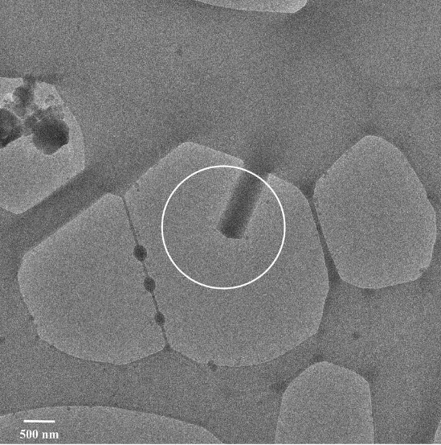
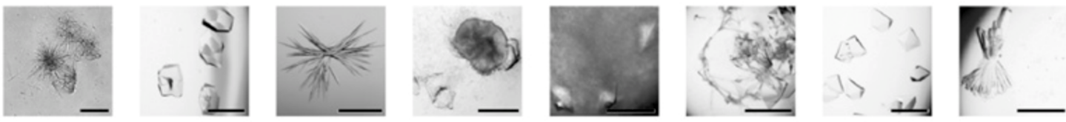
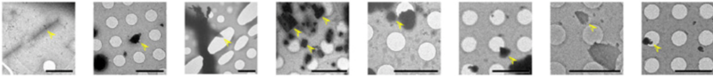
Gonen et al. 2010. JMB, 342(4):1337-1345
Clabbers et al. 2017. Acta D, 73(9):738-748
Radiation source | PDB (MX) | CSD (SX)
X-ray | >140,000 | >1,000,000
Neutron | 161 | 1,500
Electron | 111 | ~10
Tau peptide
Lysozyme
TGF-βm:TβRII
Xylanase
Thaumatin
Trypsin
Proteinase K
Thermolysin
Crystals
Fragments
Cruz et al. 2017. Nat. Methods, 14(4):399-402
Table courtesy of Tim Gruene

Slide 3

Electron diffraction from 3D protein crystals
The benefits of using electrons
Sample preparation
Microscope setup and practical considerations
Research: Focused ion beam milling of crystals

Slide 4
X-rays
Electrons
Elastic
1
Inelastic
19
Elastic
1
Inelastic
4
:
:
Adapted from Clabbers and Abrahams 2018. Crystallography Reviews, 24(3):176-204

Slide 5
Light microscope
CryoSEM at 2 keV
50 μm

Slide 6
Slide courtesy of T. Gruene

Slide 7
X-rays
Electrons
Electron density
Electrostatic scattering potential

Slide 8
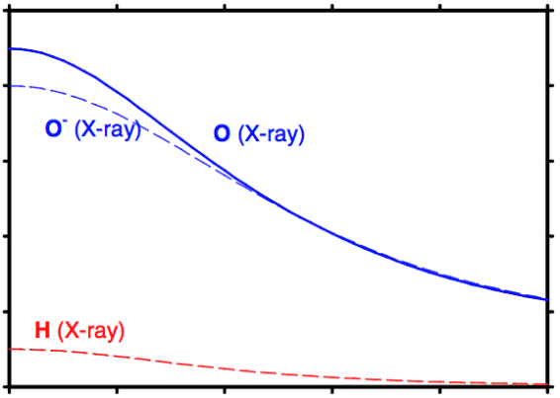
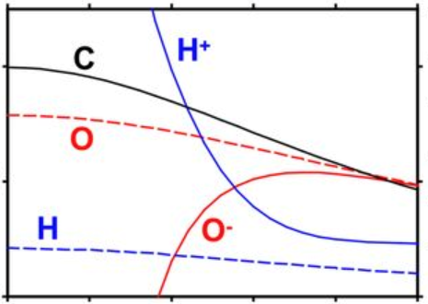
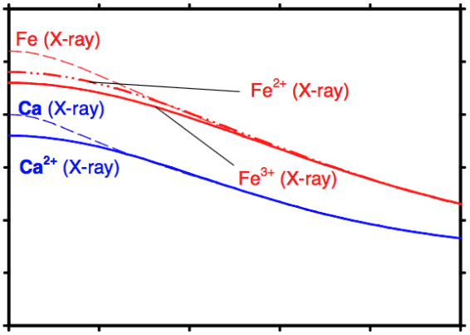
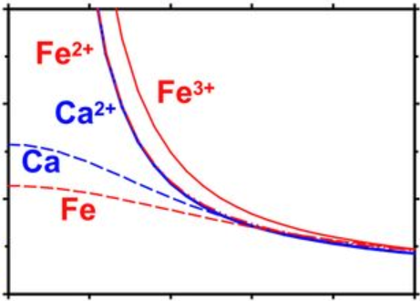
X-rays
Electrons
8.0
4.0
Atomic scattering factor (electrons)
Atomic scattering amplitude (Å)
4.0
2.0
0.0
0.0
0.0
0.1
0.2
0.3
0.4
0.5
0.0
0.1
0.2
0.3
0.4
0.5
30.0
30.0
20.0
20.0
Atomic scattering factor (electrons)
Atomic scattering amplitude (Å)
10.0
10.0
0.0
0.0
0.0
0.1
0.2
0.3
0.4
0.5
0.0
0.1
0.2
0.3
0.4
0.5
Resolution⁻¹ (Å⁻¹)
Resolution⁻¹ (Å⁻¹)
Yonekura et al. 2015. PNAS, 112(11):3368-3373

Slide 9

Heme binding site of bovine liver catalase
Refine using 8.0 -3.4 Å data
30.0
20.0
Atomic scattering amplitude (Å)
10.0
0.0
0.0
0.1
0.2
0.3
0.4
0.5
4.0 σ
3.9 σ
Yonekura et al. 2015. PNAS, 112(11):3368-3373

Slide 10
Electron diffraction from 3D protein crystals
The benefits of using electrons
Sample preparation
Microscope setup and practical considerations
Research: Focused ion beam milling of crystals

Slide 11
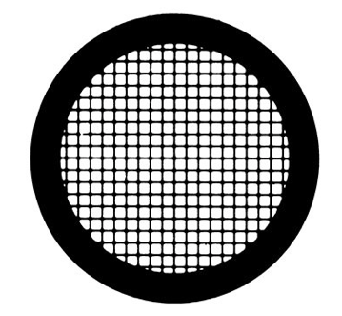
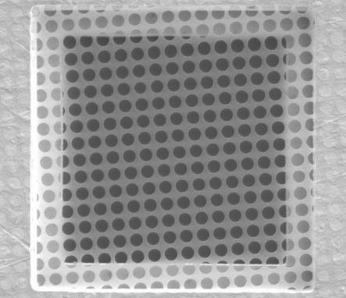
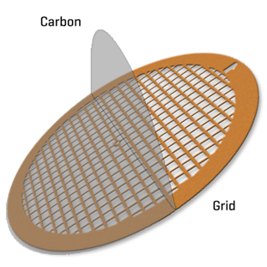
3 mm
Support film
Grid

Slide 12
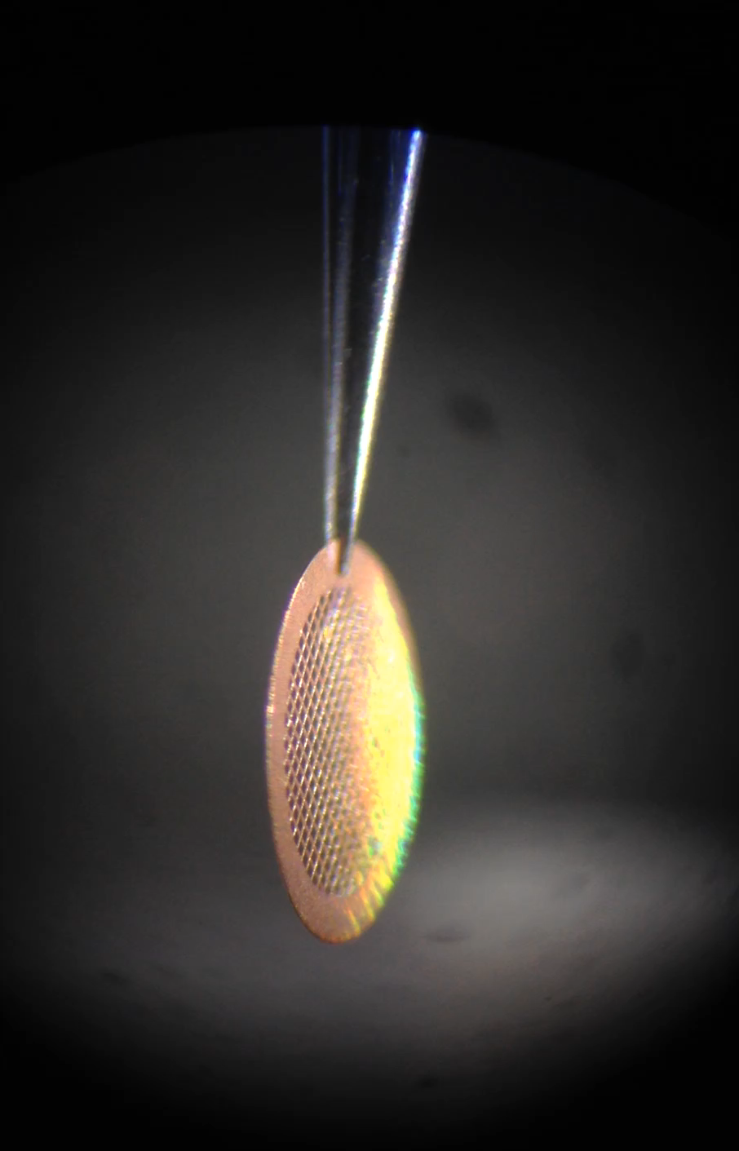

Slide 13
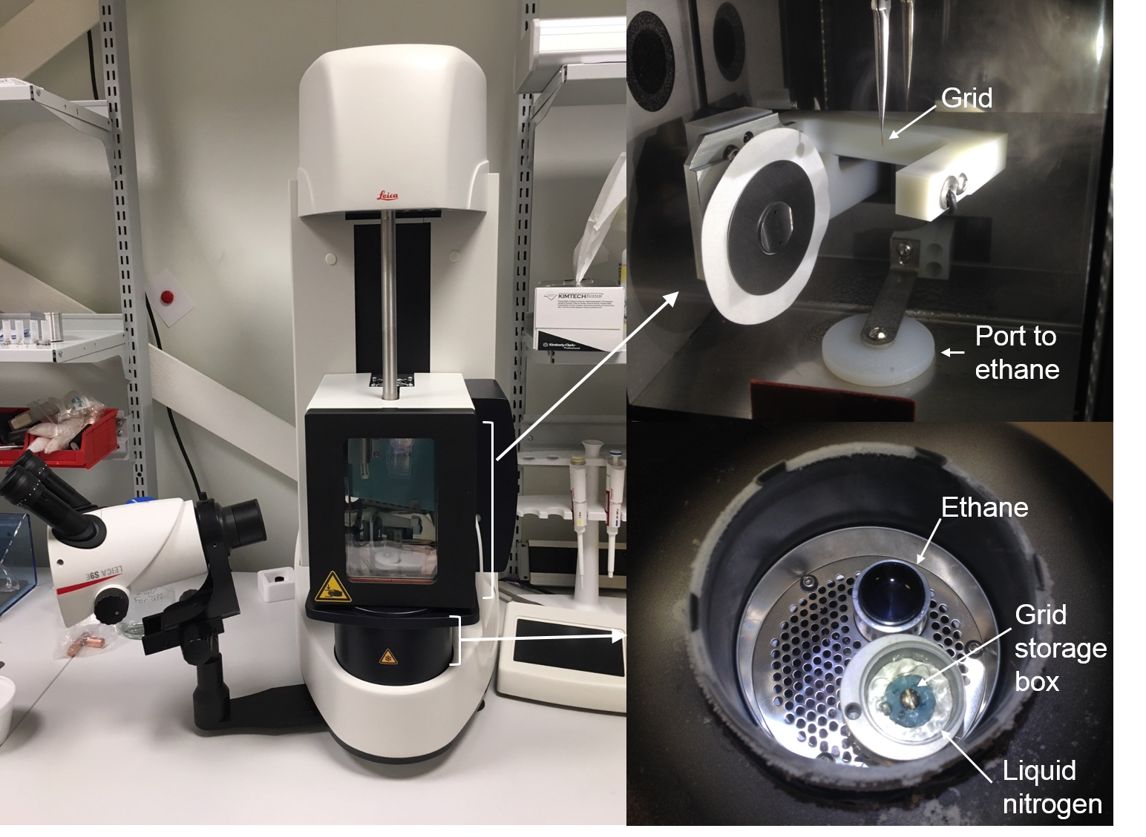

Slide 14
Proteinase K nanocrystals
20 μm
5 μm
50 nm

Slide 15
Electron diffraction from 3D protein crystals
The benefits of using electrons
Sample preparation
Microscope setup and practical considerations
Research: Focused ion beam milling of crystals

Slide 16
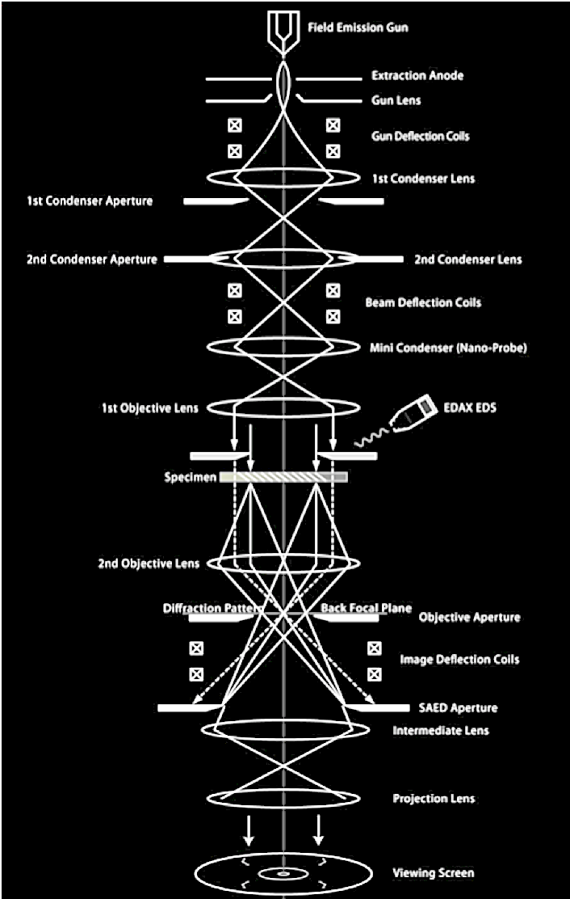
GUN
CONDENSER
OBJECTIVE
PROJECTOR
DETECTOR

Slide 17
Objective lens
Image plane

Slide 18
Objective lens
Back focal plane
Image plane

Slide 19
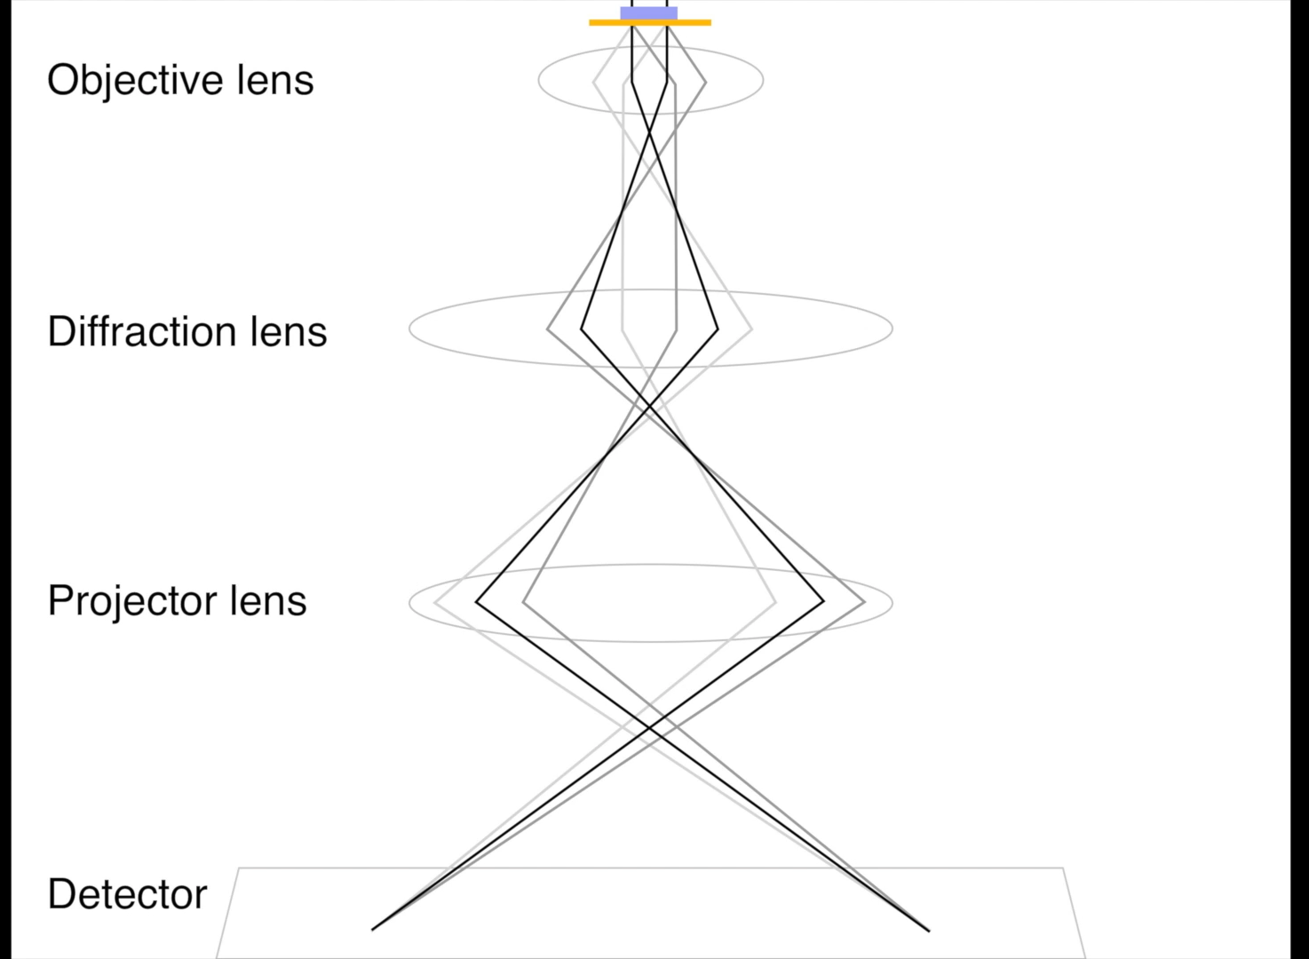

Slide 20
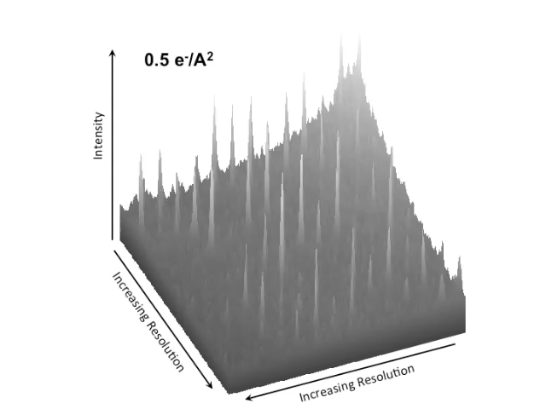
~ 30-40 degrees of data per crystal
CetaD detector, 1 s, 0.5°, 0.05 e/Å²/s
Nannenga et al. 2014. Nature Methods, 11(9):927-930

Slide 21
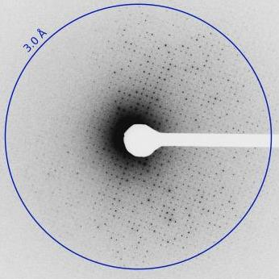
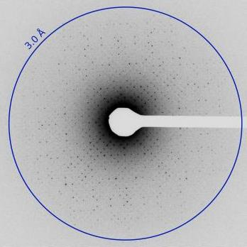
Nannenga et al. 2014. Nature Methods, 11(9):927-930

Slide 22
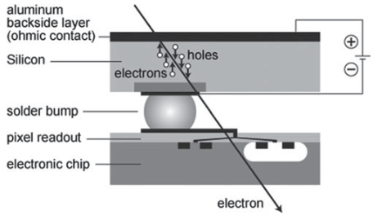
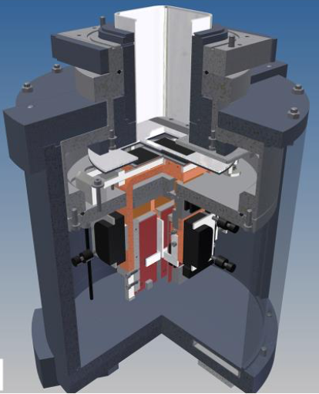
Hybrid pixel array detectors
High dynamic range
Fast frame rates
Radiation hard
Faruqi and McMullan 2011. Quarterly Reviews of Biophysics, 44(3):357-390
EIGER
  Tinti et al. 2018, IUCrJ, 5:190-199
Medipix
  Nederlof et al. 2013, Acta D, 69(7):1223-1230
Timepix
  Van Genderen et al. 2016, Acta A, 72:236-242
  Clabbers et al. 2017, Acta D, 73(9):738-748

Slide 23
Direct Electron Detectors
Monolithic active pixel sensor (MAPs)
Used for imaging – concerns over damage from direct beam or high intensity diffraction spots at low resolution
Falcon III – Hattne et al., 2019, 6(5):921-926
K2 (K3?) – Gonen lab, unpublished
CMOS detectors
Ceta, CetaD
Several examples
Comparatively poor sensitivity (low signal to noise)
Comparatively poor dynamic range
Usually present in cryoTEM, fewer concerns about damage!

Slide 24
X-rays
12 keV, λ = 1.0332 Å
Electrons
200 kV, λ = 0.025 Å
Nannenga and Gonen, 2014. Curr. Opin. Struct. Biol. 27:24-31

Slide 25
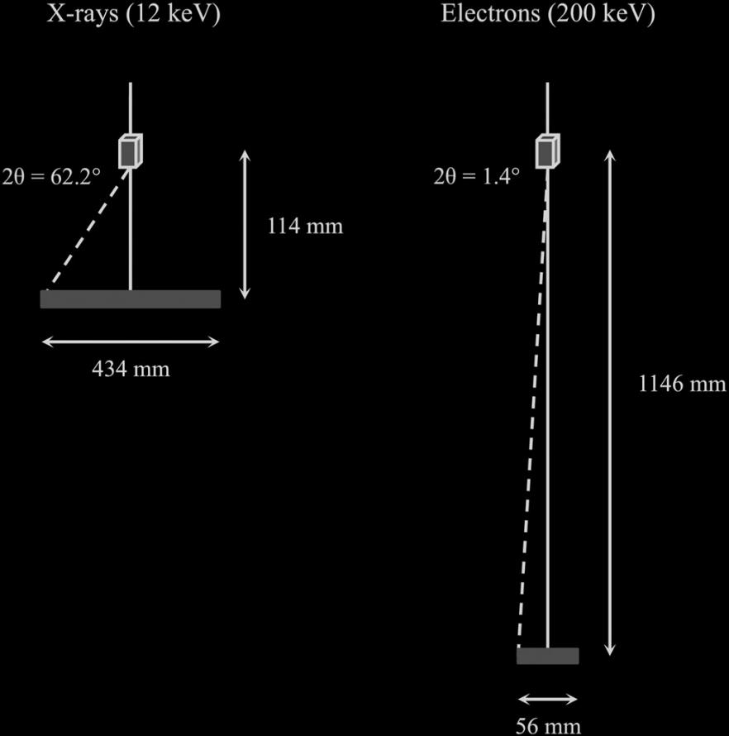
For a 1 Å reflection
X-rays
(12 keV)
Electrons
(200 keV)
Adapted from Clabbers and Abrahams 2018. Crystallography Reviews, 24(3):176-204

Slide 26
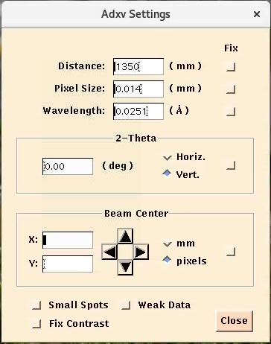
Camera length (detector distance)
Detector distance set through electron optics
Detector not physically moved
Camera lengths for proteins: 1000 mm – 2500 mm
2.34 Å
850 mm
1350 mm
2200 mm
Courtesy T. Gruene

Slide 27
Incident beam
Crystal lattice
Kinematically scattered
Dynamically
scattered

Slide 28
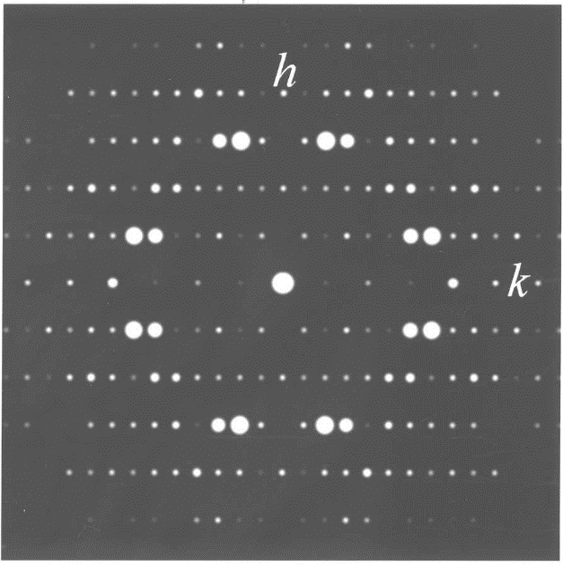
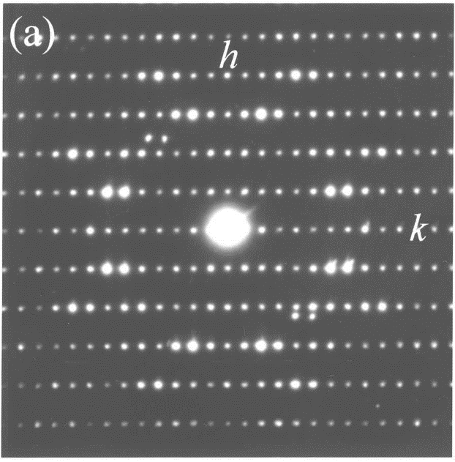
Simulated diffraction pattern based on X-ray structure
Electron diffraction pattern
Weirich et al., 2000. Acta A, 56(1):29-35

Slide 29
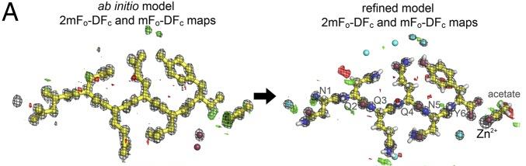
Structure solution and refinement
Currently, all protein macromolecules phased by molecular replacement
Several peptides phased ab initio (>1.2Å resolution)
Refinement using electron scattering factors

Slide 30
Electron diffraction from 3D protein crystals
The benefits of using electrons
Sample preparation
Microscope setup and practical considerations
Research: Focused ion beam milling of crystals

Slide 31
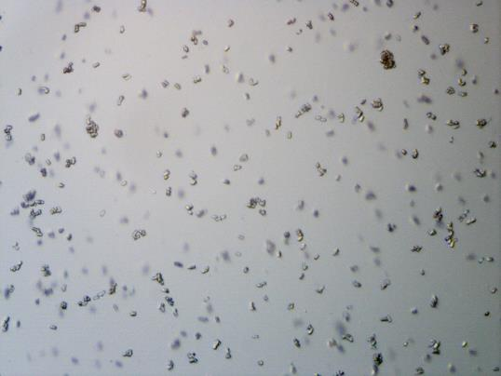
100 μm
100 µm
Too thick for electron diffraction?
Too small for current microfocus beamlines?
Too few for XFEL?
Want to determine electrostatic scattering potential?

Slide 33
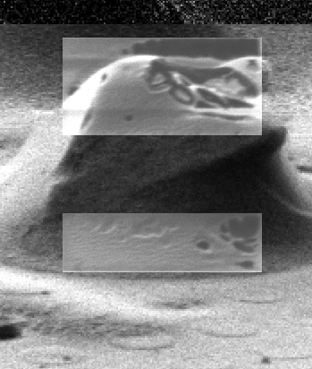
Area to be milled
Lamella
3 μm lamella
Area to be milled

Slide 34
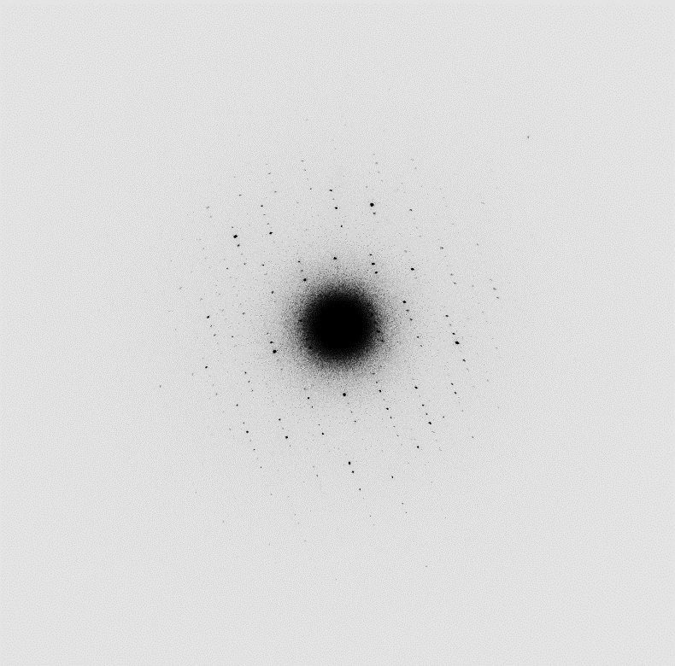
Proteinase K lamella, ~ 200 nm thick
0.04 e⁻/Å²/s, total dose ~5.5 e⁻/Å²
Continuous rotation
CetaD
2.0 Å
10 µm

Slide 35
Structure solution | Proteinase K Lamella (1 crystal, 2 datasets)
Translation-function Z-score | 59.3
LLG score | 6312.479
Refinement
Resolution range (Å) | 56.98 - 2.01
R (%) | 19.40
R_{free} (%) | 22.68
RMSD bonds | 0.002
RMSD angles | 0.500
⟨B⟩ (Å²) | 16.44
Ramachandran plot
Favoured (%) | 97.11
Allowed (%) | 99.64
Outliers (%) | 0.36

Slide 36
Acknowledgements
Diamond Light Source Ltd.
David Stuart
Gwyndaf Evans
José Trincão
John Beale
DIALS
David Waterman
James Parkhurst
STRUBI, University of Oxford
Helen Ginn
Helen Duyvesteyn
eBIC
Peijun Zhang
Corey Hecksel
Jason van Rooyen
James Gilchrist
Yun Song
Stanford University
Wah Chiu
ThermoFisher Scientific
Felix de Haas
Bart Buijsse
Abhay Kotecha

