Slide 1
Protein Data Bank in Europe Depositing your data to the PDB
John Berrisford
Notes:
Add web address

Slide 2
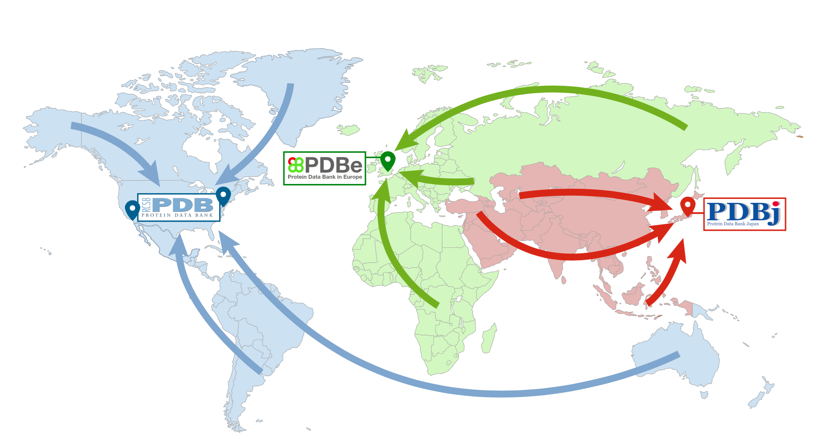
Who are the PDB?
‘The PDB’
FTP Archive
wwPDB.org

Slide 3
Value added data
Value added data
Value added data
Value added data
‘The PDB’
FTP Archive
wwPDB.org

Slide 4
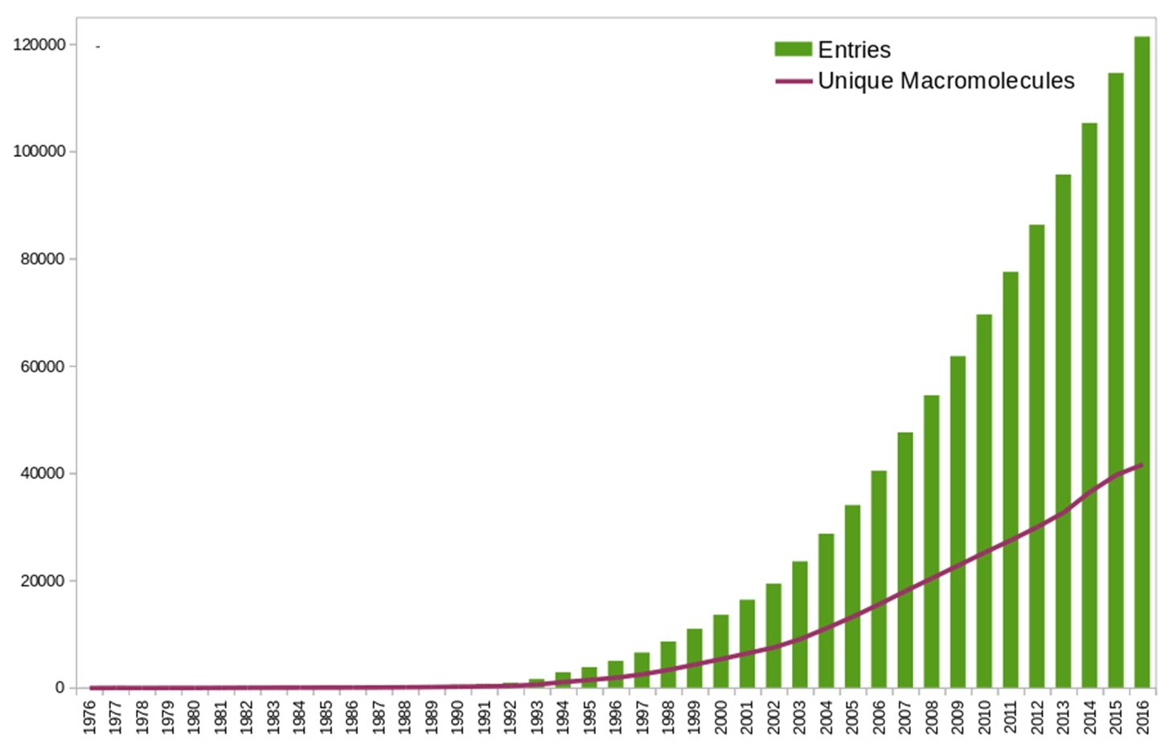
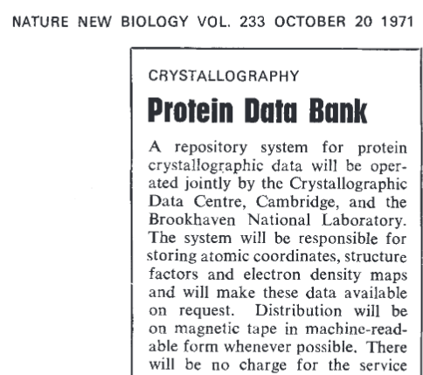
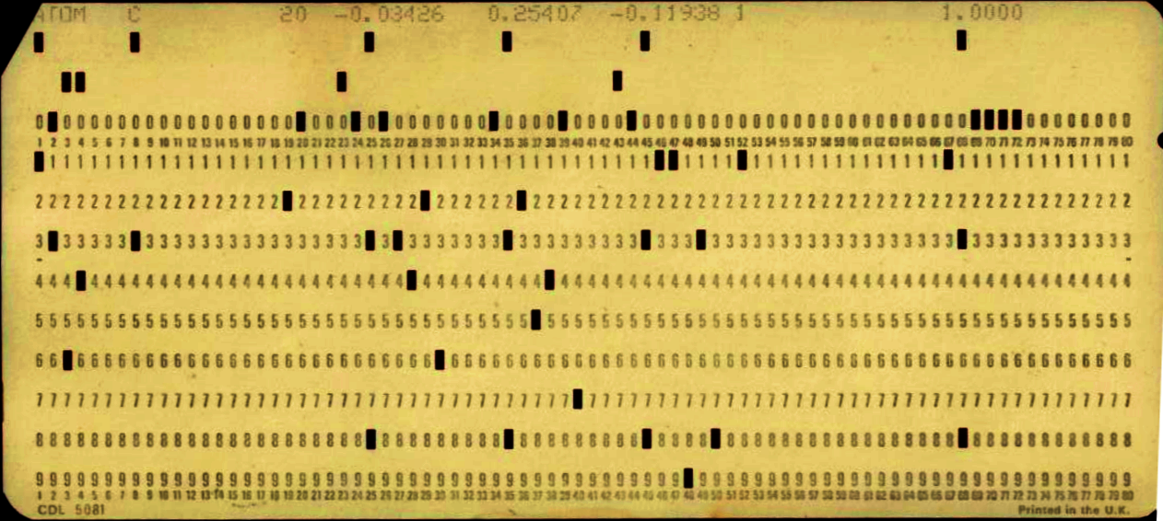
Oldest freely available biological database
7 Structures
PDBe.org

Slide 5
Why deposit to the PDB?
To make your data publicly available
Required by journals
Required by your funding

Slide 6
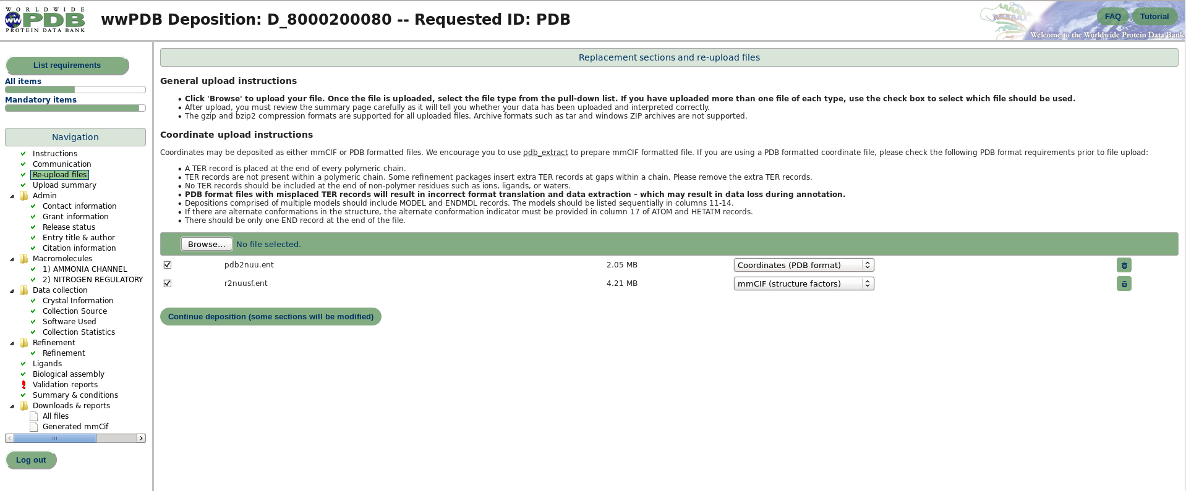
OneDep deposition system
deposit.wwpdb.org

Slide 7
What does deposition involve?
File validation
wwPDB validation
Form filling
Annotation – including more validation

Slide 8
File validation
Model file in mmCIF or PDB format
data harvesting (refinement stats) is better in mmCIF format
Refmac and phenix can output mmCIF format
http://www.wwpdb.org/deposition/PDBxDeposit
Data is checked for:
Valid file
Can we read it!
NMR models are consistent
Residual B factors
“unusual” occupancies
Negative
Over 1
http://www.wwpdb.org/deposition/PDBxDeposit

Slide 9
wwPDB validation
Ligands checked by graph match to wwPDB Chemical Component Dictionary
pdbe.org/chem
Pre-submission wwPDB validation report
Geometry issues
Polymer
Ligand
Chirality issues
Fit of model to data

Slide 10
wwPDB validation
wwPDB validation pipeline 1.0
MolProbity
Xtriage
EDS
Mogul
Percentiles
PDF maker
Geometry
Data quality
Fit to data
Ligand geometry
Comparison to other PDB entries

Slide 11
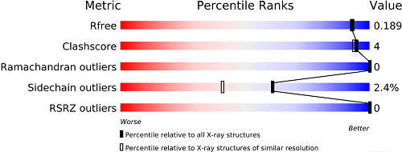
wwPDB validation
How well does the model back-predict the data?
Atoms bumping into each other
Surprising bond angles
Atoms not in electron density

Slide 12
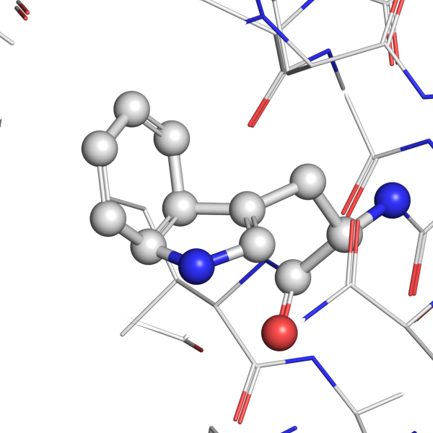
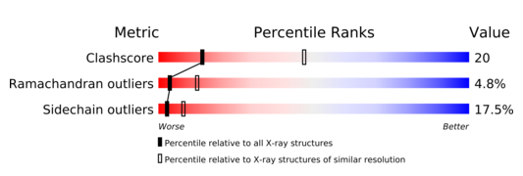
Interesting geometry 7GPB 2.9Å

Slide 13
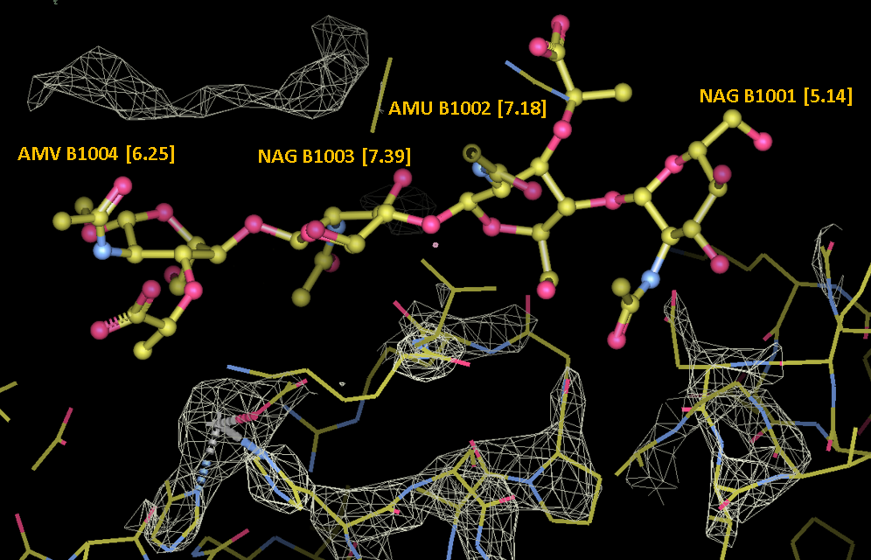
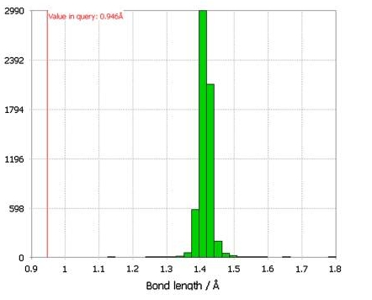
Validation for small molecules
Geometry Fit to density
RSR: Measure of how well a residue fits its local density (Jones et al., 1991)
Using Mogul
PDBe.org

Slide 14
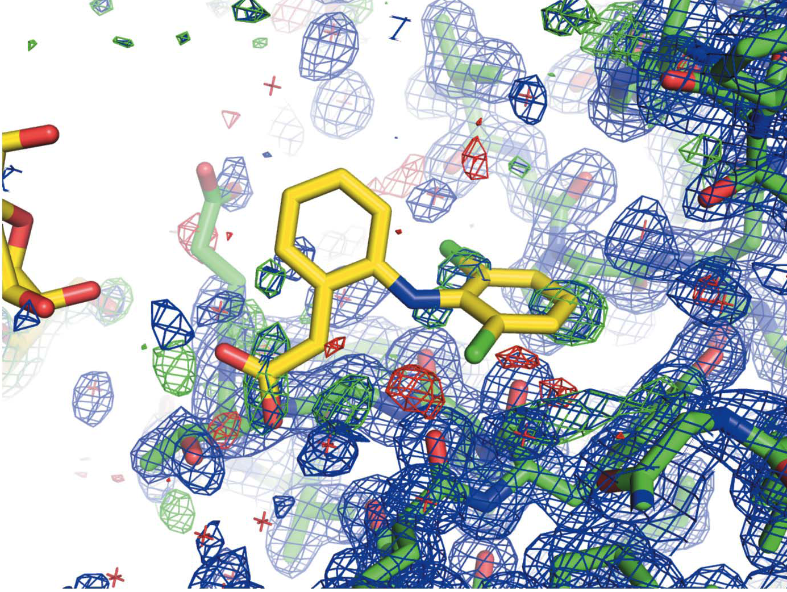
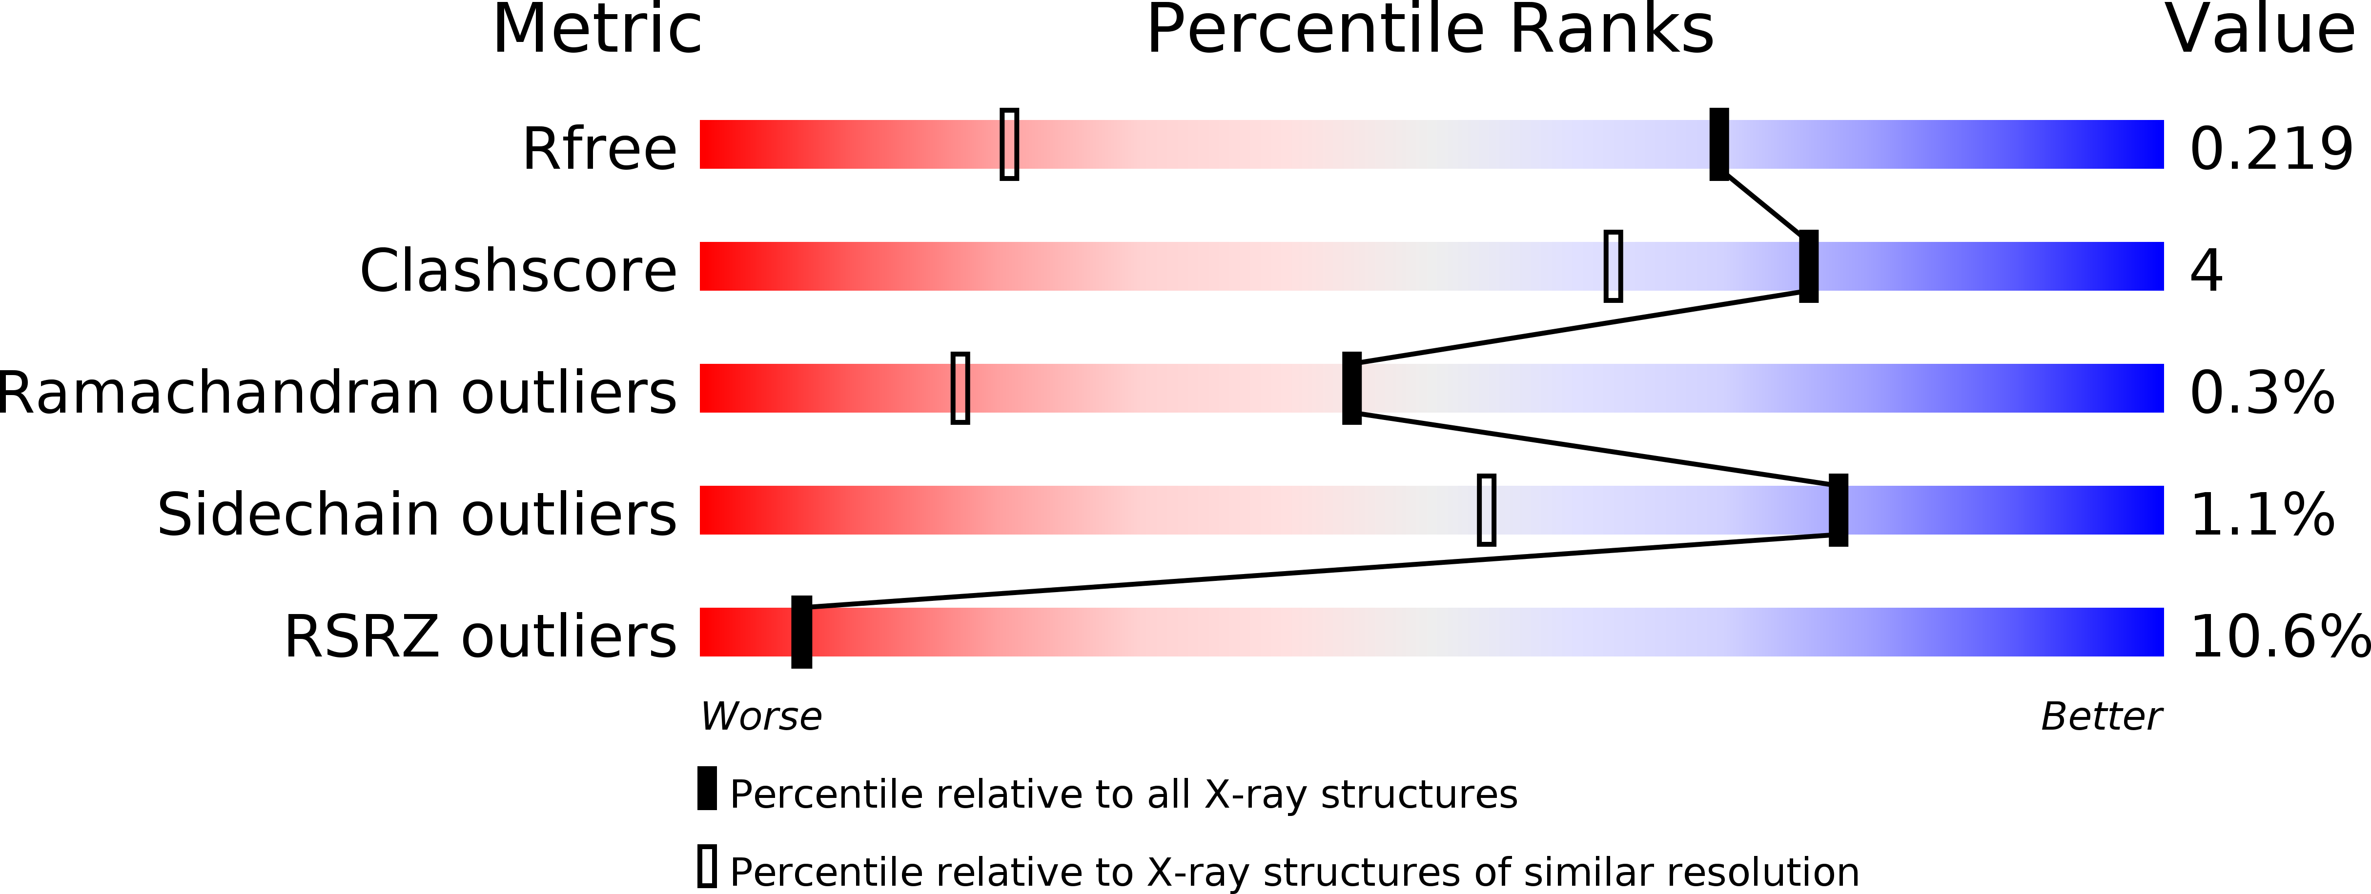
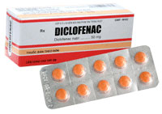
Poor density for ligand
PDB: 3IB0 (1.4Å)
DIF A701
Ligand diclofenac not supported by electron density
https://www.ebi.ac.uk/pdbe/entry/pdb/3ib0/bound/DIF
Acta Cryst. D69, 150-167 (2013)

Slide 15
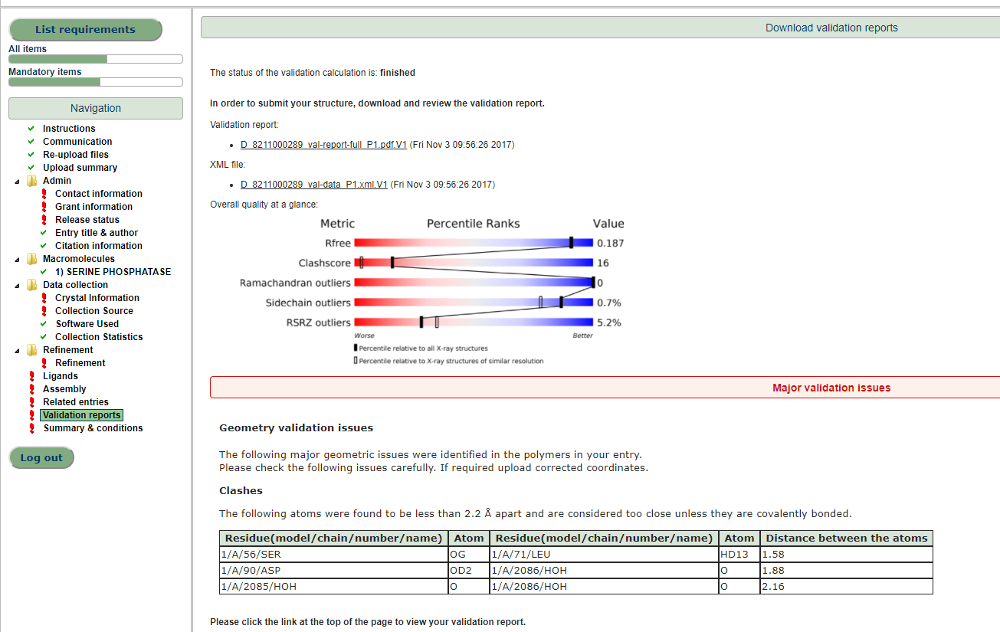
OneDep - highlighting outliers – current practice
Geometry
Clashes
Bond lengths
Bond angles
Bonds between amino acids / nucleotides

Slide 16
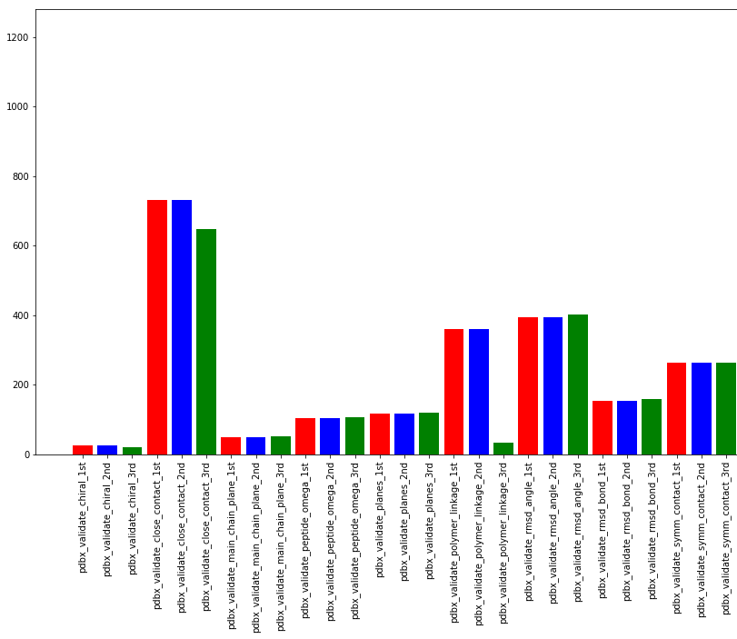
How good are depositions?
77% of depositors only upload one coordinate file and press submit
red - First upload
green - Final annotated
Close contacts
Bond angles
Polymer linkage

Slide 17
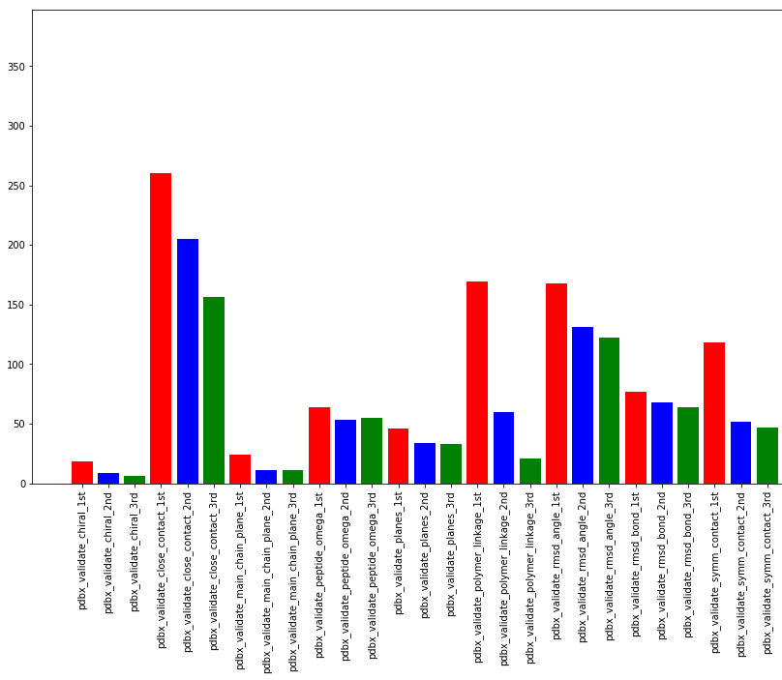
How good are depositions?
23% of depositors upload multiple times before pressing submit
red - First upload
blue - First deposited
green - Final annotated
Close contacts
Polymer linkage
Bond angles
Symmetry close contacts

Slide 18
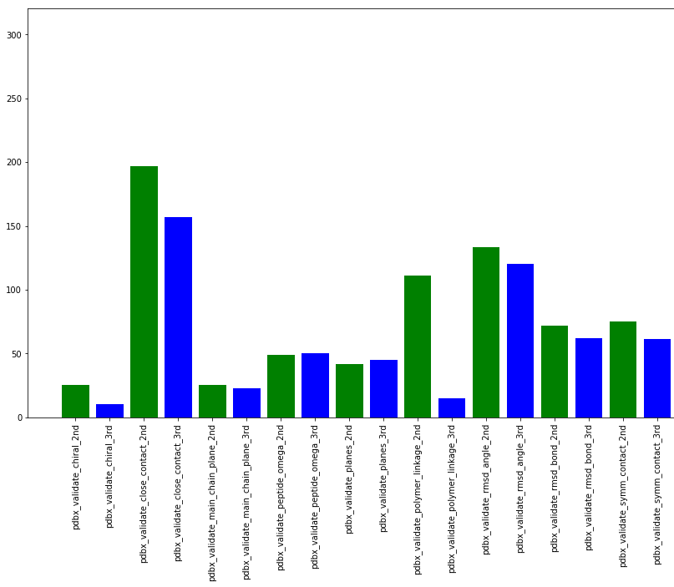
How good are depositions
Around 25% of entries have replacements after annotation
What issues do depositors fix?
green - First submission
blue - Final annotation
Close contacts
Polymer linkage
Bond angles
Symmetry close contacts
chirality

Slide 19
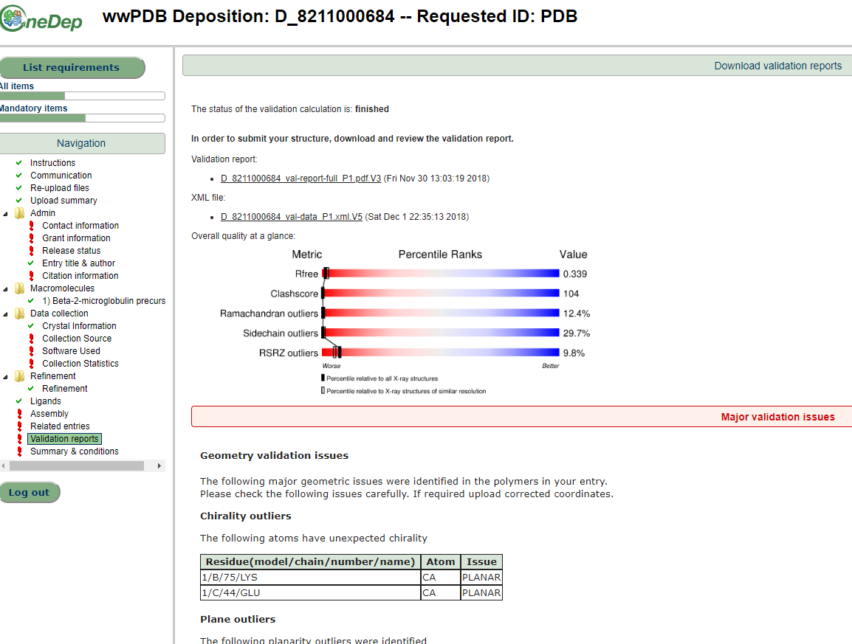
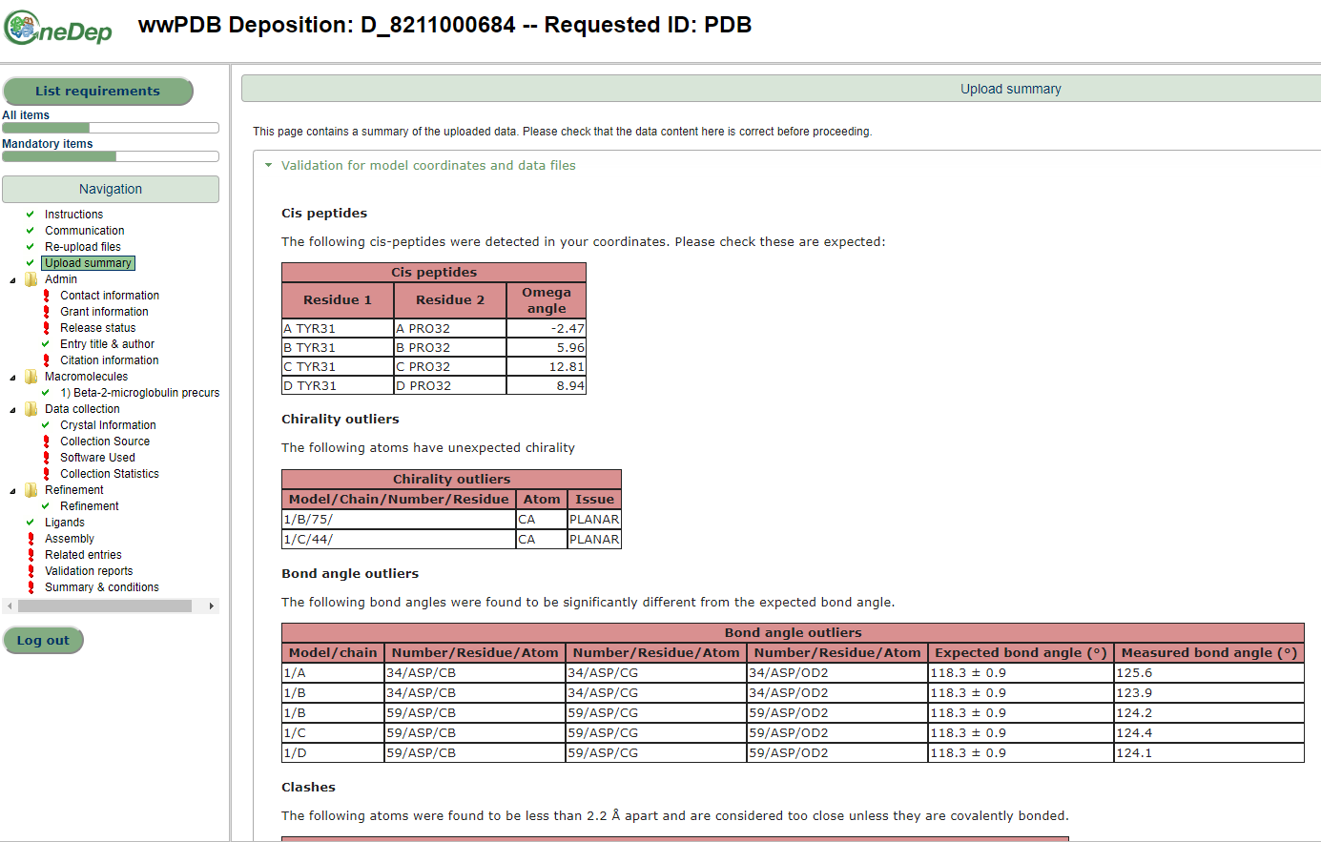
OneDep – highlighting issues earlier in deposition
Decrease the number of pages viewed before seeing outliers
Current vs proposed

Slide 20
OneDep – highlighting issues earlier in deposition

Slide 21
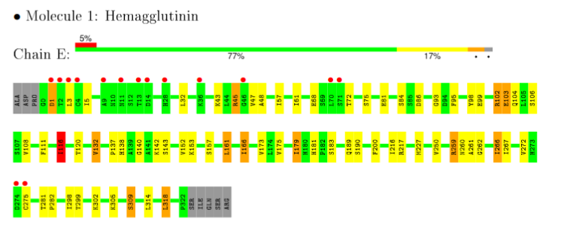
Why give you all this validation upfront?
PDF available on wwPDB websites
XML available
Viewers use this to display validation
COOT
LiteMOL @PDBe
PyMOL (PDBe plugin)
PDBe.org

Slide 22
What do we need?
Mandatory items in deposition
Red in the deposition interface
Admin information
Who are you?
When do you want your entry released?
Sequence information for each macromolecule
Better to add this to your file in advance
Data collection statistics
Where did you collect your data?
Refinement statistics
Normally parsed directly from your uploaded file
Ligand identity
If you submit mmCIF we get your refinement dictionaries automatically

Slide 23
Form filling
Controlled vocabularies
Beamlines
Detectors
Software
Sanity checks / Cross validation
Wavelength of greater than 2.0 is unusual
Resolution of data collected is higher than you refined!
Detector type is linked to detector

Slide 24
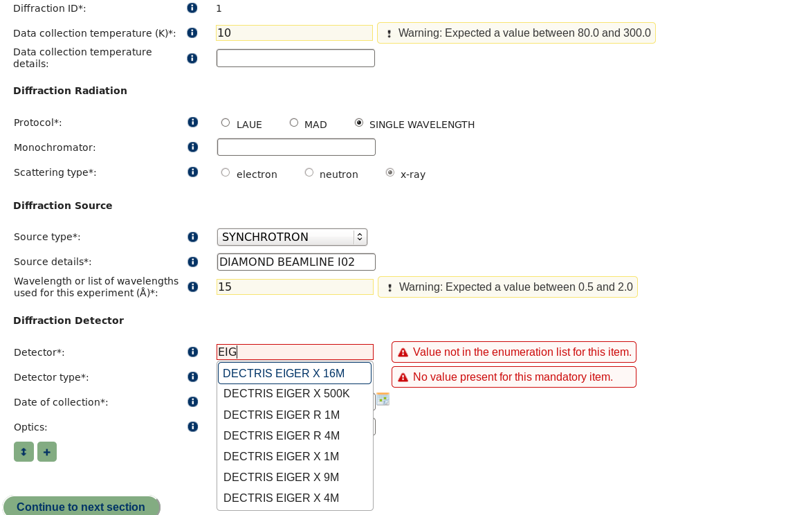
Sanity Check
Controlled vocabulary

Slide 25
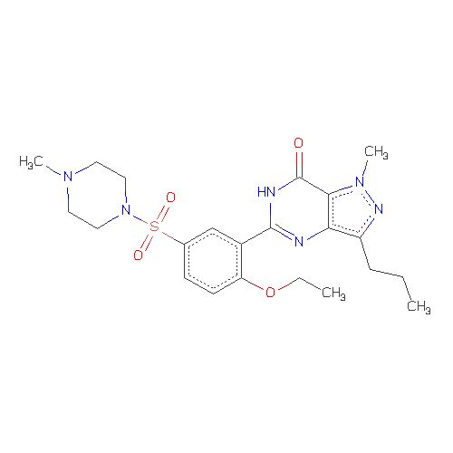
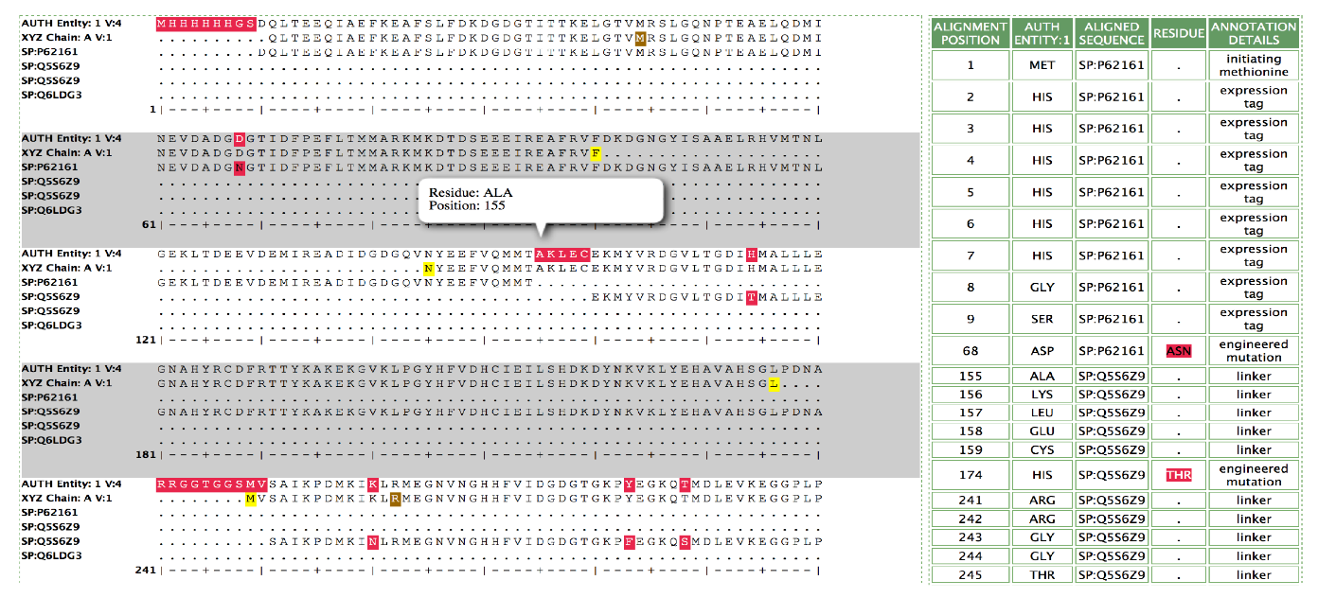
Biocuration (annotation)
Ligand matching to dictionary
All identical chemicals have the same code
Taxonomy
Sequence matching to UniProt
Highlight mutations, conflicts, tags etc
Assemblies
Standardising of representations – helping make PDB searchable
Sanity - is that really purified from human hearts?
4.5 FTEs for all of Europe and Africa- >4000 structures a year

Slide 26
Can you try it out?
YES
pdbe.org/deposition
gives a link to a validation server which can be used prior to deposition
https://validate.wwpdb.org/
validate.wwpdb.org

Slide 27
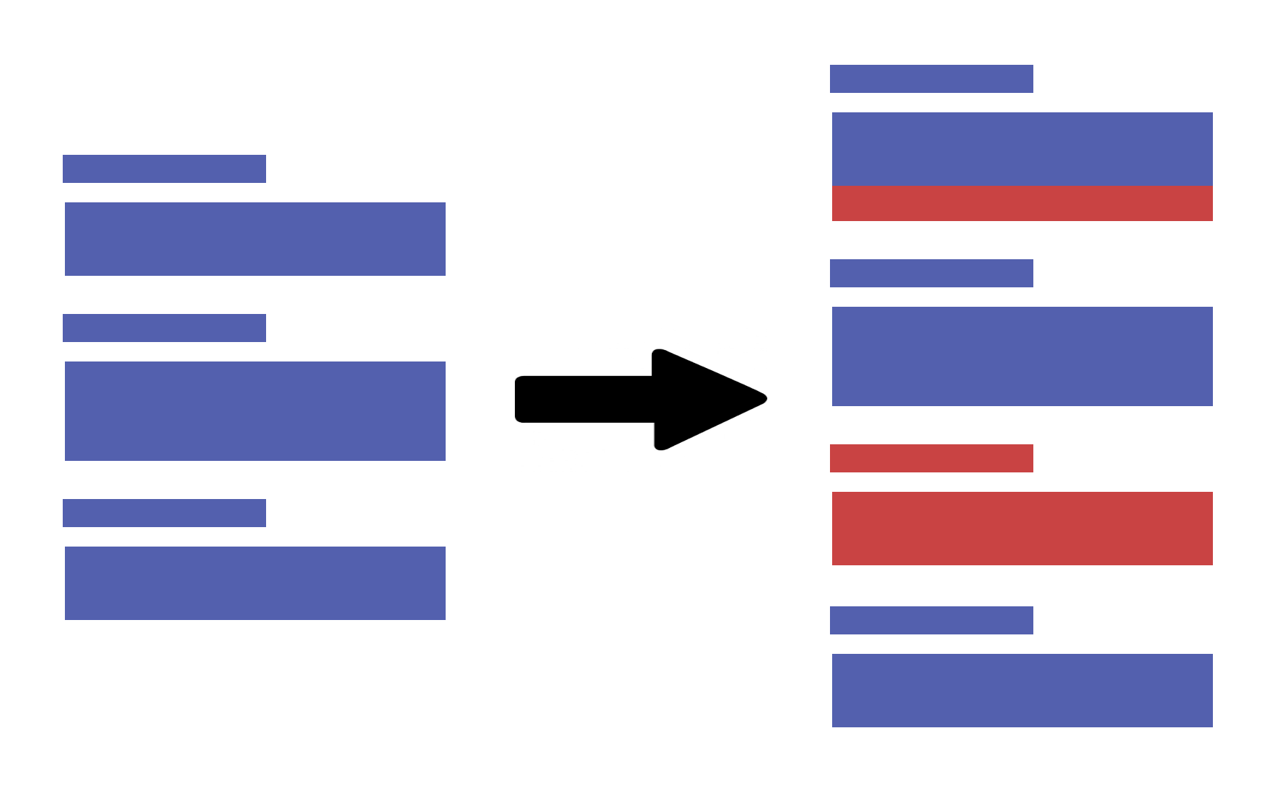
New wwPDB developments
PDBx/mmCIF V5
More metadata for EM derived models
all EM categories except em_map
Better audit information
Some data standardisation
work still on-going to clean up data
V4
V5
wwPDB.org

Slide 28
Coming soon
Versioning
Update released entries
And retain the ID code
Details yet to be finalised
1xyz
1xyz_2 ?

Slide 29
Getting data out of the PDB
pdbhelp@ebi.ac.uk
proteindatabank
@PDBeurope
Notes:
Thanks to Martin Beck for standing in at the last minute for Yannik.

Slide 30
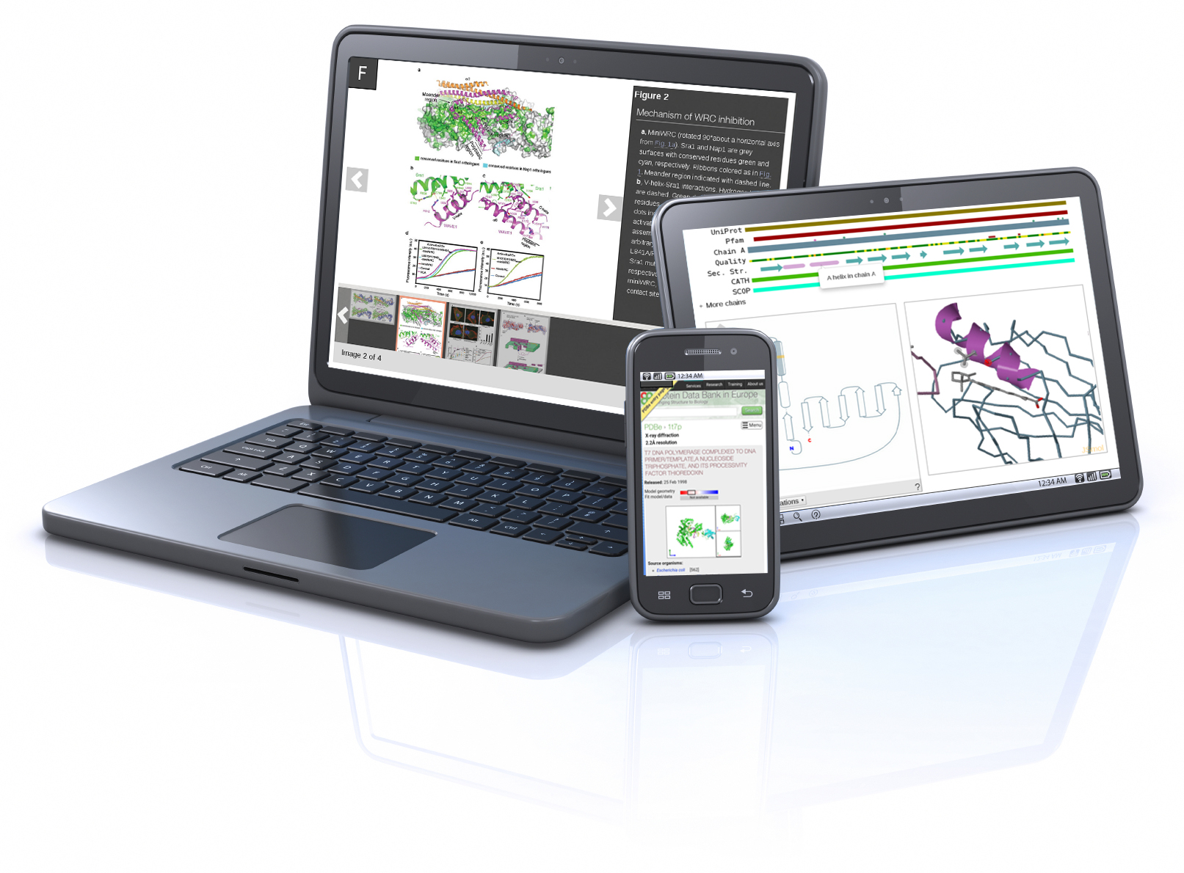
Searching the PDB made simple
At PDBe we’ve implemented:
Auto-complete search suggestions
Facets to narrow down search results
Quality presented on search results
Four views of results
Moving away from entry-centricity
pdbe.org

Slide 31
Challenges – from archive to resource PDB is a historic archive
“Archive” – i.e., what was described in the literature
We have to accept and distribute everything
Provider-centric
Organised by entry not molecule/complex/function
Integrate with other biological & chemical data
Integrate structural data on scales from atoms to cells
Deliver appropriate structure data to non-experts (in context of their work)

Slide 32
MetaData is vital
Sequence databases
Taxonomy
Publication
Function
“Coordinates by themselves just specify shape and are not necessarily of intrinsic biological value, unless they can be related to other information.”
Gerstein, (2000)
Nature Structural Biology 7 960 - 963

Slide 33
Turning an archive into a resource
Easily searchable
Cleaned up data
Standard vocabularies
Value-added information
Quality assessment
Standard comparisons
Flag irregularities

Slide 34
Lots of data clean-up locally
Historical data in the PDB are noisy
How many ways can you spell ‘engineered’?
Moolecular Replacment?
Ribosomal RNA names
Lots more

Slide 35
Improving the Resource The problem with the PDB is…
I can’t find what I want
Too many false hits when I search
CaM, CaM-Kinase, CaM binding protein, Cam-like…
Results are too complicated
Which lysozyme to use? 1600 structures from 50 species!
Which is best?/what is best?
Redundancy
How many unique human protein structures?

Slide 36
What is needed to answer such queries?
DATA
Improved data quality
Cleaned up data
Standard vocabularies
Value-added information
Intuitive ways to present 3D structure information
1D-3D mapping
Images, images, images!

Slide 37
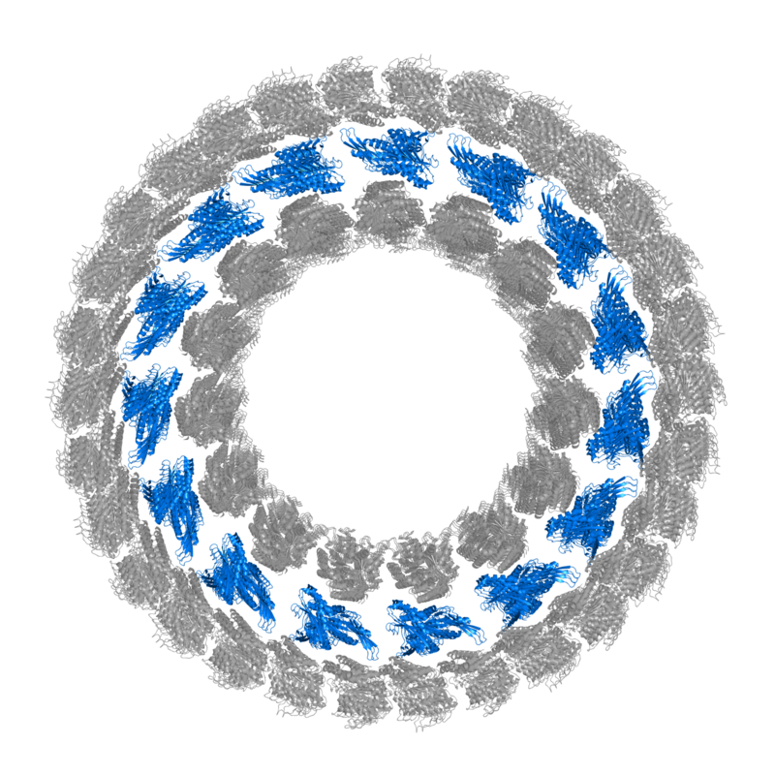
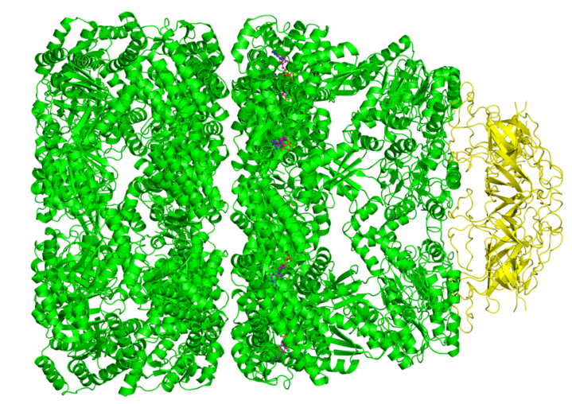
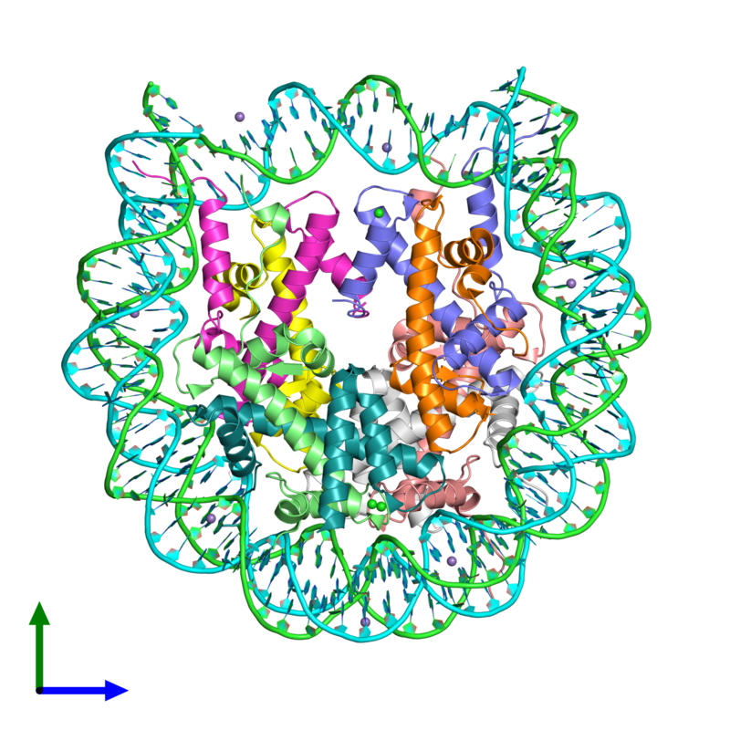
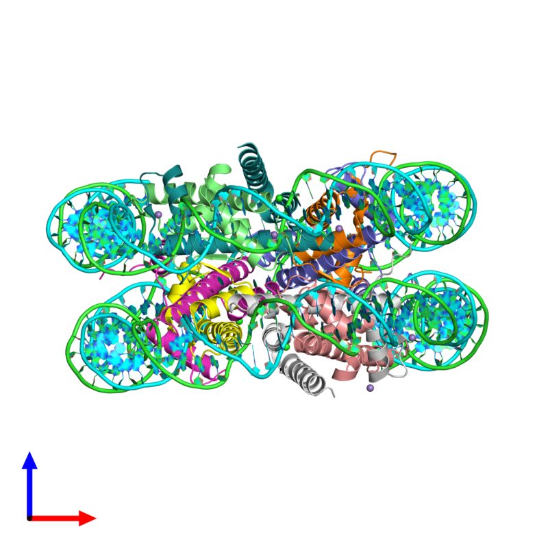
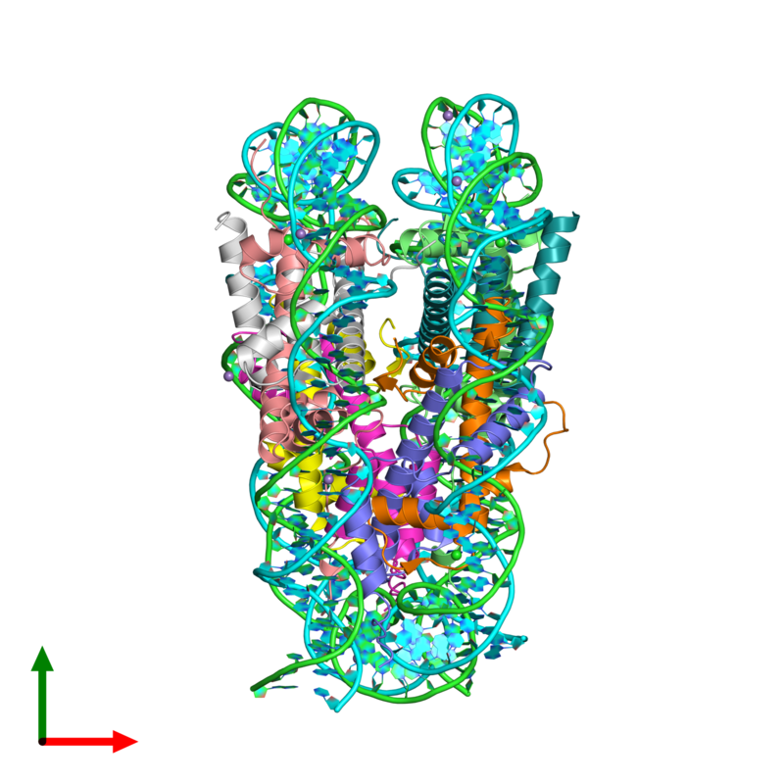
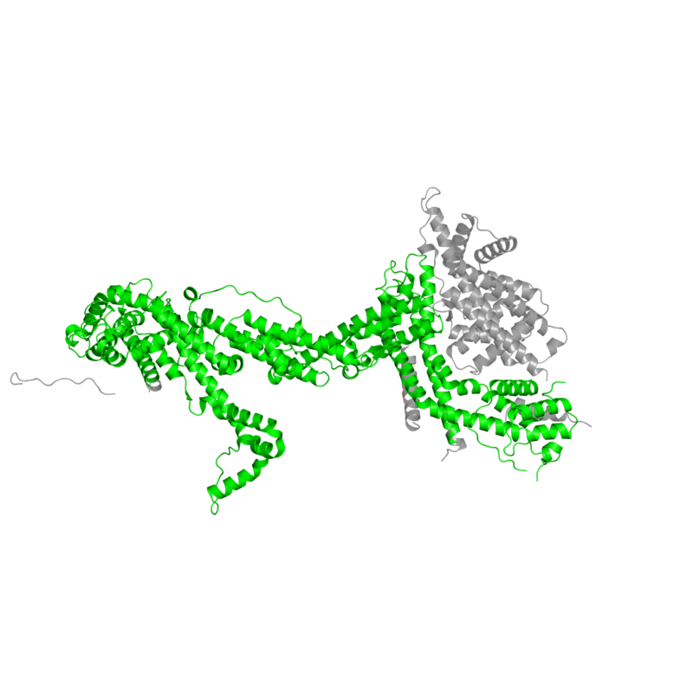
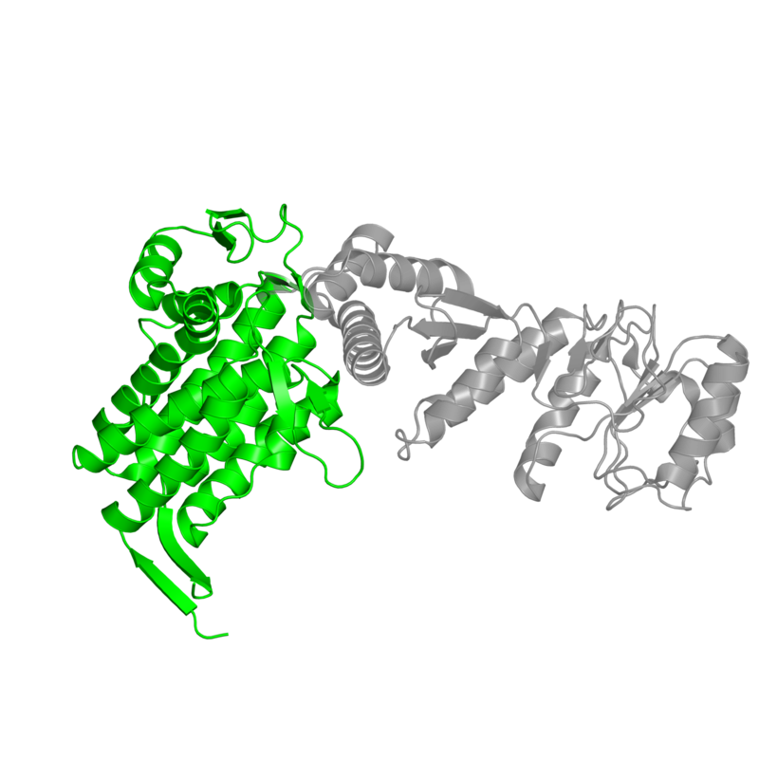
Using images to convey information
Where is “my protein” in this assembly?
How many unique macromolecules are there in this complex?
What is the overall shape of the complex?
Where is this sequence or structure domain in the 3D structure?

Slide 38
Searching the PDB made simple
At PDBe we’ve implemented:
Auto-complete suggestions
Facets to narrow down search results
Quality presented on search results
Four views of results
Moving away from entry-centricity
pdbe.org

Slide 39
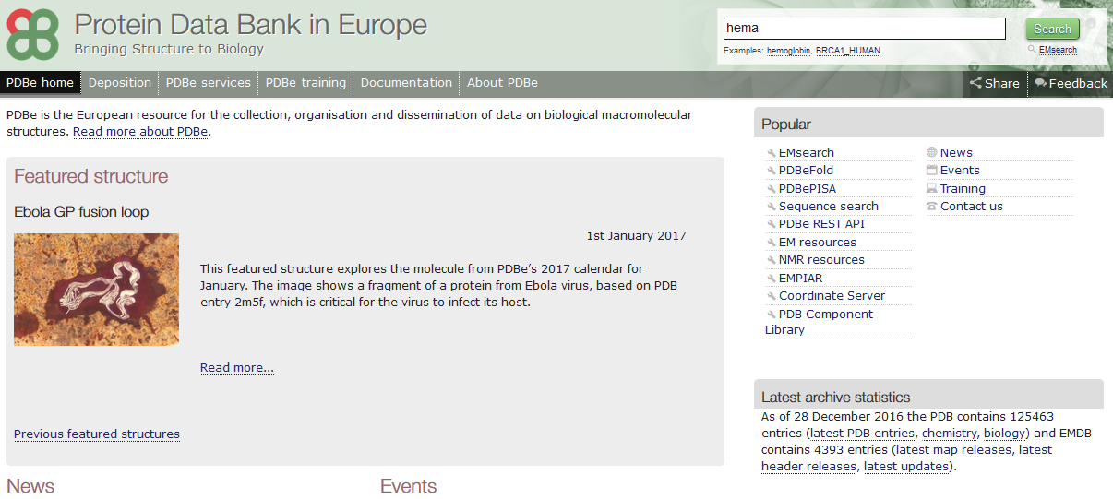
pdbe.org

Slide 40
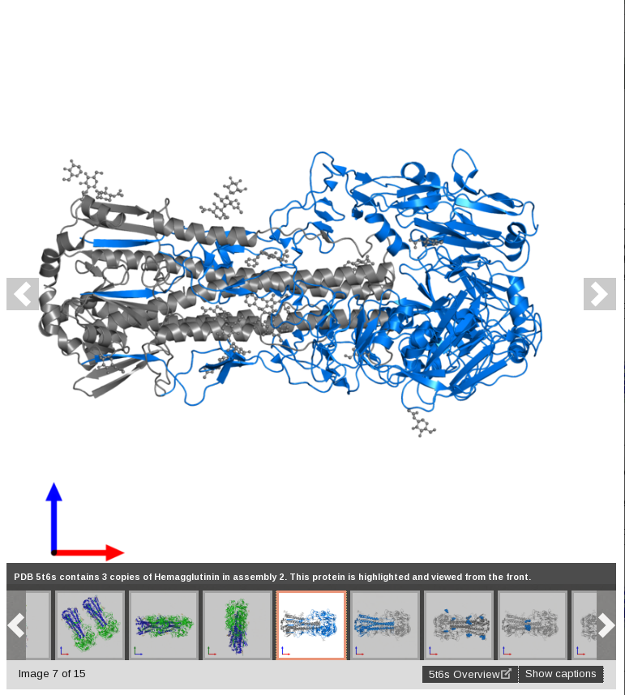
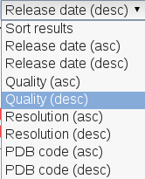
Quality
Gallery
(image shown is assembly)

Slide 41
pdbe.org/2az9

Slide 42
Also shows maps for EM entries
pdbe.org/5gaq

Slide 43
Improvements for viewing entries

Slide 44
Linking sequence, topology and structure

Slide 45
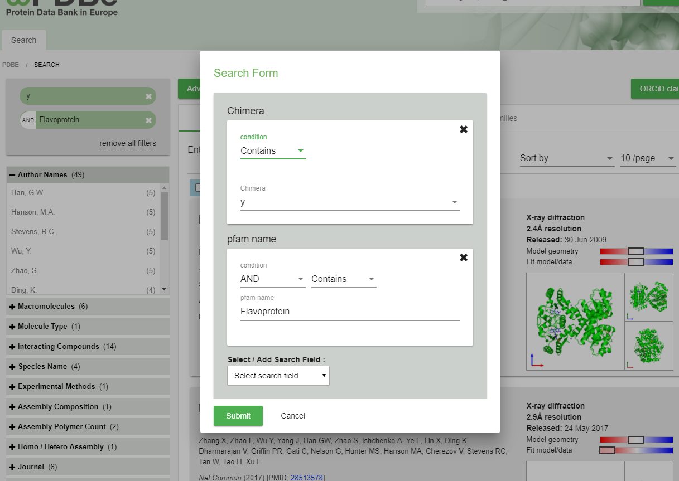
New features – Advanced search
Advanced search
https://www.ebi.ac.uk/pdbe/widgets/advance-search-test/search

Slide 46
New features – protein pages
We are developing pages for each protein in the PDB
Interacting ligands
Interacting macromolecules
Literature per protein
https://wwwdev.ebi.ac.uk/pdbe/pdbe-kb/proteins/P00698
Try with any UniProt

Slide 47
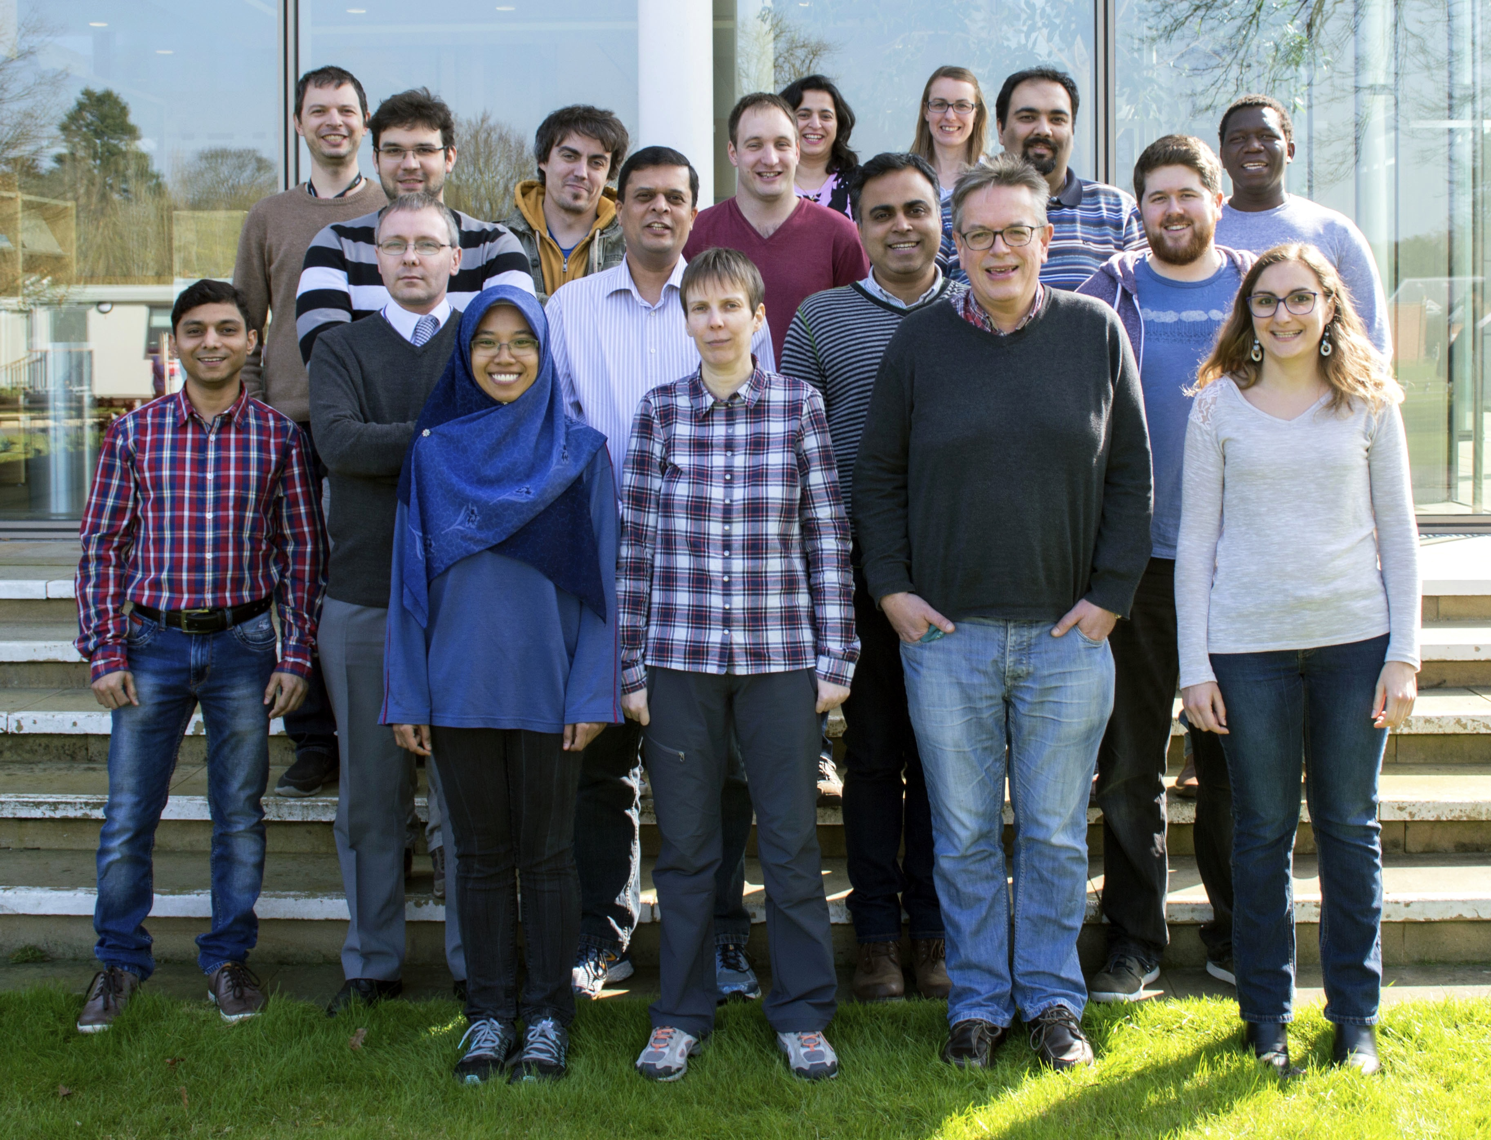
Use PDBe because it’s useful
If it isn’t, tell us how to improve
pdbe.org

Slide 48
PDBe.org
Thanks!
You, for providing the data!
pdbhelp@ebi.ac.uk
proteindatabank
@PDBeurope

