Slide 1
Pierre Aller
ISPyB for MX
at Diamond

Slide 2
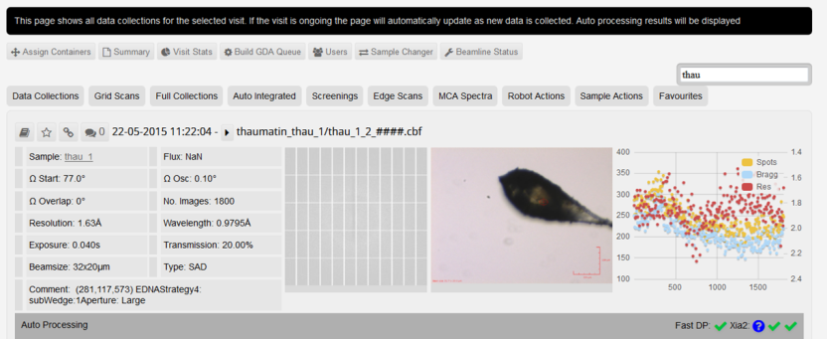
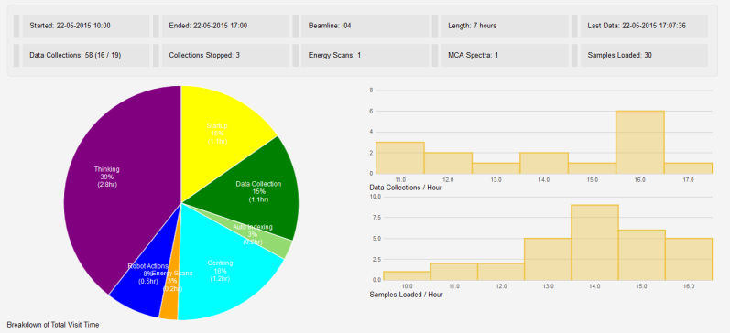
When to use ISPyB?
Before beamtime Shipping preparation Sample registration
During beamtime Beamline status/remote access Puck allocation MX – pipeline (Dave)
After beamtime Shipping Lab book – experiment Data backup

Slide 3
When to use ISPyB?
Before beamtime Shipping preparation Sample registration
During beamtime Beamline status/remote access Puck allocation MX – pipeline (Dave)
After beamtime Shipping Lab book – experiment Data backup

Slide 4
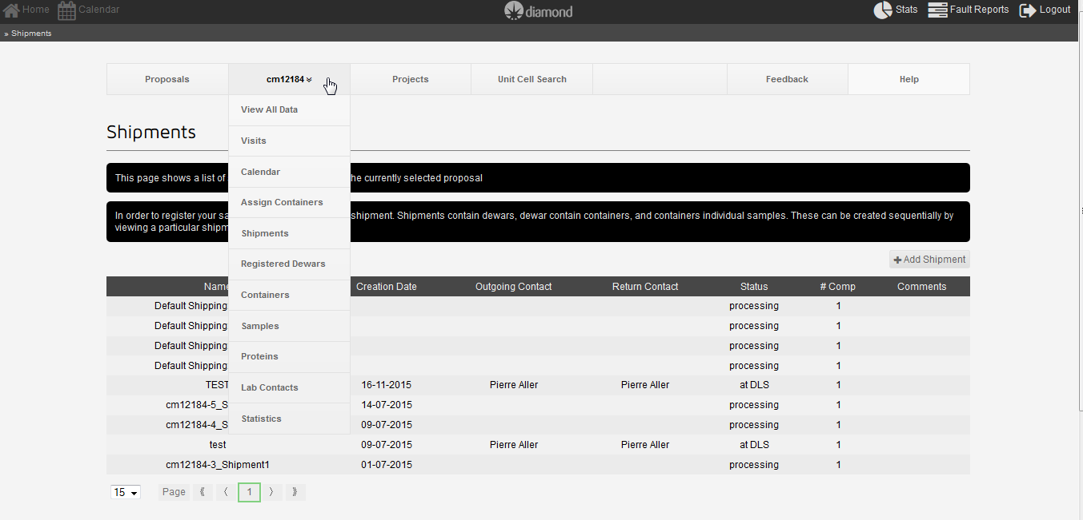
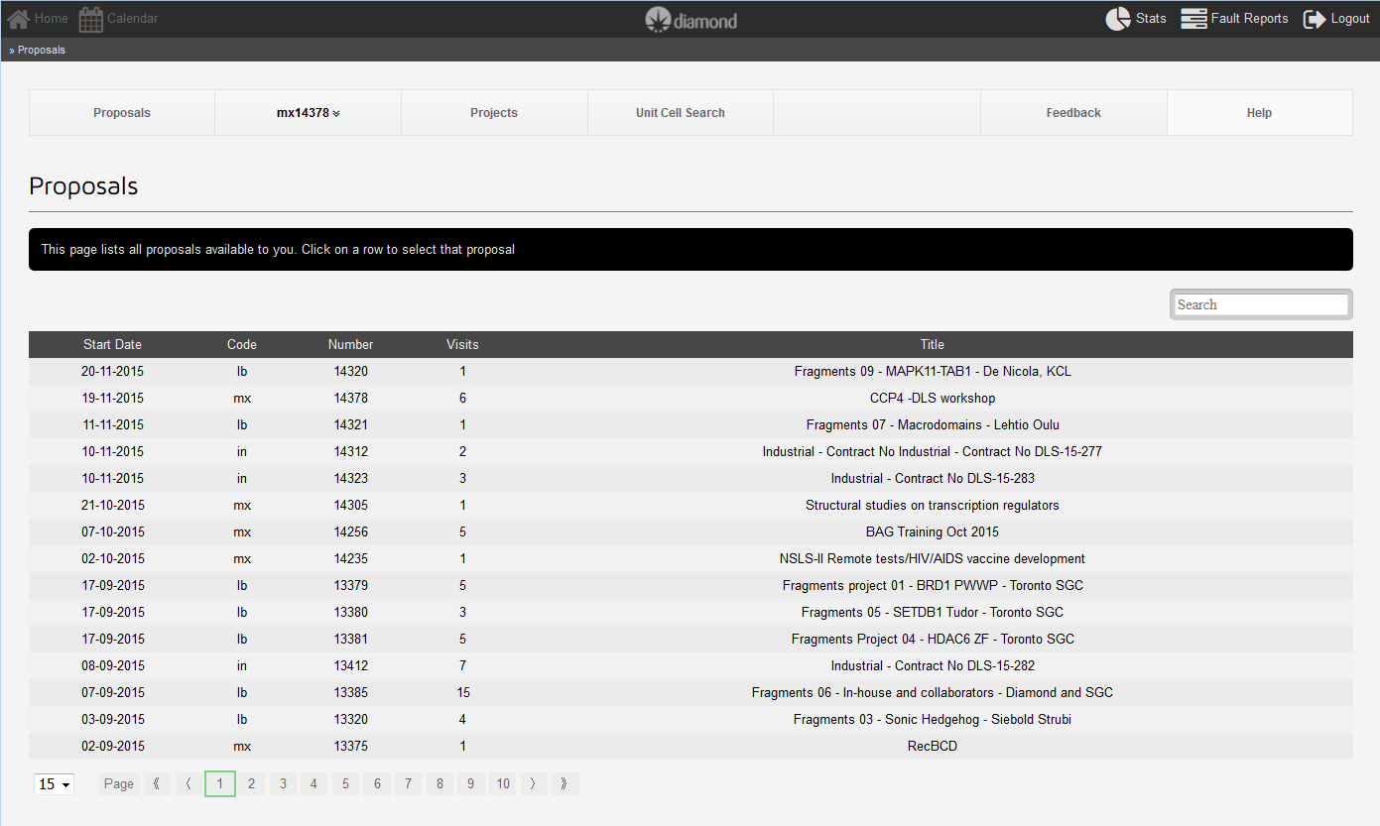
ISPyB quick Intro – http://ispyb.diamond.ac.uk
Access Menu
Choose proposal

Slide 5
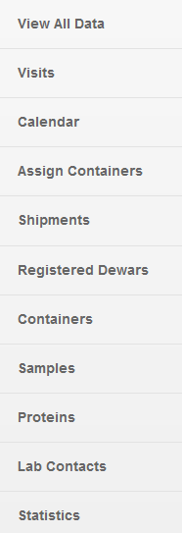
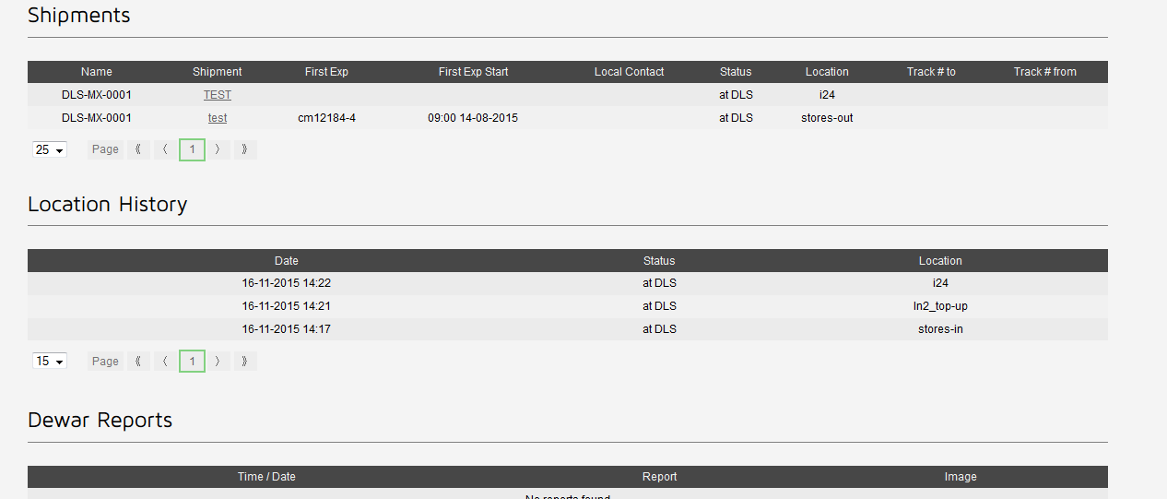
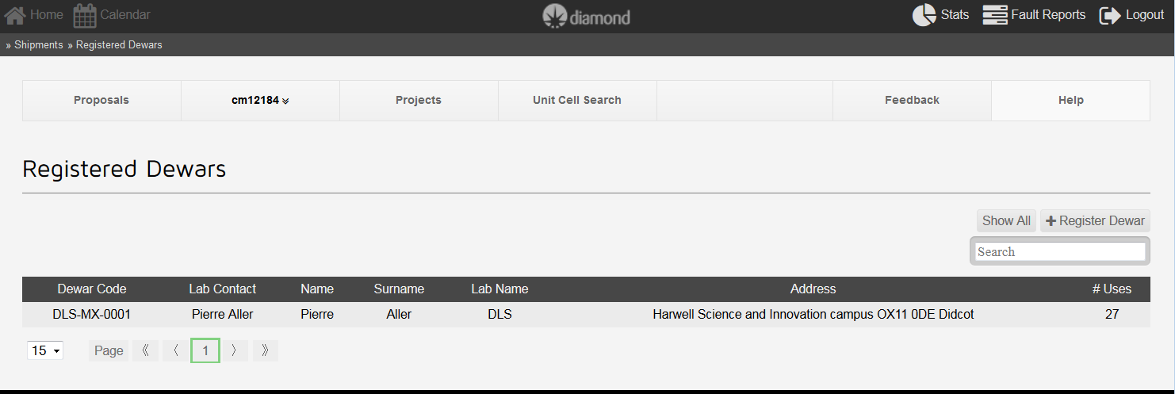
Before beamtime
Unique label to affix on dry shipper
Fast dewar identification
Track history/issues on a specific dry shipper

Slide 6
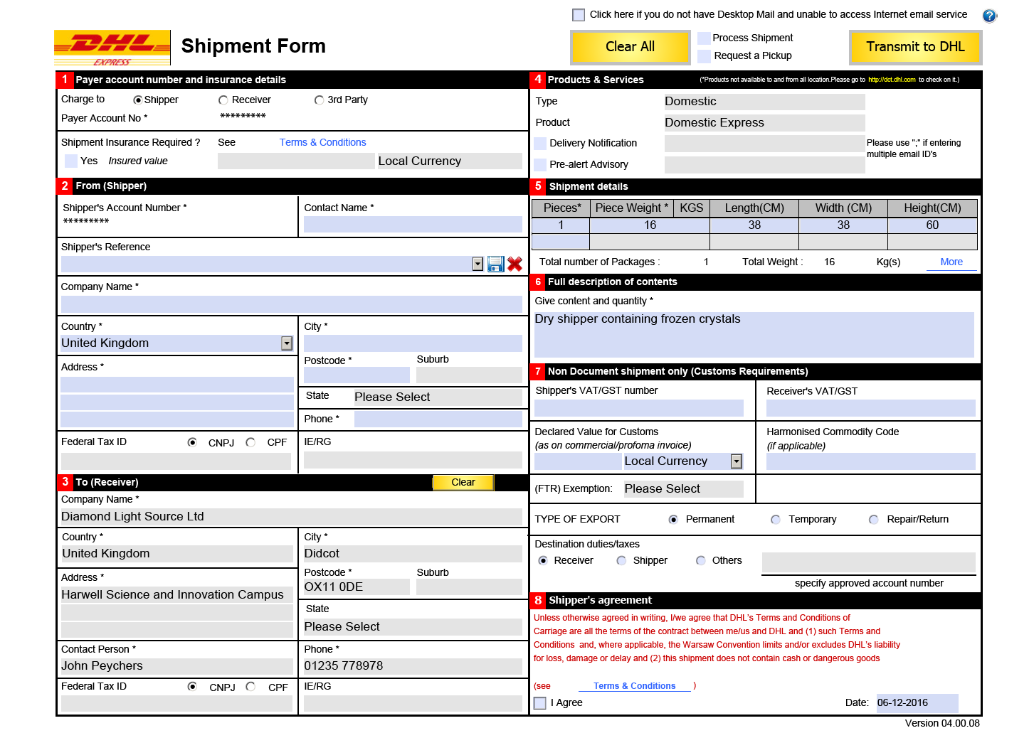
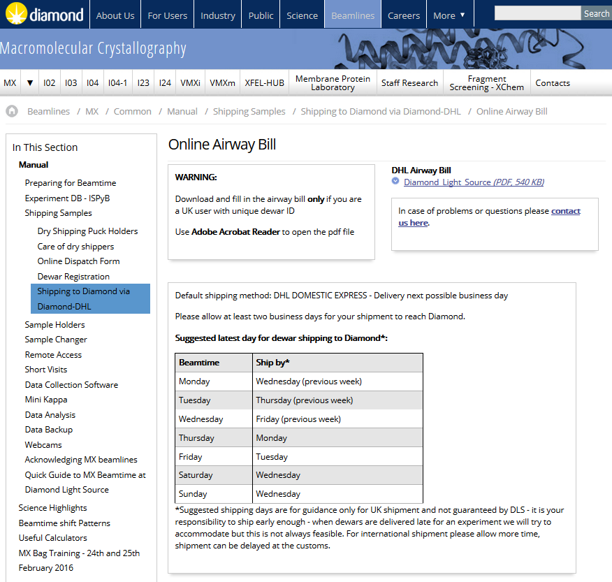
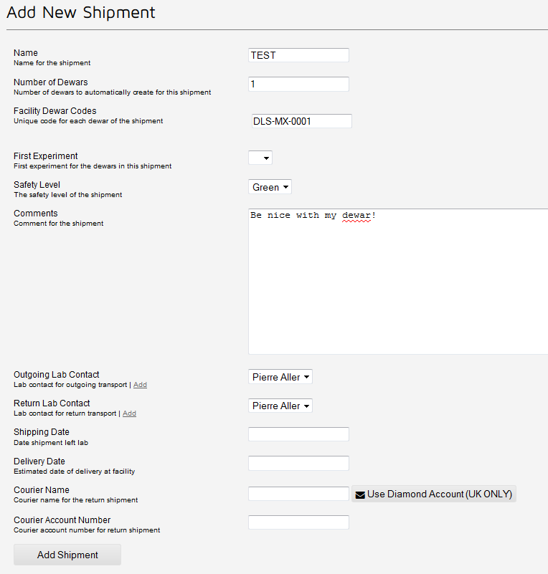
Prepare your shipment

Slide 7
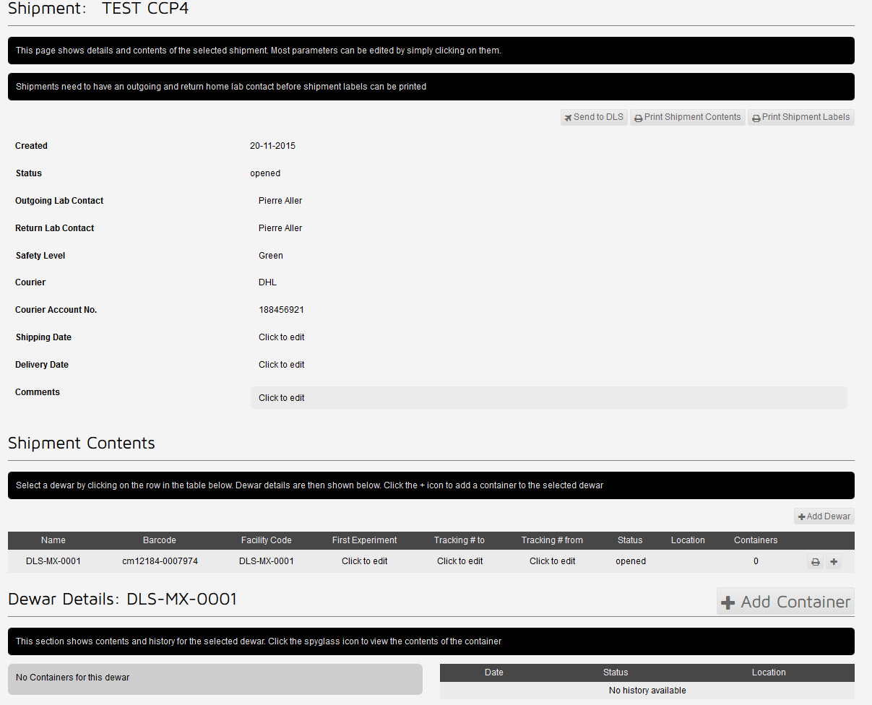
You can have several dewars attached to the same shipment!

Slide 8
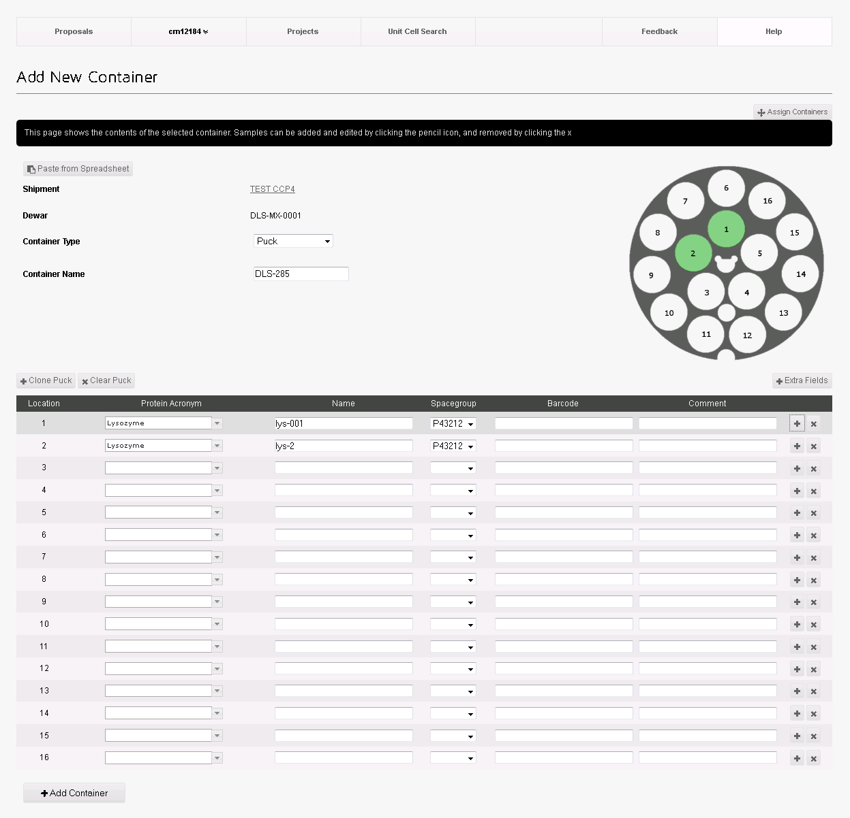
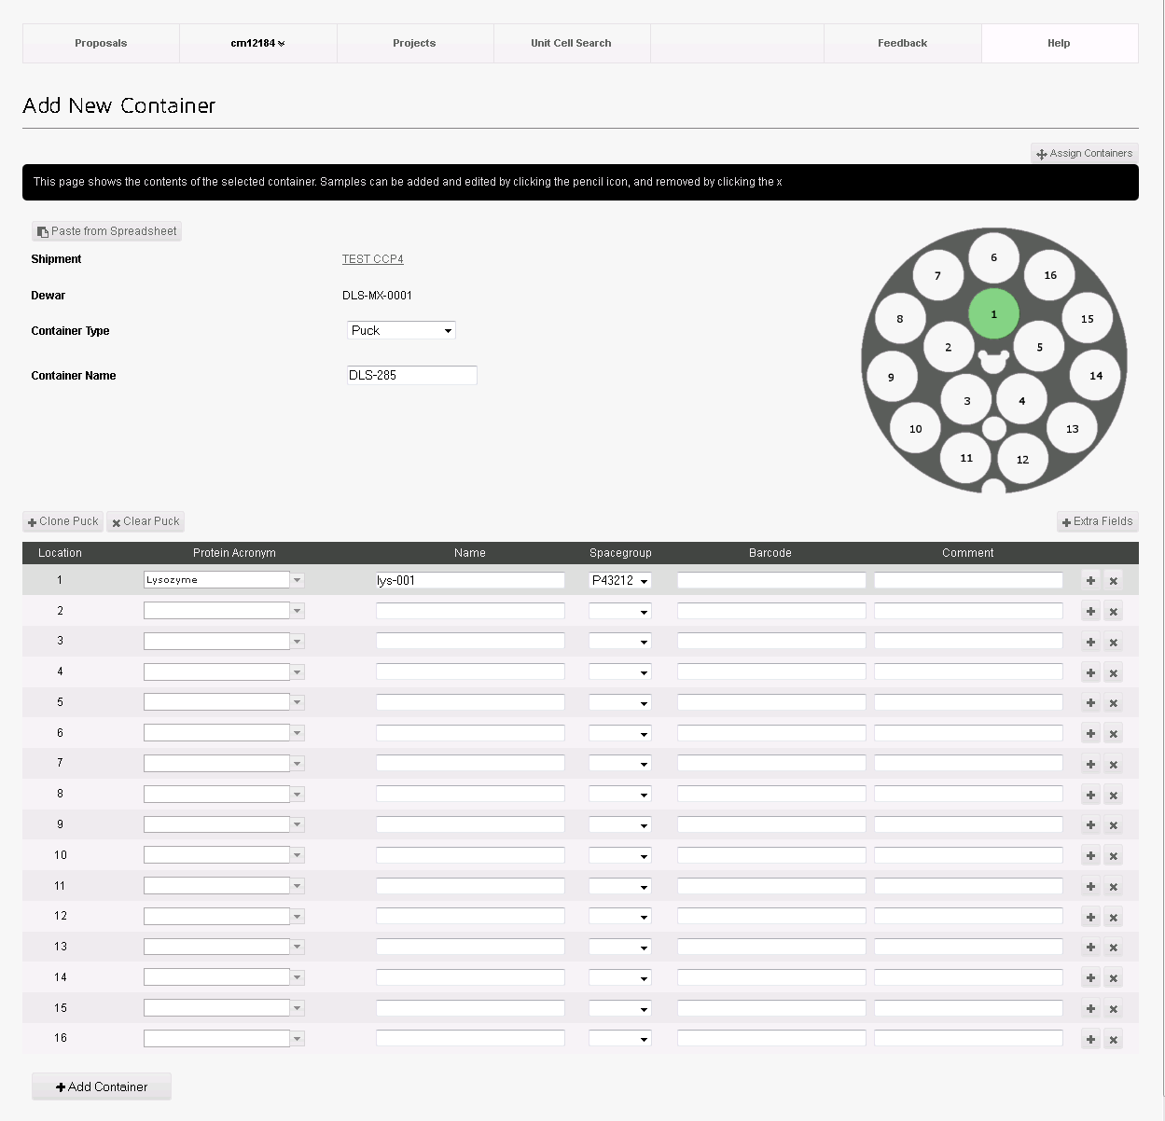
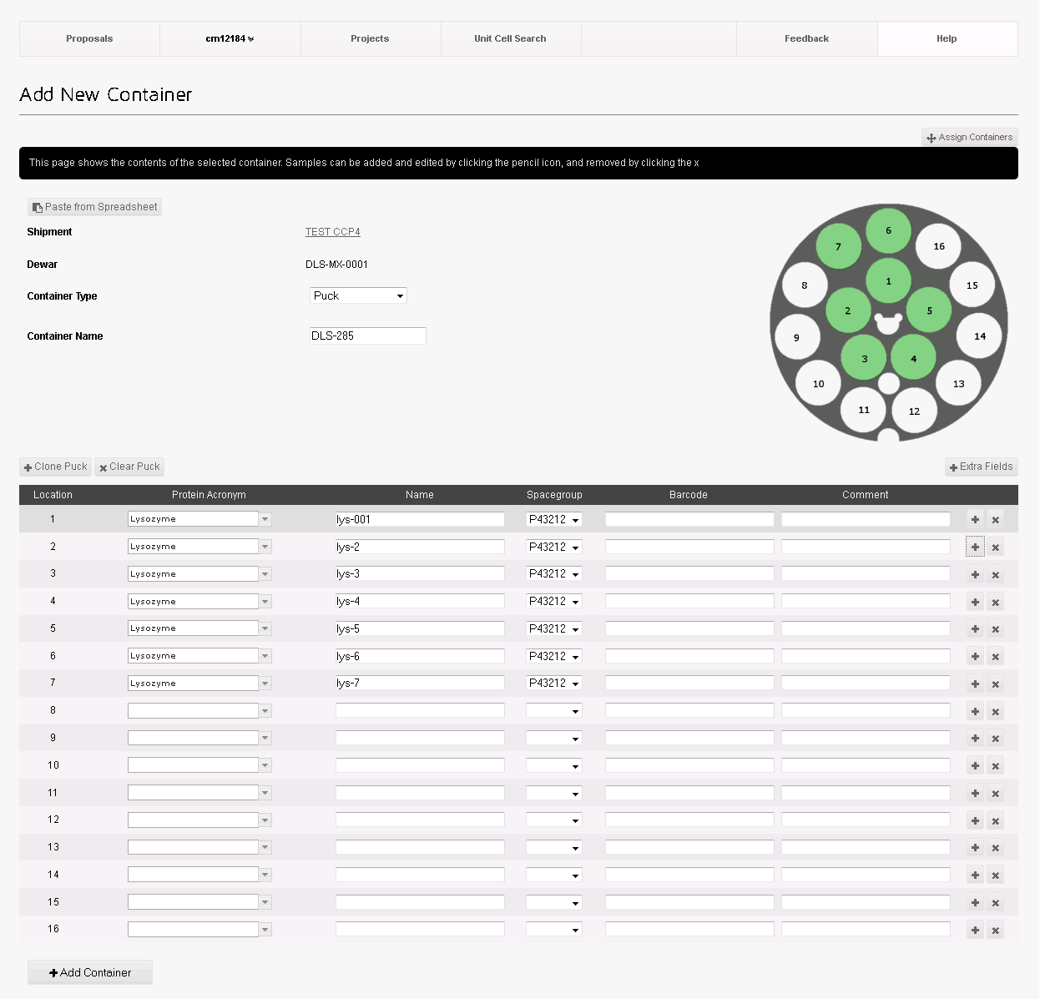
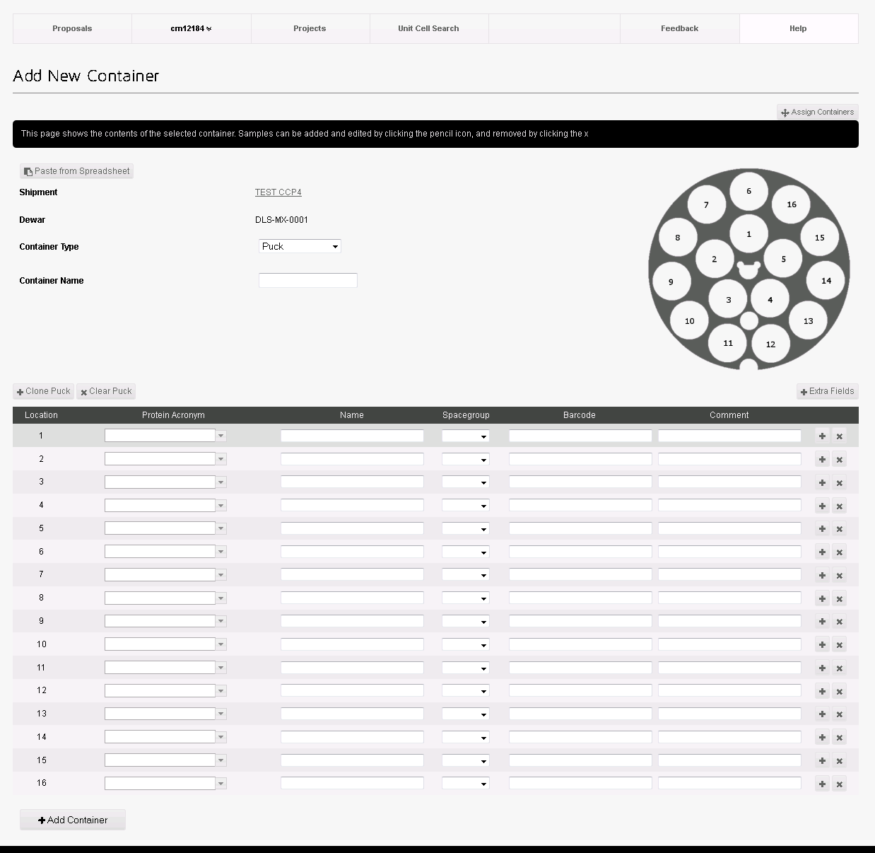

Slide 9
Show all containers associated with the shipment for the visit.
Can edit the pucks contents

Slide 10
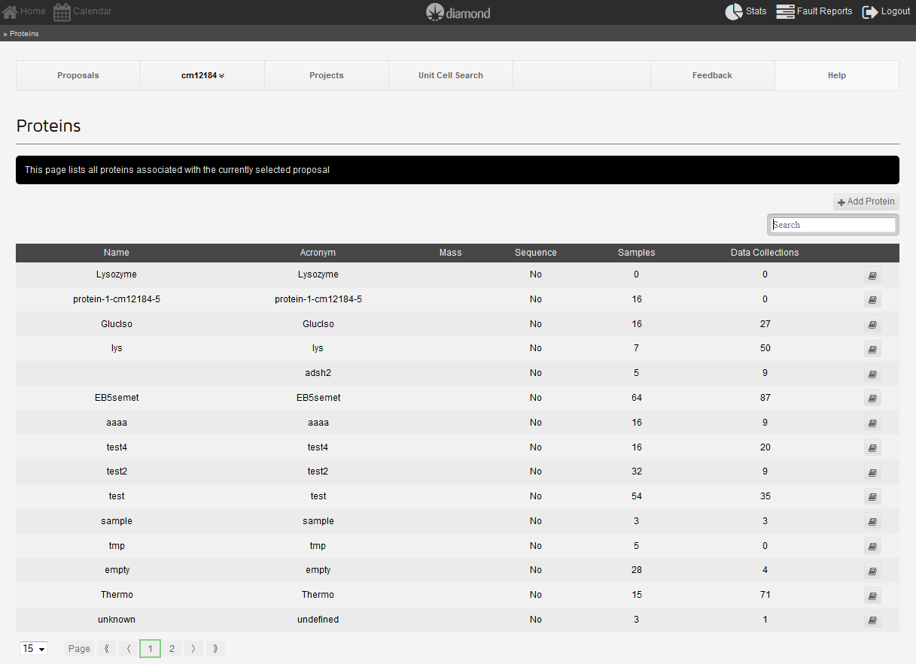
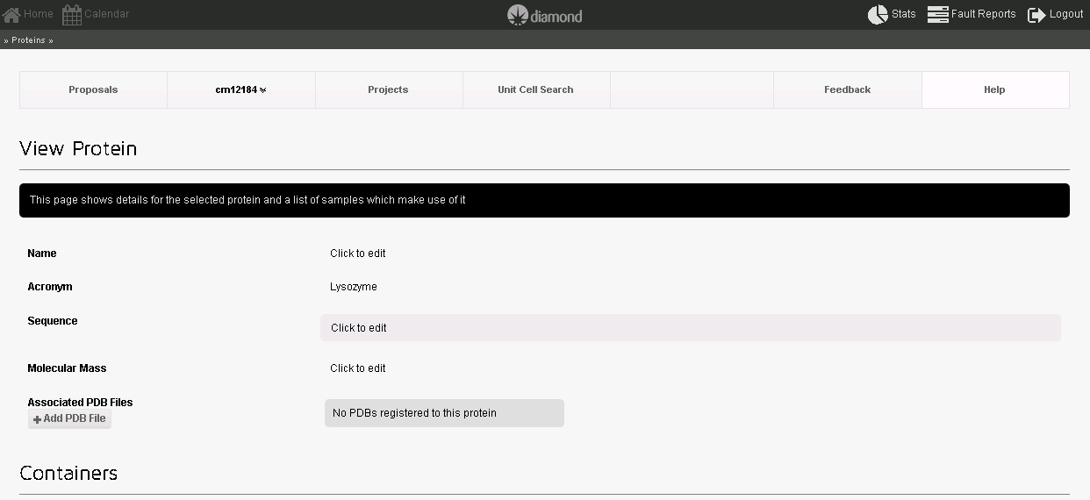
Downstream pipeline:
Add PDB file for Dimple (screening for ligand)
Add sequence for auto MR with Mr Bump

Slide 11
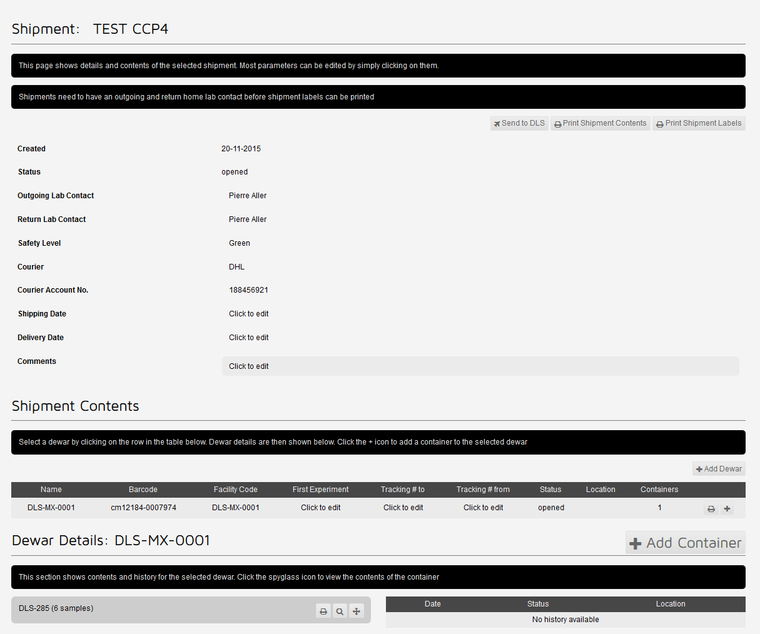

Slide 12
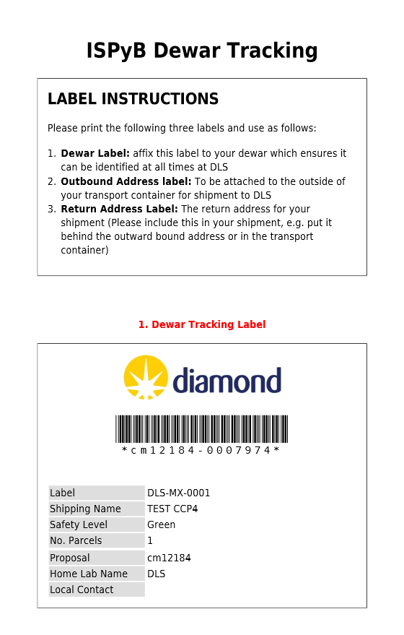
Print label and affix it on your dewar
Label gives all the information needed for the beamline /synchrotron staff:
- Beamline
- LC
- Visit/date
…

Slide 14
When to use ISPyB?
Before beamtime Shipping preparation Sample registration
During beamtime Beamline status/remote access Puck allocation MX – pipeline (Dave)
After beamtime Shipping Lab book – experiment Data backup

Slide 15
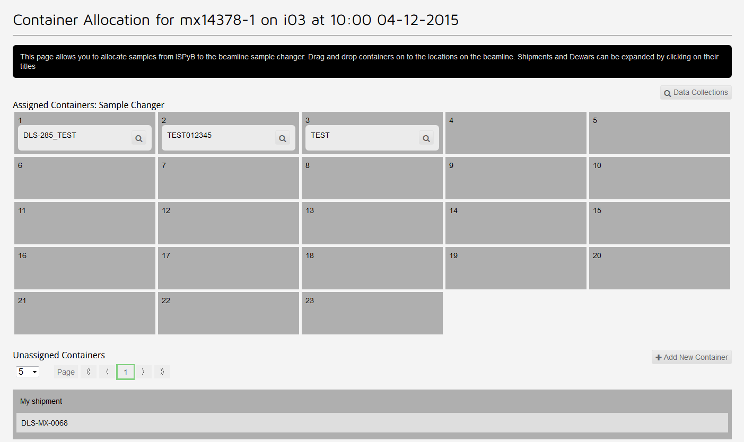
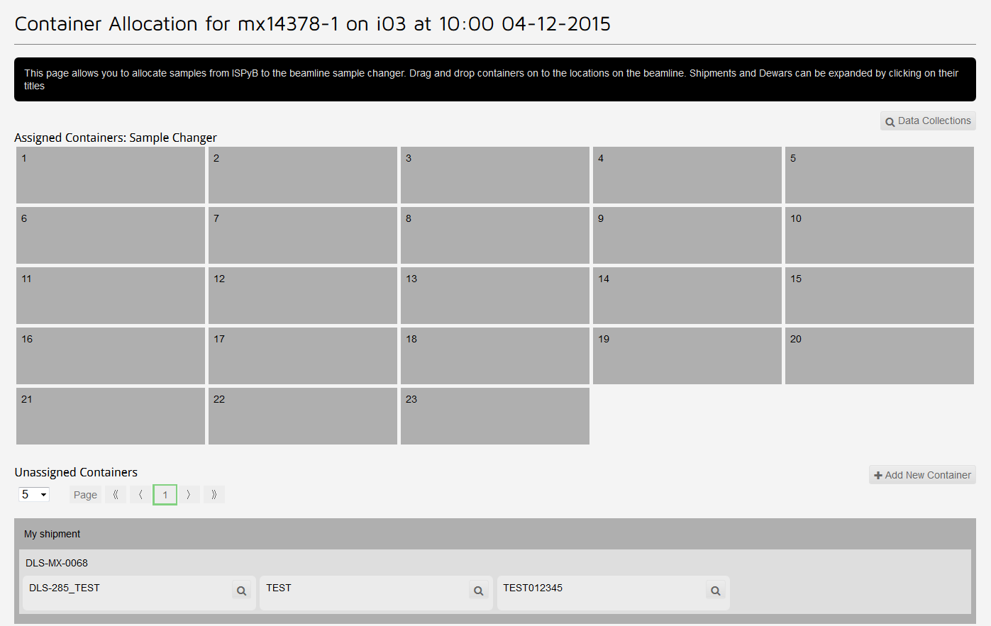
During beamtime
Can create containers on the fly – no need for a shipment
Allocate the container to a position in the robot dewar

Slide 16
To allocate puck positions in experimental hutch use the touch screen:
Both cases will send to GDA the puck positions
Better to register samples before beamtime!!!!

Slide 17
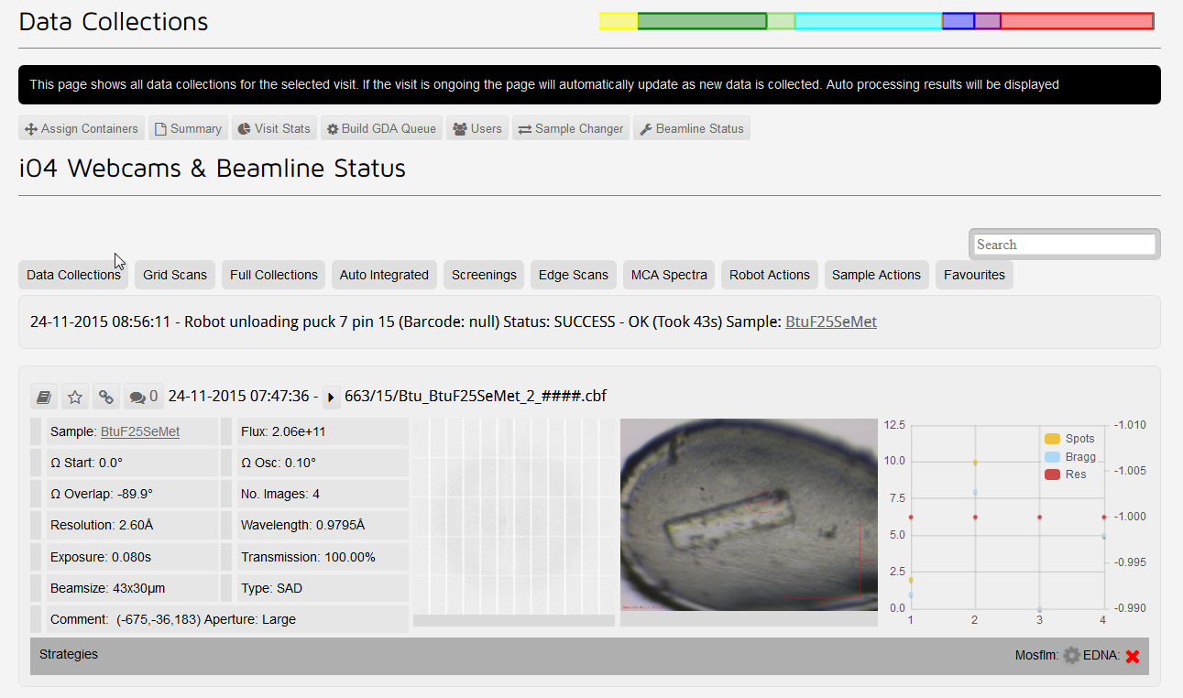
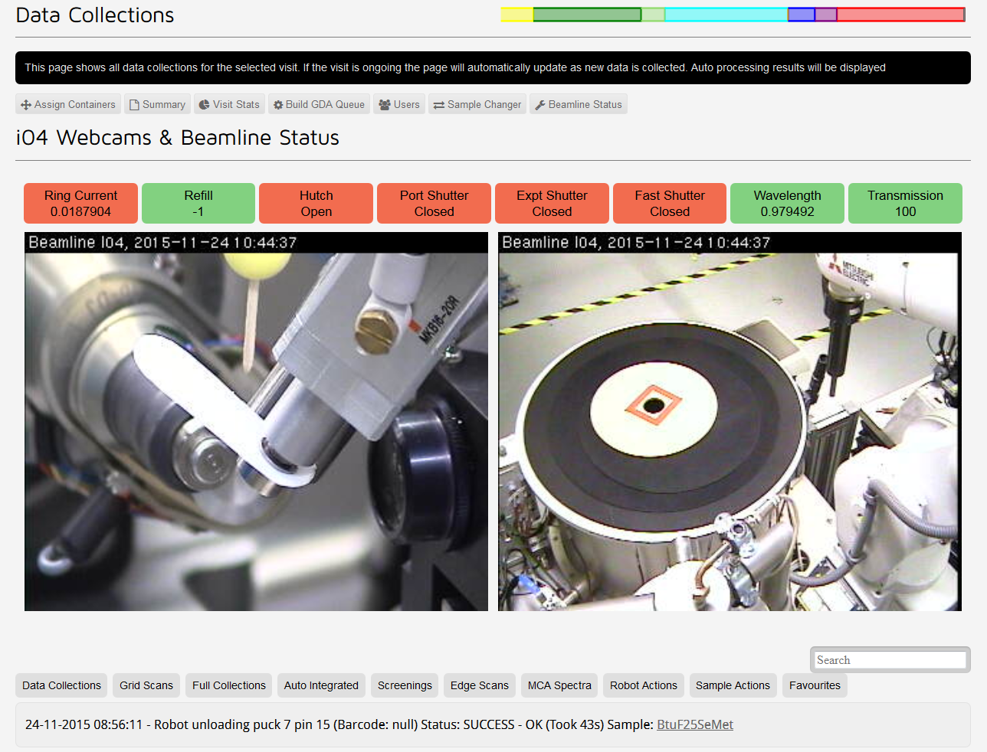
Can follow what is happening!

Slide 18
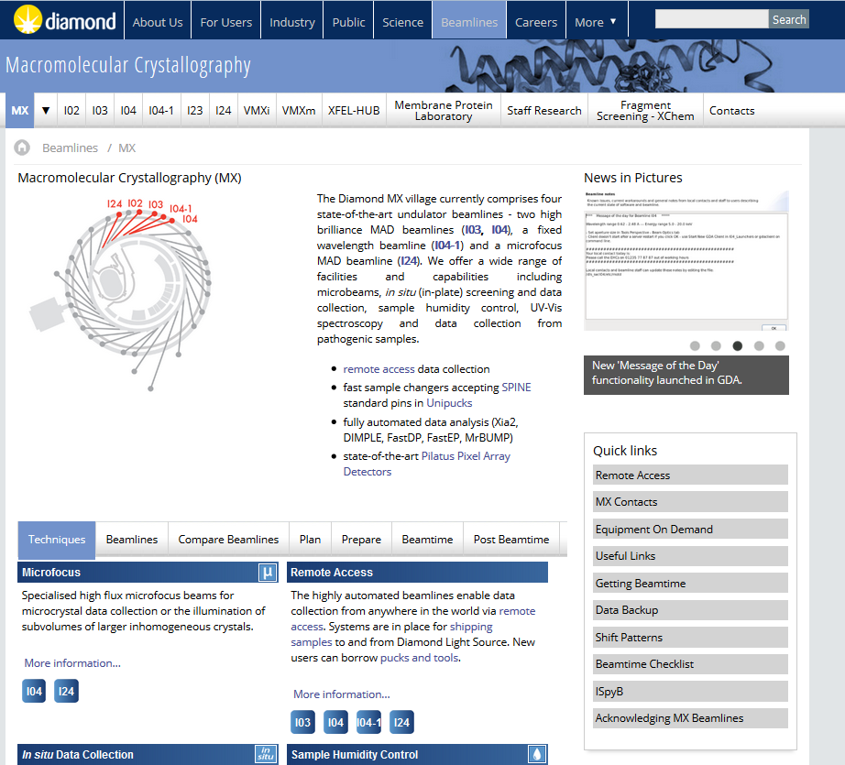
Remote Access:
From any computer: Linux, Windows, Mac OSX
Download nomachine (latest version)
Big screen! 23’’
Fast connection (>10Mbps)

Slide 19
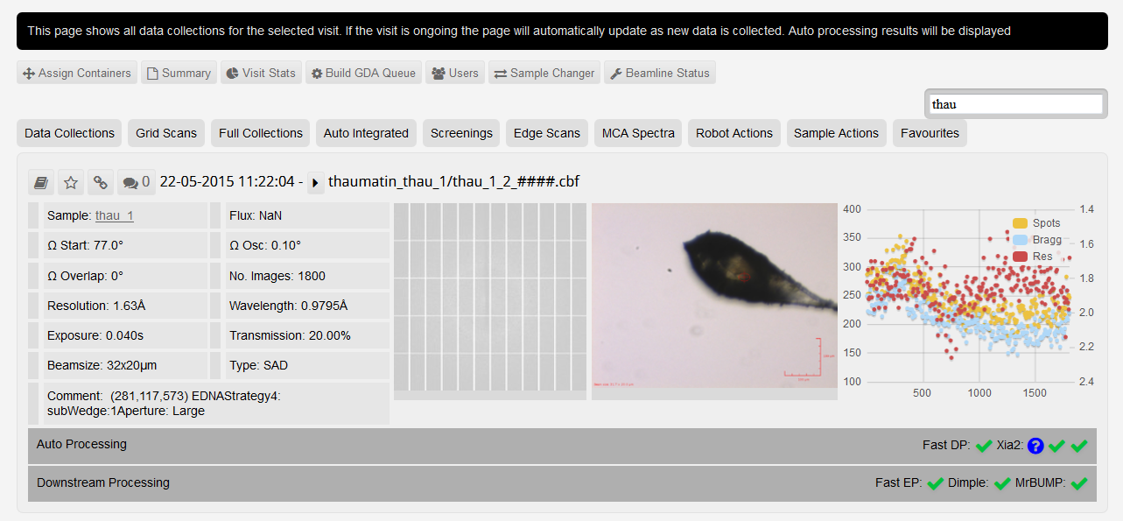
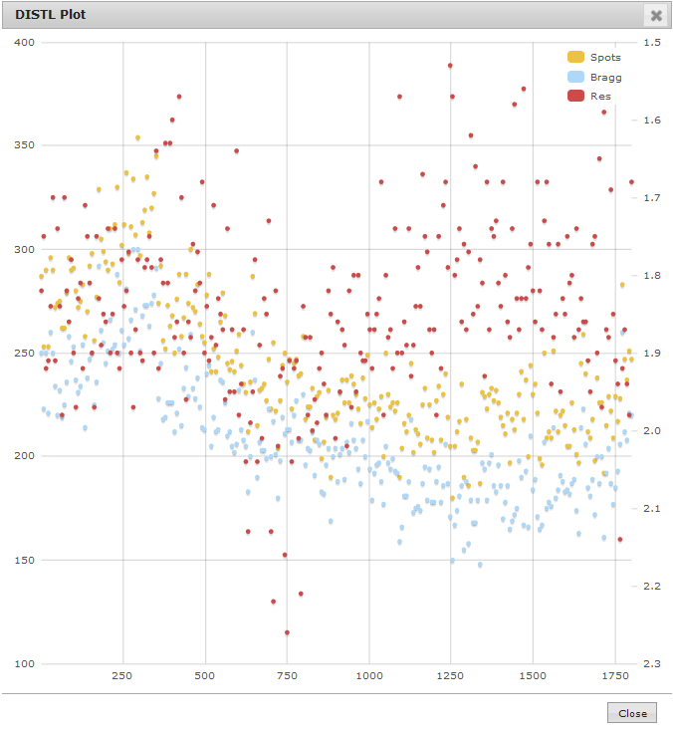
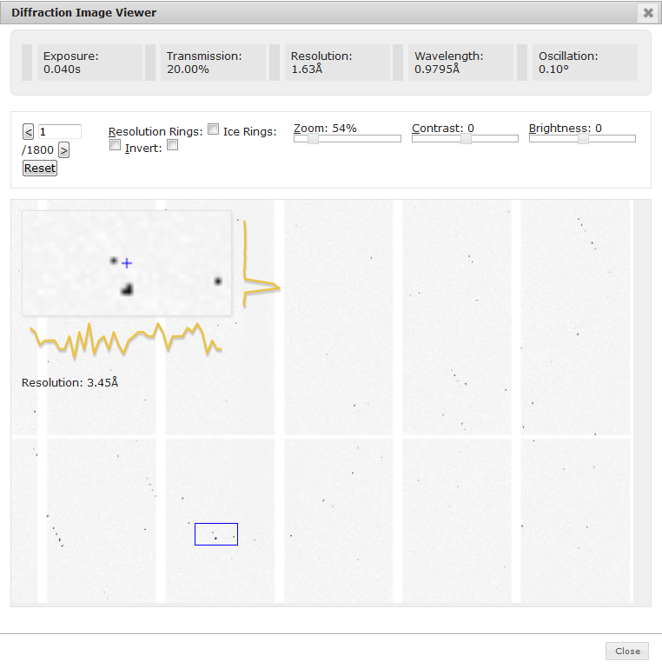
MX pipeline – automatic processing
Per image data analysis
Diffraction image viewer

Slide 20
When to use ISPyB?
Before beamtime Shipping preparation Sample registration
During beamtime Beamline status/remote access Puck allocation MX – pipeline (Dave)
After beamtime Shipping Lab book – experiment Data backup

Slide 21
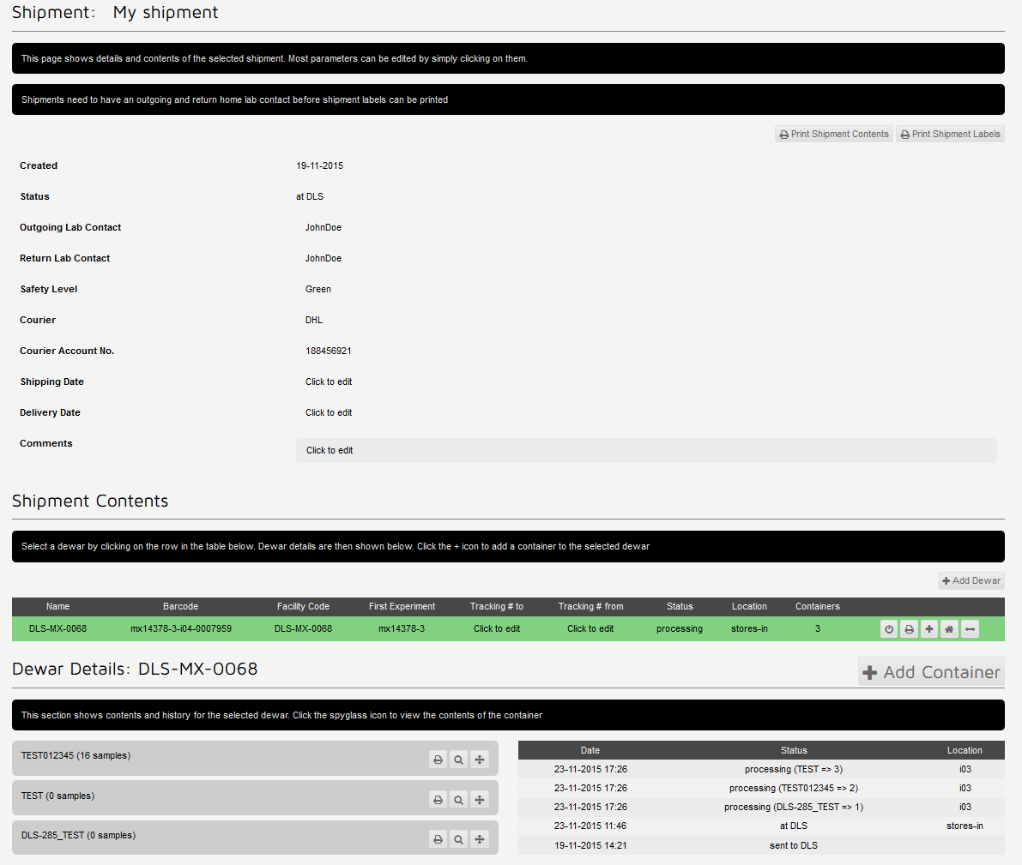
At the end of the beamtime:

Slide 22
At the end of the beamtime:
Send back your dewar(s) to your lab
From UK – choose Diamond DHL as a courier
From EU – Courier account number
Keep your dewar(s) at Diamond for your next visit
Automatically send email to your LC (for the current and next visit), Diamond Store and EHC

Slide 23
After beamtime
Reorganize your data / create project and favourite
Search and share metadata
Visit Statistics
Download MTZ and/or PDB file
ISPyB is like a lab book with all the experiment details
Metadata on ISPyB are always available
Raw images are not stored in ISPyB and can be retrieved later on icat

Slide 24
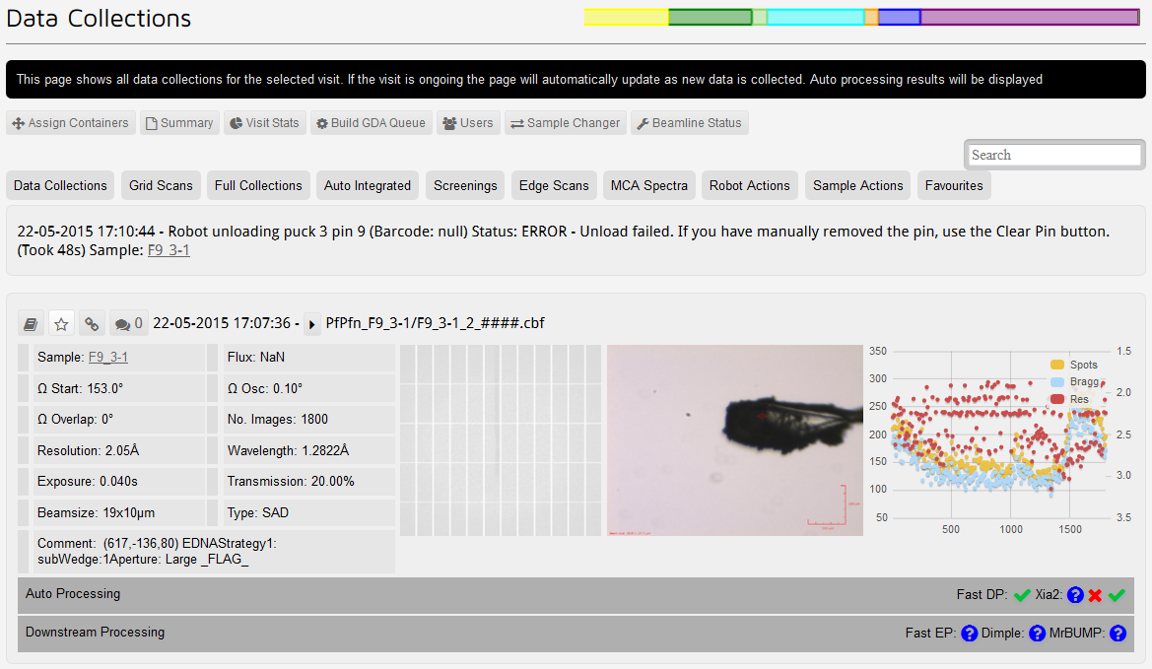
After beamtime

Slide 25
Create a comment on a particular dataset
Create a link on a particular dataset you can share with your colleagues
Reprocess data with Dials
Create a favourite

Slide 26
Assign this dataset to a project
To create a project (top menu of ISPyB)
Assign member
Assign proteins
Sorting your data when collected with other labs inside the same bag

Slide 27
Visit Statistics
Help to understand where you spend your time and how to optimize it for the next visit

Slide 28
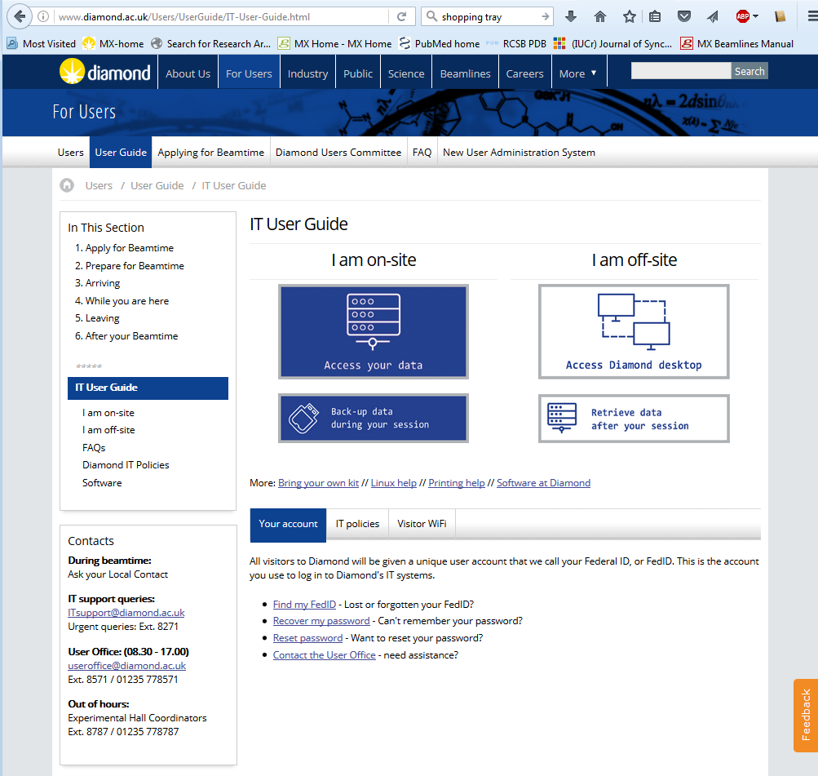
Data access/transfer
/dls/beamline/data/YYYY/experiment-visit
/dls/i04/data/2016/mx16692-2
processing : your place to process data
processed : automatic processing results
40 days to re-process your data via remote connection to Diamond nx cluster

Slide 29
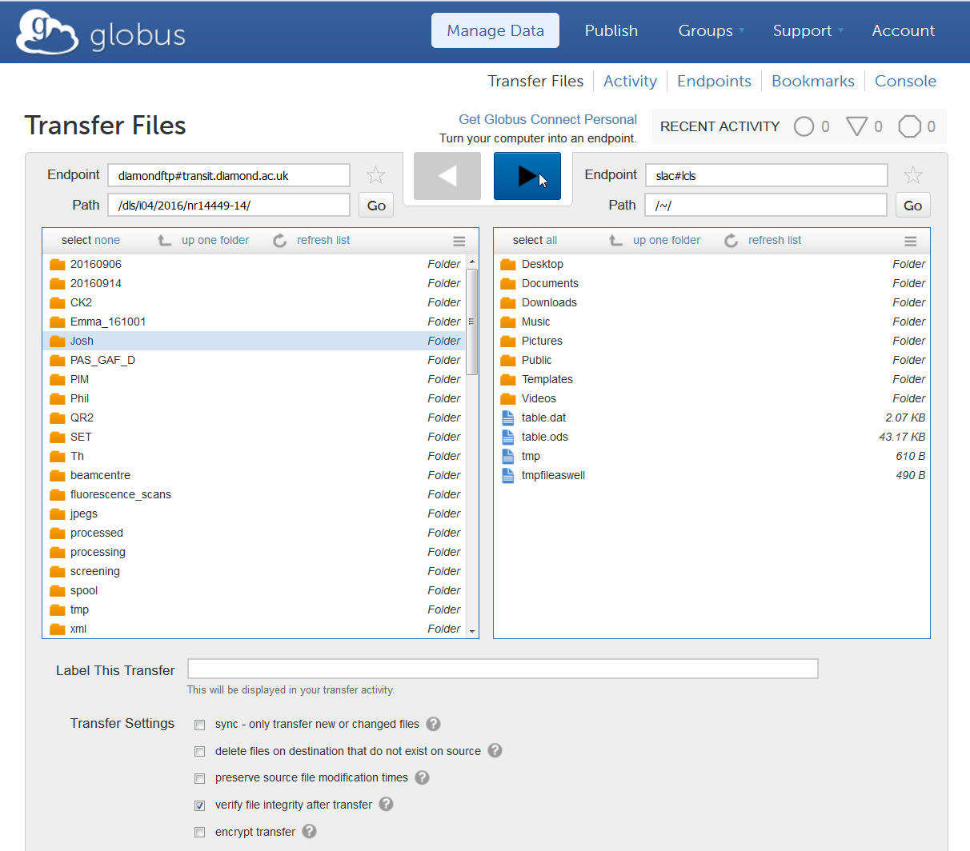
On-site:
BYO HD: Back-up with data dispenser (all HD format supported except Mac OSX extended)
Off-site:
<40 days
SFTP, SCP : different programs available for all OS. e.g. winscp (Windows), Cyberduck (Mac OSX), command line scp (Linux or Mac)
Globus : fast and reliable. Your institute need to have a globus endpoint (diamondftp#transit.diamond.ac.uk)
https://www.globus.org
Notes:
IT recommend Globus for data set >20GB
For less than 20GB use scp sFTP

Slide 30
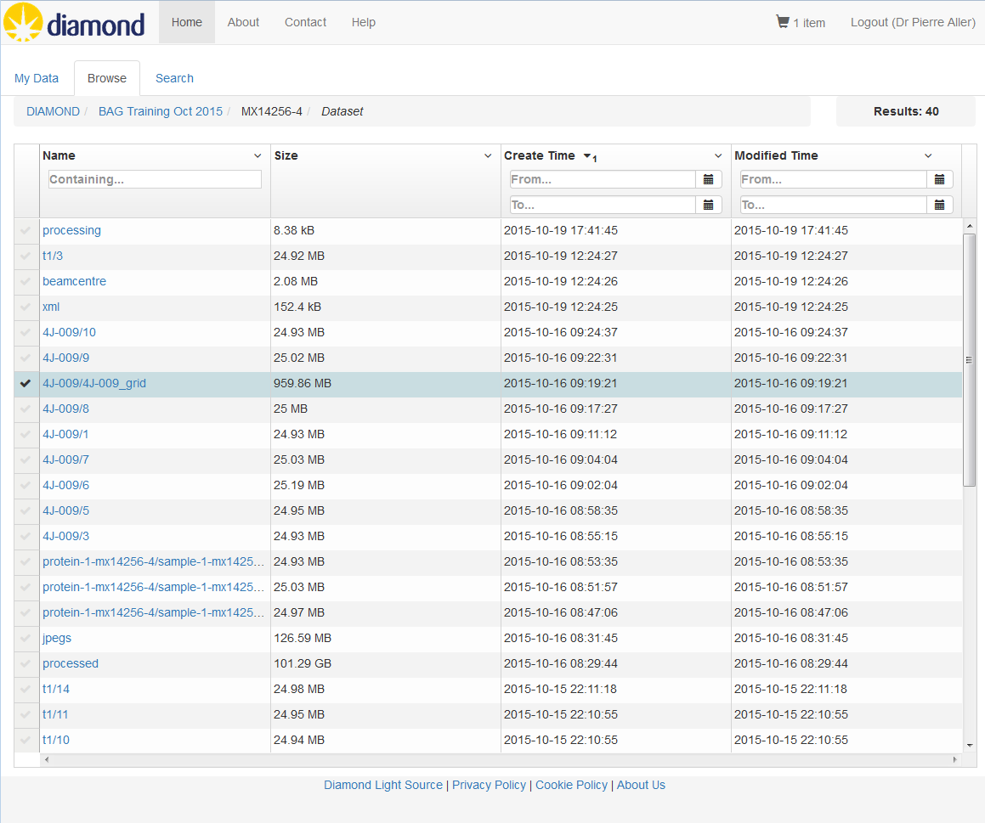
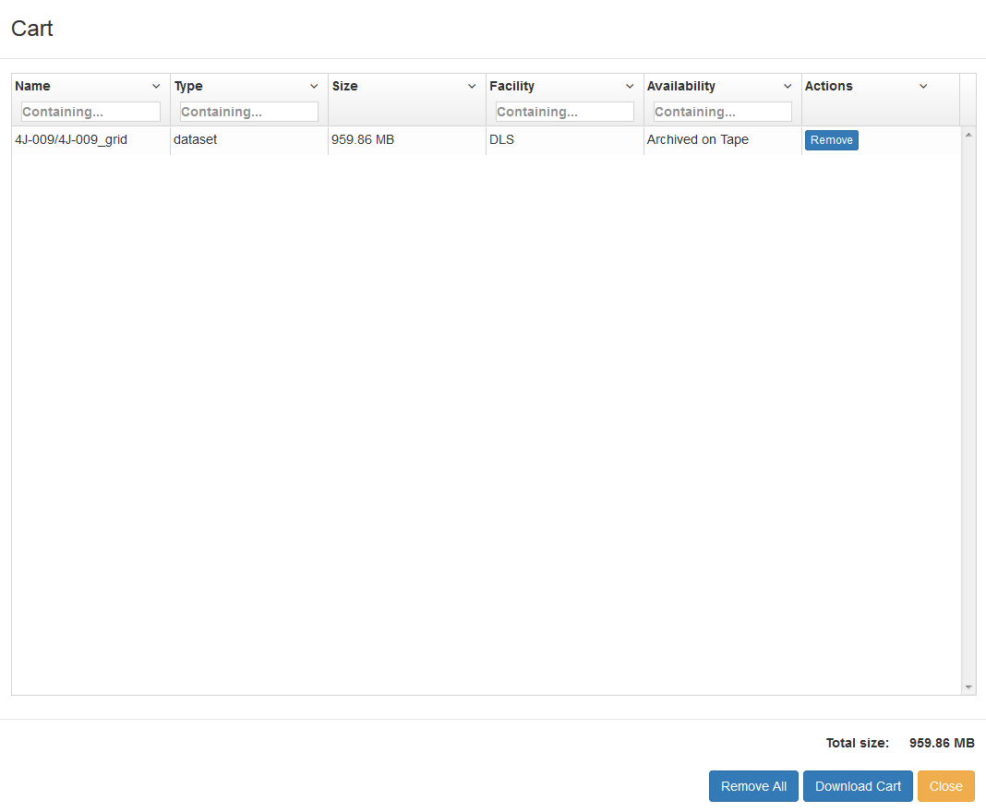
Off-site:
> 40 days
icat : Data have been archived and they will be stored forever… https://icat.diamond.ac.uk

Slide 31
In conclusion :
In one interface:
Great tool to keep track with your experiments at Diamond
Show auto-processing results
Metadata available for download
Manage your shipment: dewar/pucks
Use the feedback button to tell us what you think!

Slide 32
Acknowledgment:
Stuart Fisher
Karl Levik
Alun Ashton
Katherine McAuley
Dave Hall
Mark Williams
All MX staff and Diamond scientific software group

Slide 33
Any questions before live demo?
Before beamtime Shipping preparation Sample registration
During beamtime Beamline status/remote access Puck allocation MX – pipeline (Dave)
After beamtime Shipping Lab book – experiment Data backup

