Slide 1
New Directions in Structural Biology at Diamond
Martin Walsh
Life Sciences Coordinator

Slide 2
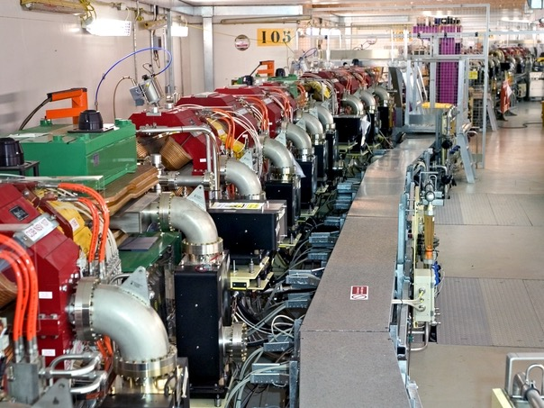
The Diamond Project
At its base electrons…
encompassing SR, EM and X-FEL

Slide 3
Diamond Light Source
The UK’s 3rd generation synchrotron
The largest single scientific investment, at its time, in the UK for 45 years ~ £500 million on completion;
33 Beamlines (36 branch lines) on completion of Phase III (2018)
Funded by Our Shareholders – The UK Government through the STFC (86%) and the Wellcome Trust (14%)
A Scientific USER Facility
  First scientific users from 2007....
  Project celebrated first 10 years in autumn of 2012!
Notes:
CEO appointed….My background
Started research with X-ray Synchrotron Light in 1973;
Used and advised various SR facilities in Hamburg, Berlin,Ithaca, Brookhaven, Stanford, Chicago, Harima, Grenoble;
For many years Director of HASYLAB, Member of DESY Scientific Directorate, Prof. at Hamburg University;
Last not least: solid state experimental physicist

Slide 4
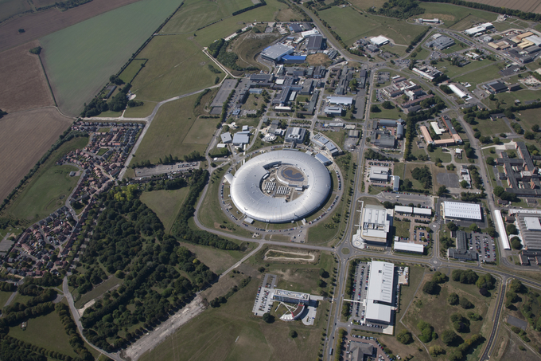
Harwell Campus
Mary Lyon centre
Mouse functional
genomics
ISIS
Target Station 2
MRC Harwell
CLF
Public Health
England
eBIC
Guest house
Research Complex
OPPF,
International Space Innovation Centre (ISIC)
RAL
Rutherford Appleton Laboratory
Element Six
Synthethic Diamonds
(De Beers)
The European Centre for Space Applications and Telecommunications (ECSAT)

Slide 5
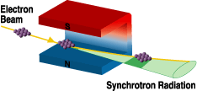
What is Synchrotron Radiation?
Synchrotron light is the name given to the electromagnetic radiation emitted by charged particles when accelerated in an external magnetic field.
This could be from any source (e.g. astrophysical), but is generally thought of as coming from a man-made relativistic beam of electrons.
Synchrotron light sources

Slide 6
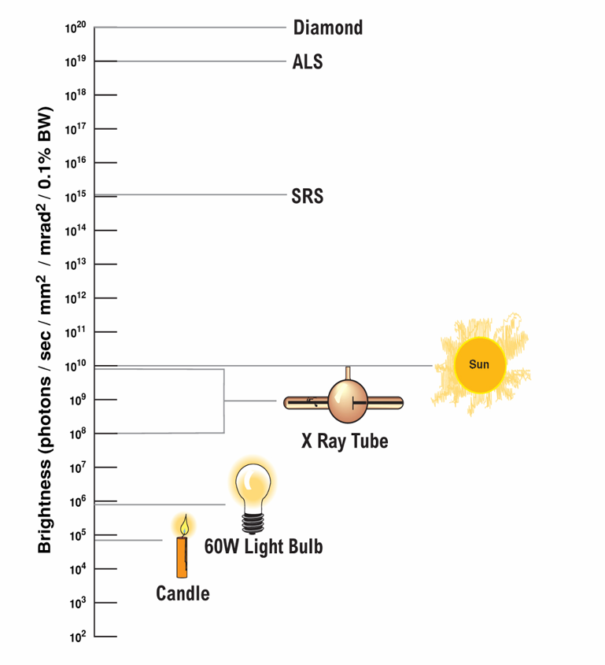

In this business, it's all about brightness !
X-rays from Diamond are 100 billion times brighter (10¹¹) than from an X-ray tube
Or 10 billion times brighter (10¹⁰) than the Sun
>10⁵ times brighter than the previous UK Synchrotron, the SRS !
Notes:
We are the next generation of synchrotrons. The graph here shows our positioning against current synchrotrons.
We will offer our users a proactive and flexible service as far as possible. We understand that industry user in particular require fast turnaround and quick access and we will do our best to meet expectations as long as you tell us what they are!
Around the main experimental hall area, each beamline will have a dedicated support laboratory – a very useful thing to allow users to prepare and pack their samples. XXXXXX
We have recruited a strong scientific team. The user office team will be there to ensure that our approach is focussed on our users, and believe me, all of us in the team who have been users at some point or another, know how important it is to feel looked after properly!

Slide 7
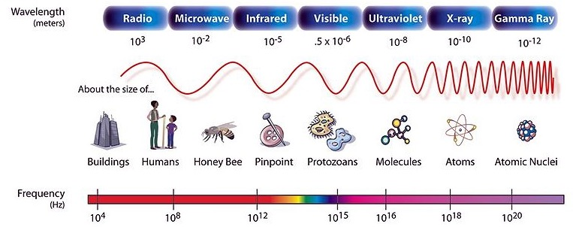
Synchrotron Radiation - Properties
Synchrotron light is useful because it:
- Covers a wide spectrum (infra-red through to x-ray)
Small spot size
Pulsed time structure
Tuneable
- High stability
Intense
Polarised

Slide 8
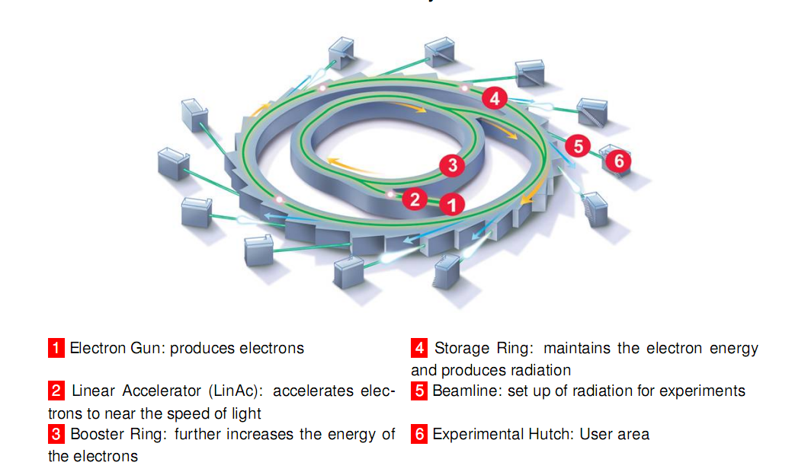
Synchrotron – main components

Slide 9
Some statistics on use and output
 | 2014/15 | 2015/16
Proposals awarded beamtime | 642 | 1,026
Experimental shifts awarded | 7,815 | 9,091
Number of user visits | 4,988 | 5,472
Total no. of unique users | 2,948 | 3,252
Total no. of unique PhD student users | 850 | 1,011
Total no. of journal papers | 769 (2014) | 967 (2015)
Over 50% of our MX users are now REMOTE!!!
Notes:
Gi-SAXS concept design lower right of slide
2D Scattering pattern from Zeolite in Laser trap on microfocus platform. SAXS is at the very centre of the pattern and the WAXS is “just” discernible with the lights down! Plus photo of trap.
1D SAXS curve from GroEL recorded with HPLC system plus flow cell developed to be interchangeable between syringe pump system and HPLC
No pictures for last two

Slide 10
Application Process –who can apply
Diamond is free for UK researchers who publish their results (users are supported while they are here – accomodation/subsistence support)
European users are supported by the H2020 iNEXT network grant but need to apply to iNEXT (http://www.iNEXT-eu.org)
Rest of academic world –free at the point of access
Proprietary access also available

Slide 11


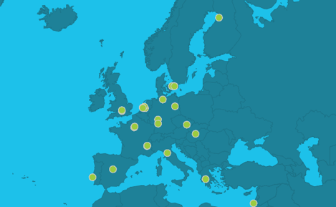
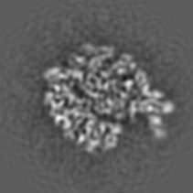
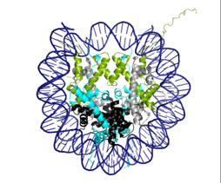
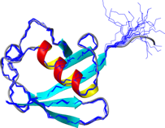
Infrastructure for NMR, EM and X-rays for Translational research
Europe-wide network
1st Sept. 2015
iNEXT funded for 4 years
primary website
http://www.inext-eu.org/
X-rays = MX and BIOSAXS
The iNEXT consortium involves 23 partners from 14 different European countries. Networking activities are carried out to attract new users and to disseminate scientific results across academia and industry.

Slide 12

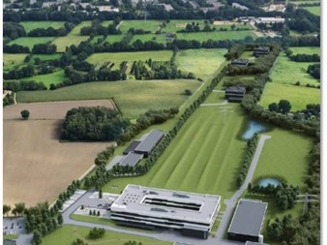
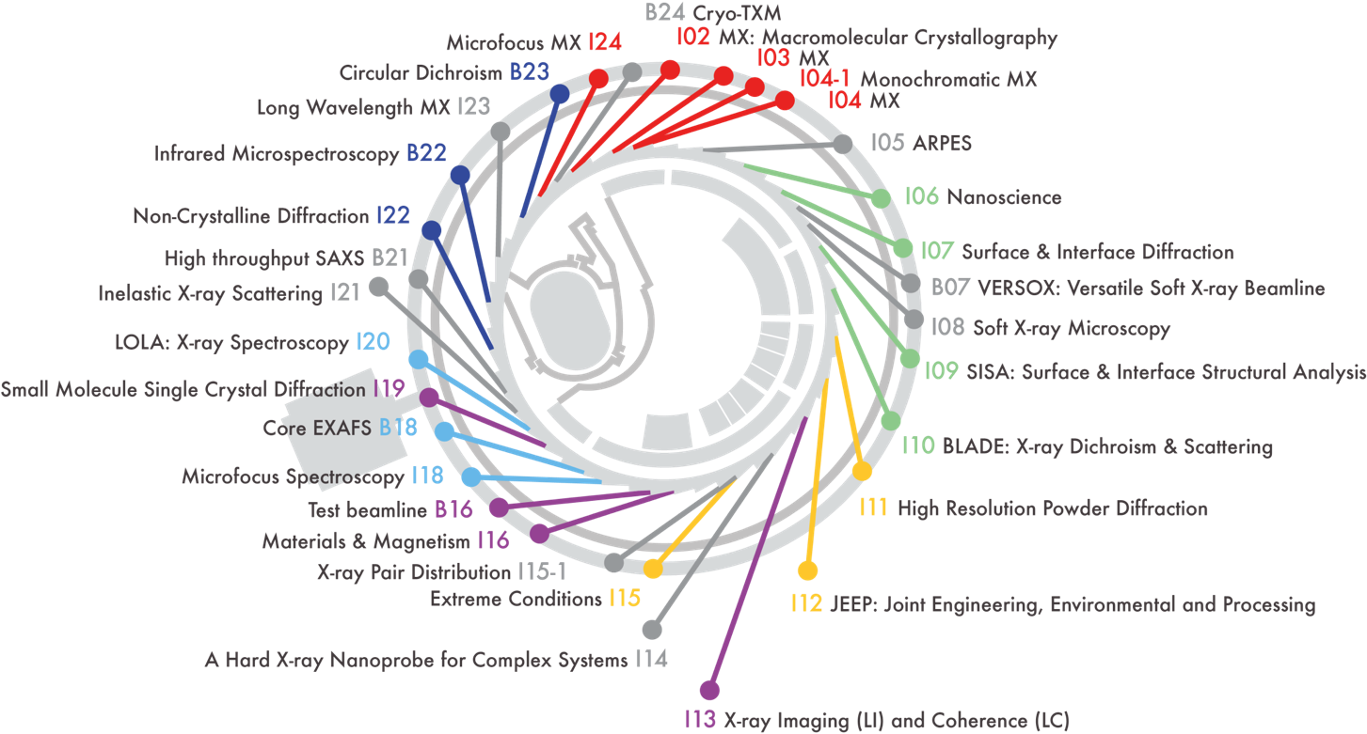

Beamlines by Village
E-XFEL
eBIC
Macromolecular Crystallography
Soft Condensed Matter
Spectroscopy
Materials
Engineering and Environment Surfaces and Interfaces

Slide 13
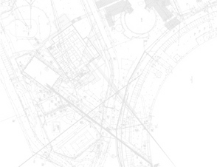
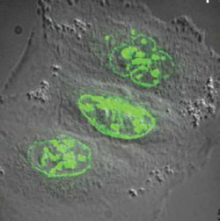
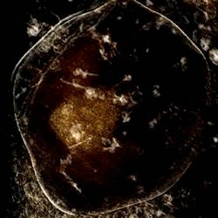
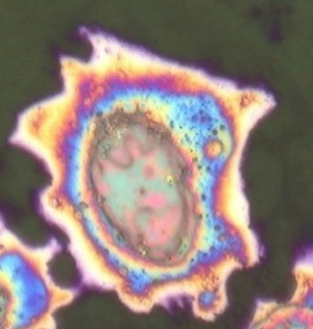
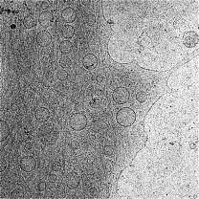
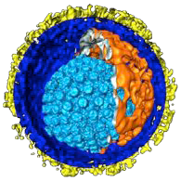
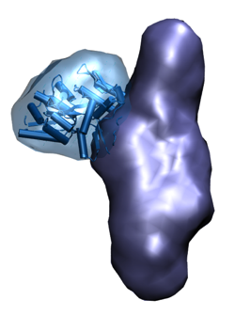
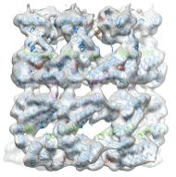
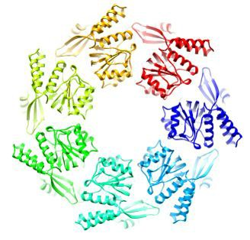
One major player – integrated Structural biology Increasing biological complexity and integrity
Fluorescence microscopy
(B24/CLF)
B24 X-ray microscopy
B22 - Infrared
microspectroscopy
Cellular cryo-electron tomography
CryoET
Cryo-electron tomography
B21 X-ray Solution Scattering
Single particle cryo EM
X-ray crystallography
Increasing resolution

Slide 14
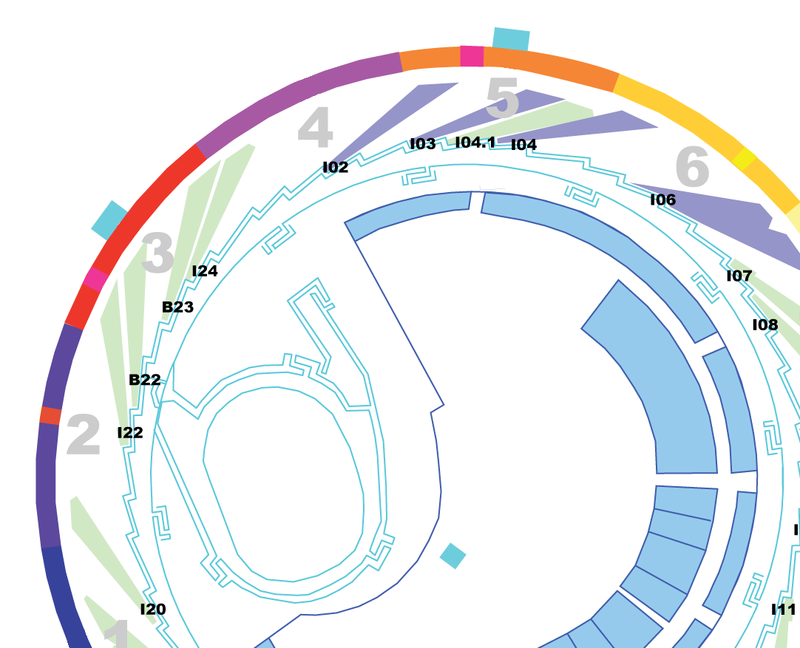
MX Village
I02/VMXi
I03
Operational
  Phase I
    Tuneable I02, I03, I04
  Phase II
    Fixed λ I04-1
    Tuneable microfocus I24
In Development
  Phase III
    Long λ I23
    VMX m and i
I04-1
I24
VMXm
I04
I23

Slide 15
New era for MX
Faster detectors
  …currently 100 Hz ...expected close to KHz in near future
New sources
  MAX IV (Sweden) opened for business this year
  ESRF upgrade program
  Upgrades proposed for nearly all 3rd generation sources ...
  Proposal for Diamond II increase brillance x10...more beamlines..
New beamlines offering new capabilities…
  At Diamond unique opportunities
    Long wavelength beamline I23 to solve phase problem in crystallography (in commissioning now...)
    Dedicated in situ beamline VMXi first users in December 2016 [crystals analysed within crystallisation plates]
    Submicron focussing tuneable beamline for MX ...first of its kind (2018)
X-ray Free Electron Lasers
  LCLS and SACLA operational
  European XFEL (Hamburg) 2017
  Other national hardy X-ray XFELs – Swiss
Challenges remain for exploiting these wonderful opportunities ...
  Sample delivery
  Software for data reduction/analysis
  Data management...HPC .....
  Optimised workflows....

Slide 16

UK and femtosecond crystallography at the European X-FEL - SFX
James Naismith David I Stuart Jan Löwe Martin A Walsh Henry N Chapman
On behalf of the UK Structural Biology Community
via Instruct & CCP4

Slide 17
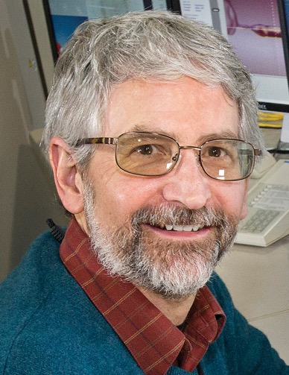
Funded by Wellcome Trust, BBSRC and MRC to make the UK the largest partner in the consortium at the European XFEL (http://www.xfel.eu) for this dedicated crystallography instrument
Enable diffraction from nanocrystals….time resolved experiments…ultimate goal image single particles…
Allen Orville now leading from Diamond
Notes:
JHN TO SPEAK TO THIS: Key points

Slide 18
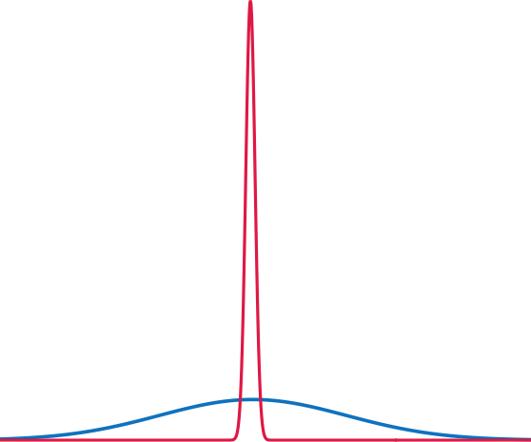
Potential of XFEL
30 fs pulse, X-ray doses exceeding 1 GGy
Unique: diffraction before sample destruction
Structures from smaller & sensitive crystals not currently tractable:
paradigm shift for
  Membrane proteins
  Protein protein complexes
  Time resolved experiments
  Single particle imaging….
XFEL
photon flux
10¹² photons
30 fs
50 GW peak power
Synchrotron
10⁶ photons
30 ps 50 W peak power
time
Notes:
JHN TO SPEAK: Key points diffraction before destruction

Slide 19
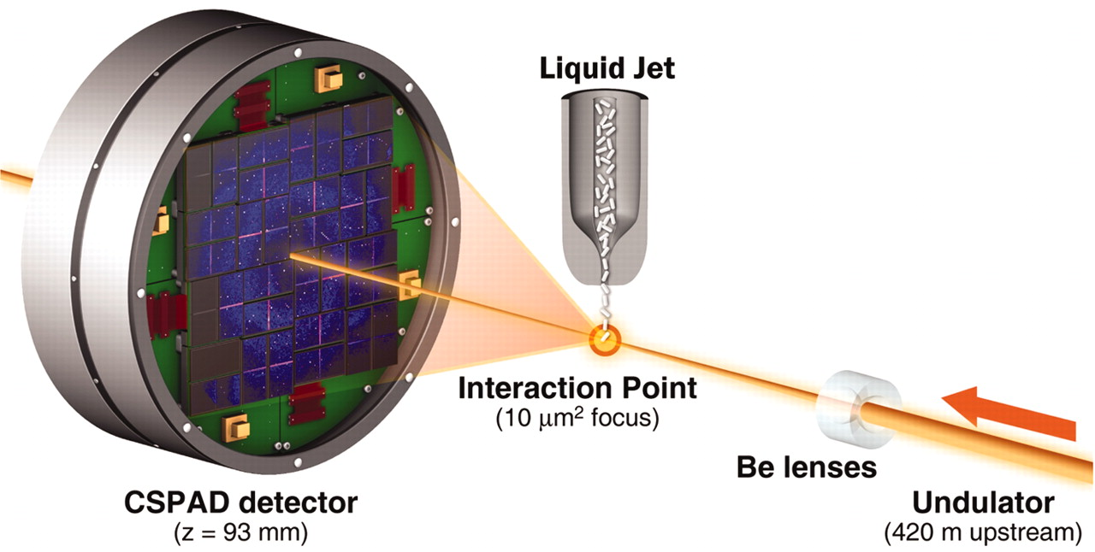
The first high-resolution protein structure determination by SFX methods
124,000 indexed | = 8.3% | 10,575 indexed | = 0.53%
1,500,000 images |  | 2,000,000 images
Lysozyme microcrystals
~1 μm x ~1 μm x ~3 μm
Each in random orientation
9.4-keV (1.32 Å) X-ray pulses
Pulse | 40 fs | 5 fs
Images | 1,500,000 | 2,000,000
Crystal hits | 675,000 (45%) | 40,000 (2%)
Indexed | 124,000 (18.4%) | 10,575 (26.3%)
Sébastien Boutet et al.
Science (2012) 337: 362-364
Notes:
Boutet, S. et al. High-resolution protein structure determination by serial femtosecond crystallography. Science 337, 362-364, doi:10.1126/science.1217737 (2012).
We collected about 1.5 million individual “snapshot” diffraction patterns for 40-fs duration pulses at the LCLS repetition rate of 120 Hz using the CSPAD. About 4.5% of the patterns were classified as crystal hits, 18.4% of which were indexed and integrated with the CrystFEL software.
In addition, 2 million diffraction patterns were collected by using x-ray pulses of 5-fs duration, with a 2.0% hit rate and a 26.3% indexing rate, yielding 10,575 indexed patterns.

Slide 20
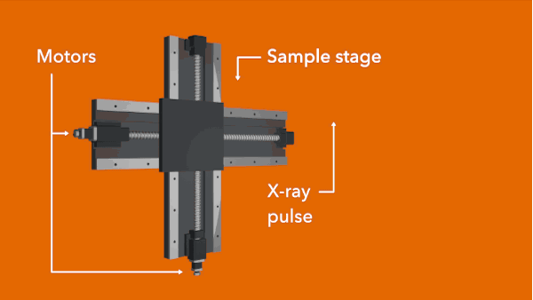

Developments at Diamond
Fixed target approaches
Acoustic Drop Ejection
(Primarily Robin Owen and coworkers)
(Primarily Allen Orville and coworkers)
Variable droplet size
Clean separation between samples
Heterogeneous and or large crystals sizes (up to 100 µm)
Variable delivery freq.
Variable belt speed
Flexible pump laser pulse schemes
Spectroscopic analysis possible
Time delay from seconds to fs
  Chip can potentially hold > 11,000 crystals
  Size of apertures chosen to match size of crystals
  Load by pipetting crystal slurry over the top
Both potentially offer high hit rates with low sample consumption.

Slide 21
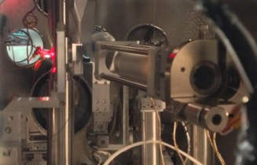

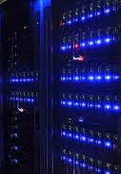



UK Hub at Diamond
- establishing an open XFEL user programme
Development of Sample delivery & Environments
High Performance Computing and Data curation
Facilitate access to XFELS/UK User Program for SFX
Software Developments for automated data analysis
Integrated Structural Biology Infrastructure @RAL
UK XFEL HuB
UK HuB
LCLS
SACLA
Users
EU-XFEL
Notes:
Facilitate access:
Fast track establishment of a UK XFEL user base
Establish links to operational XFELS
SACLA – Japan
LCLS - USA
Establish a Sample prep lab to allow pre-visit optimisation
Training and dissemination
Developments in sample hardware...
Development of Sample delivery solutions with SFX partners
Prototyping solutions
Exploit synergies between Diamond and xfels for sub-micron sample delivery
Minimize sample quantities
HPC:
Build on Diamond expertise in provision of automated data reduction and analysis pipelines for XFELS
Provide a tier 1 link between EXFEL and RAL with associated HPC hardware for data analysis and curation

Slide 22
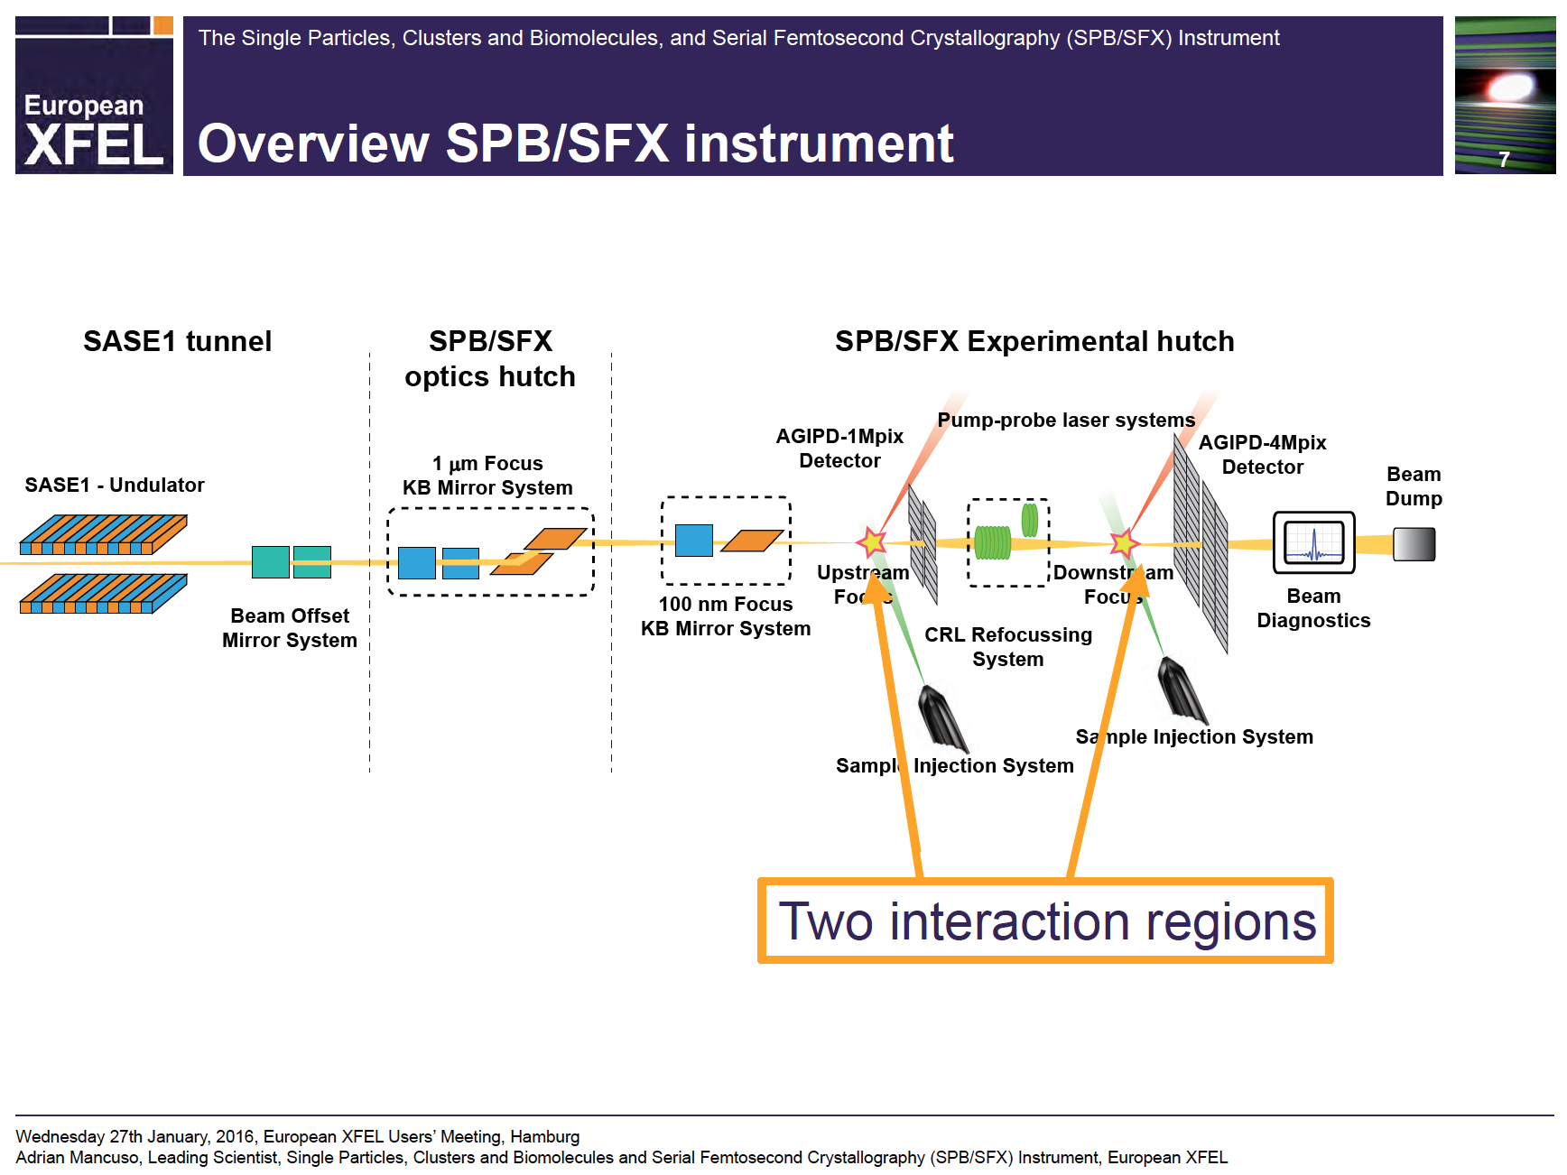
~1st - 2nd Q 2017 call for Upstream proposals →→ ~4th Q 2017 early expts.
SFX user
consortium
www.sfx-consortium.org
Upstream Interaction Region
user ops. ~ 2018
Single particle imaging
Serial femtosecond crystallography
Downstream Interaction Region
user ops. early 2019
Reuses X-ray beam
Serial femtosecond crystallography
Vacuum
Chamber
Vacuum
(and/or He) Chamber
User Operations:
Upstream early 2018; downstream early 2019
www.xfel.eu/research/instruments/spb_sfx
adapted from:

Slide 23
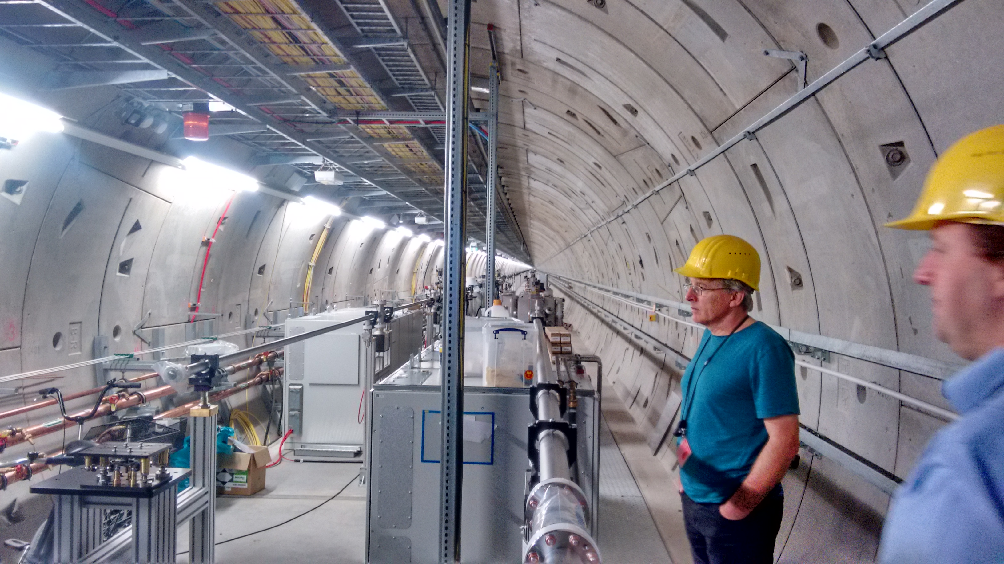
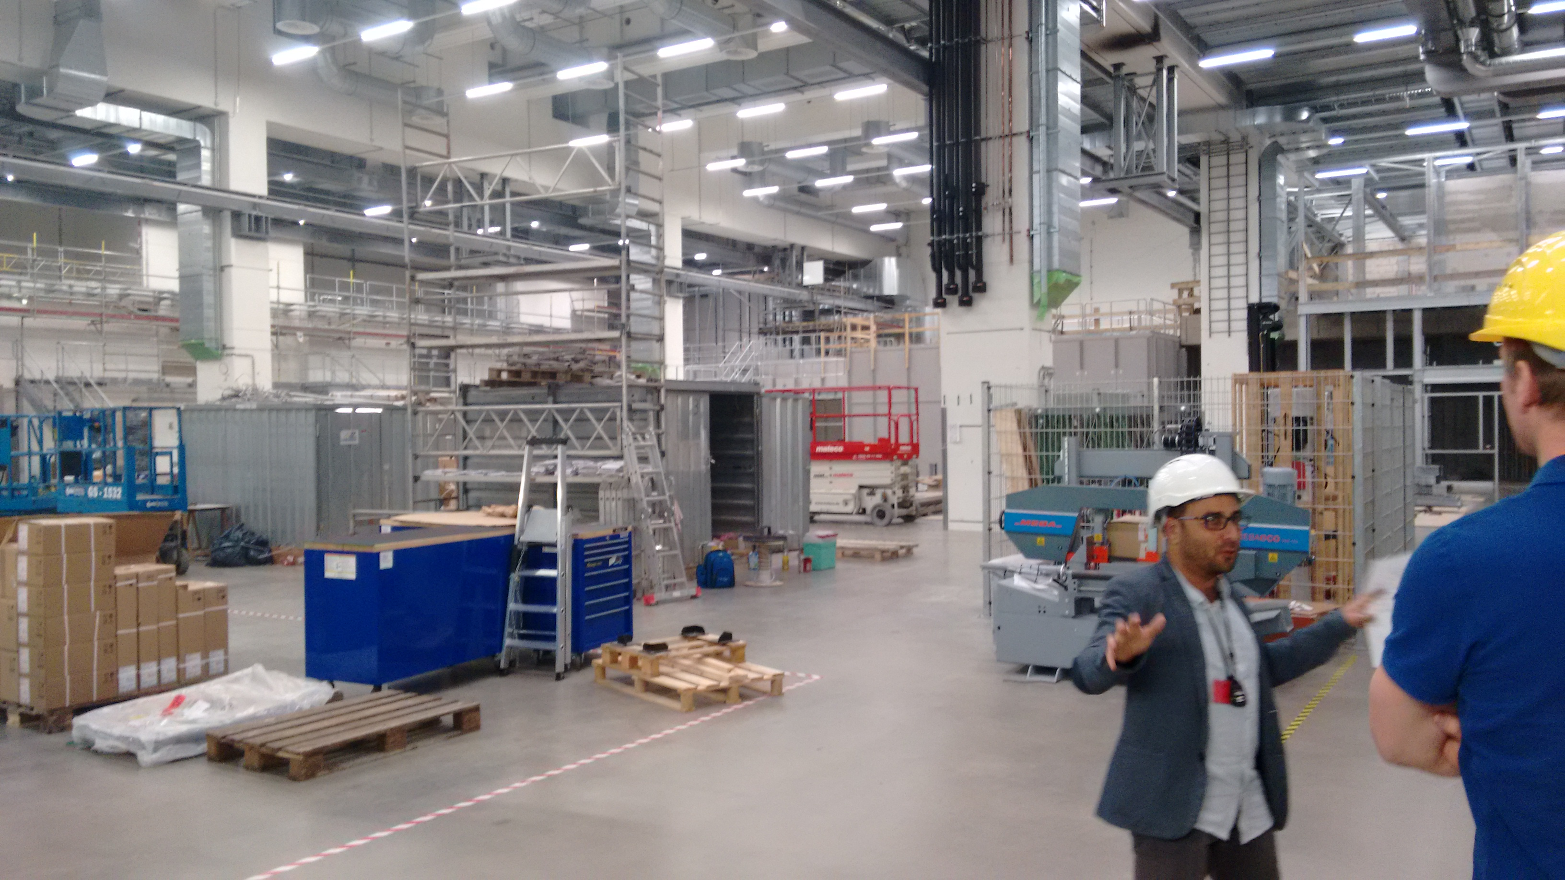
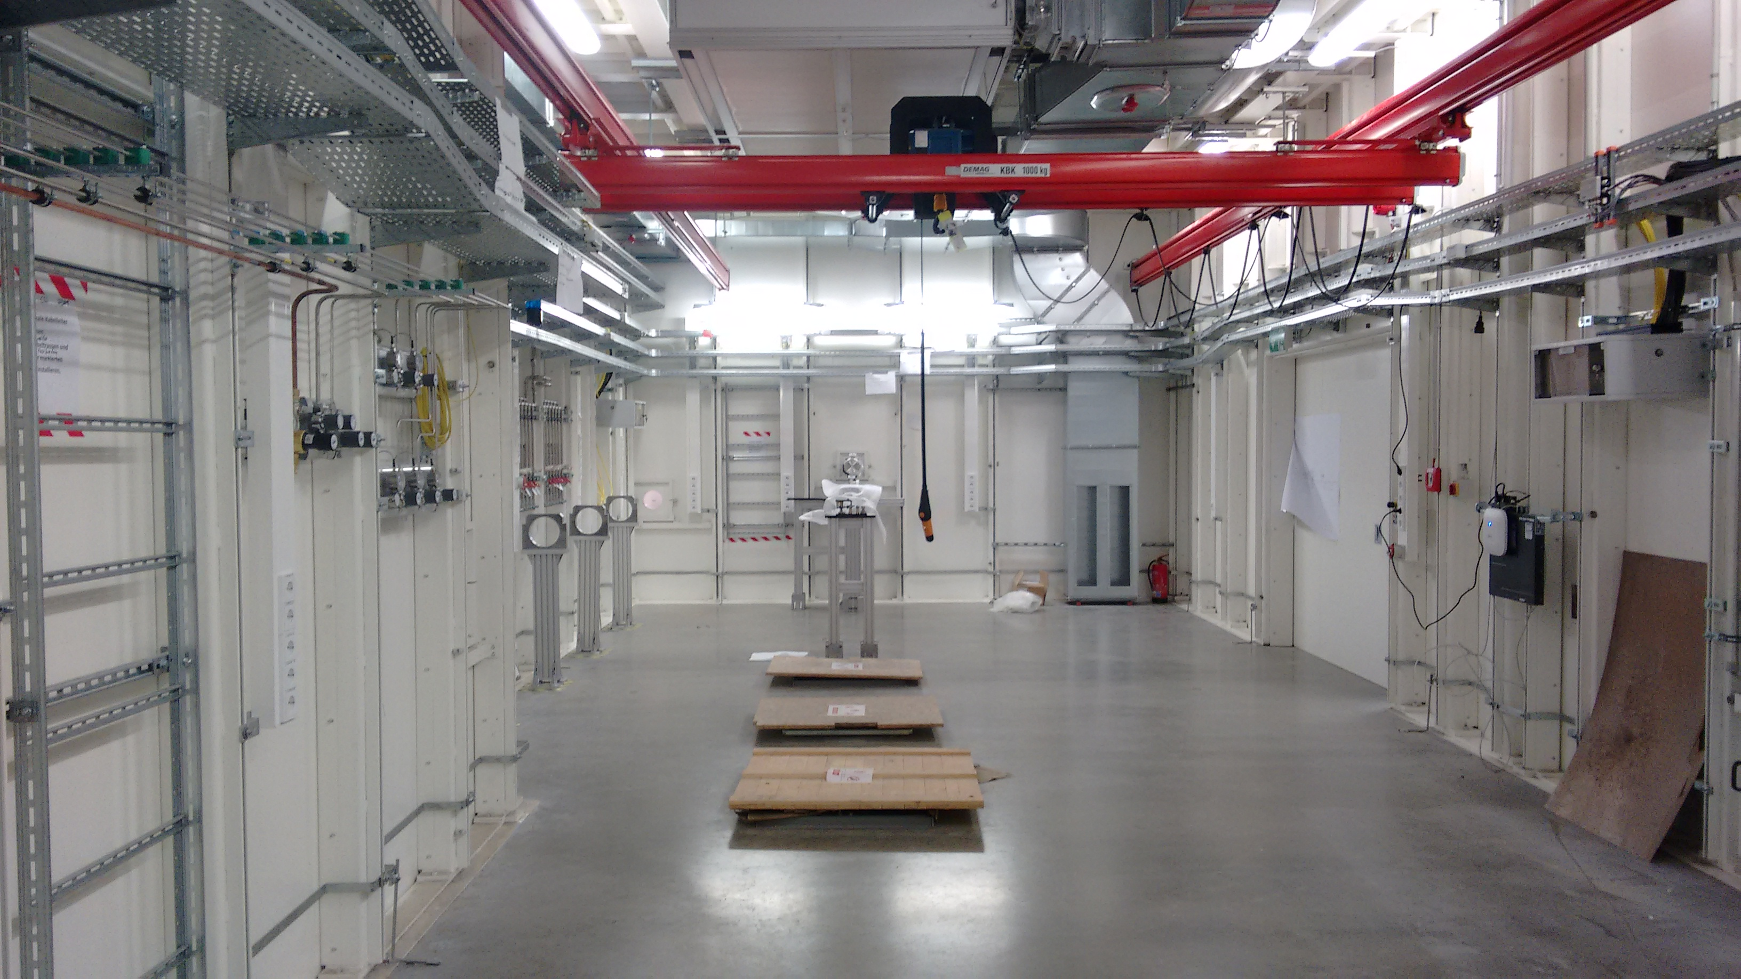
SFX/SPB at E-XFEL
2nd November 2016
Experiments hall
XFEL tunnel
Experimental hutch

Slide 24
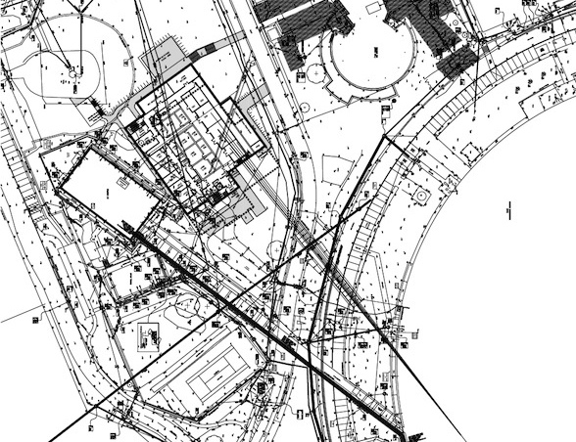




A National User Facility for
Biological Electron Cryo-microscopy (eBIC)
Funded by the Wellcome Trust, MRC and BBSRC at level of £15.6 M over 5 years
Wellcome Trust Strategic Award/MRC/BBSRC, applicants:
Helen Saibil, Kay Grünewald, David Stuart, Gerhard Materlik
The planned facility will include:
  4 high-end 300kV automated cryo EMs (Titan Krios FEI)
  200 keV automated feeder instrument (Talos Arctica)
  Cryo focussed ion beam instrument (SCIOS)
  Sample prep incl. vitreous sectioning
  Correlative fluorescence/EM
  FEI Polara @OPIC Oxford for CAT 3 samples

Slide 25
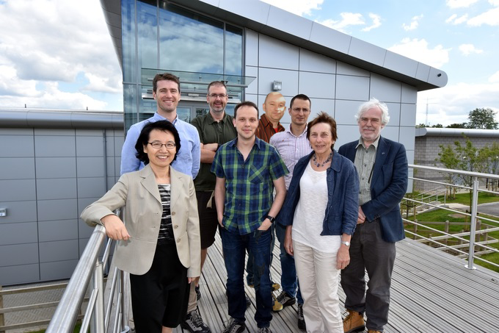
Aims
Establish state-of-the art facilities for single particle analysis and cryo-tomography
Provide cost-effective access, based on scientific excellence, to high-end Microscopes and auxillary equipment, incl. containment facilities at OPIC, Oxford
Run 24/7 aka synchrotron beamline supported by expert staff
Provide focus for future hardware/software developments
Grow and train user community – especially structural biologists and cell biologists with facilities advanced sample preparation
Retain cutting edge with strong in-house research program
Key part of vision for integrated approach to structural and cellular biology

Slide 26
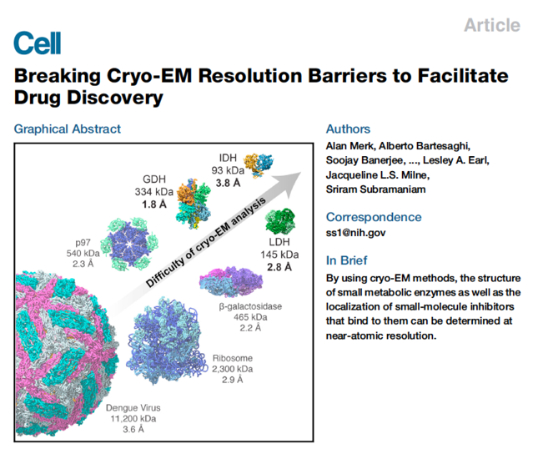
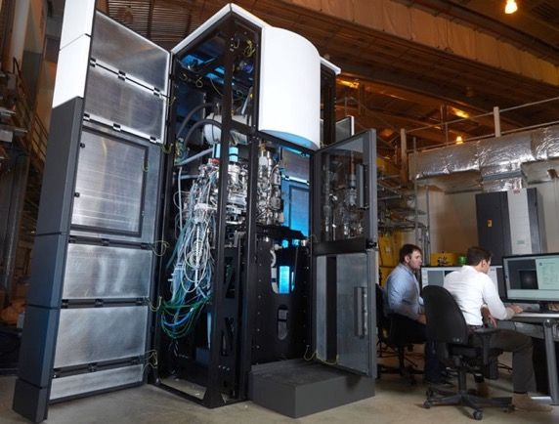
Cryo-EM & Cryo-Tomo
The resolution revolution
Single particle analysis requires similar high quality samples to X-ray crystallography
Massive advances in microscope, detectors (movies), software.
Still much to come with improved sample presentation, automation, hardware/software.
Already pretty efficient
(data output> MX beamline, computional demands circa 1000-fold more).

Slide 27
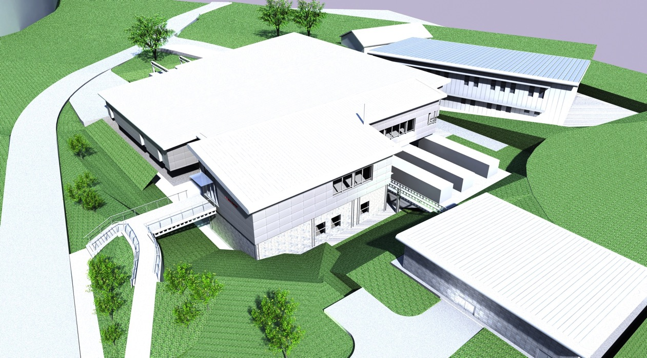
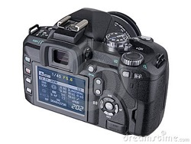
Electron Microscopy facility
Diamond
I13
I14 and EM Facility
Building Services
Restaurant
Notes:
As per slide 1 but animated with different views of the building.

Slide 28
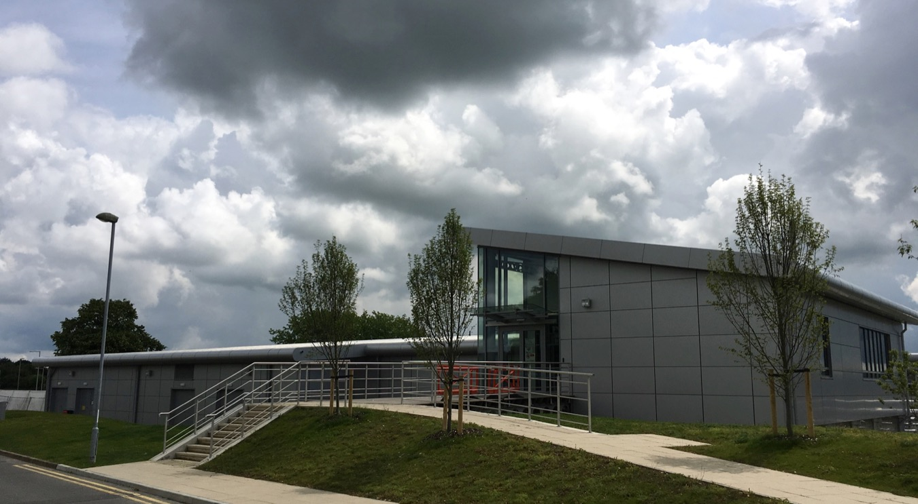
eBIC 16th June 2016

Slide 29
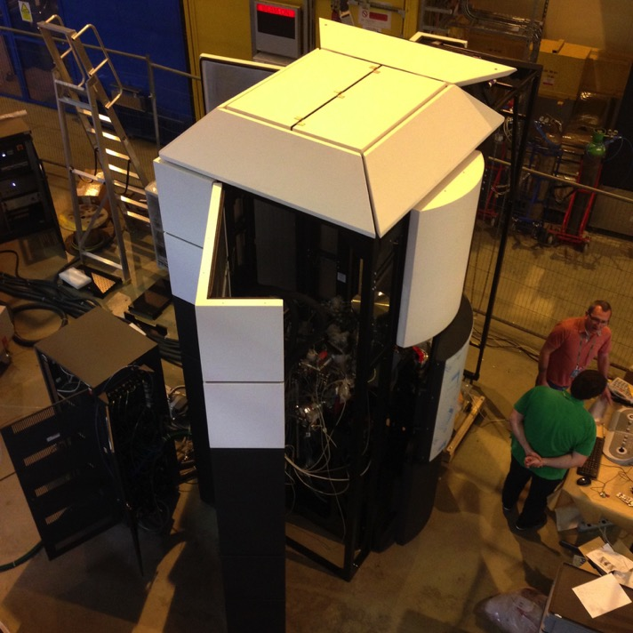
Krios I Diamond
Installation, on the Diamond hall floor, commenced 28th April 2015 (really like a beamline!)
2nd Titan krios microscope started user programme June 27th 2016
CL2 and CL3 work:
Polara with direct electron counting detector (K2 Gatan) available at Oxford Particle Imaging Centre OPIC
(http://www.opic.ox.ac.uk)
3rd Titan krios microscope arriving tomorrow!!!

Slide 30
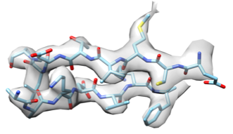
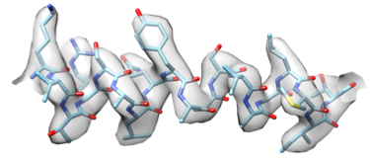
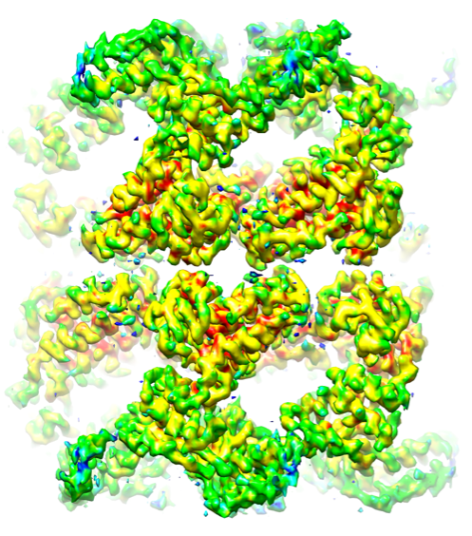
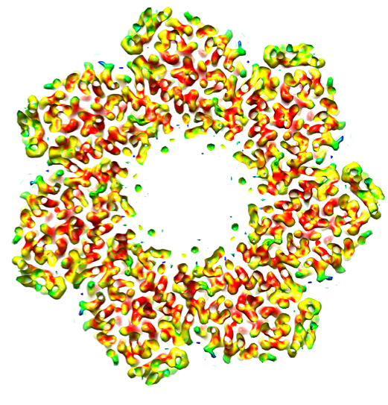
Commissioning automated: GroEL EPU-K2
17,500 particles
10 hours data collection
Average resolution 3.2 Å processed with Relion
Dan Clare Diamond, Sonja Welsch FEI

Slide 31
EM Data Collection at Diamond
As of the 23/11/16 - 152 external visits, 69 unique, 450 TB of data generated
Averaging just over 2TB/ 48 hr session with the Falcon II direct electron detector – single particle only
The first facility in the world to have the bioquantum-K2 Summit detector integrated with EPU and averaging 2.4 Tb/ 48 hr session
Multiple ~3Å reconstructions comprising multiple submitted/accepted manuscripts.
At least Three reconstructions at better than 3Å

Slide 32
First External Users Papers Published

Slide 33
Towards Integration at Diamond/RAL
Diamond Beamlines:
Macromolecular Crystallography, Scattering, X-ray spectroscopy
XFEL - UK Hub@Diamond
Rosalind Franklin Institute
Screening
(SGC)
Computational environment / CCP4
Cell Biology
MRC
OPPF-UK
MPL
RC@H
X-ray imaging.
CCP EM
Fluorescence microscopy
(CLF(STFC & DLS)
Cryo-EM/ET
eBIC

Slide 34
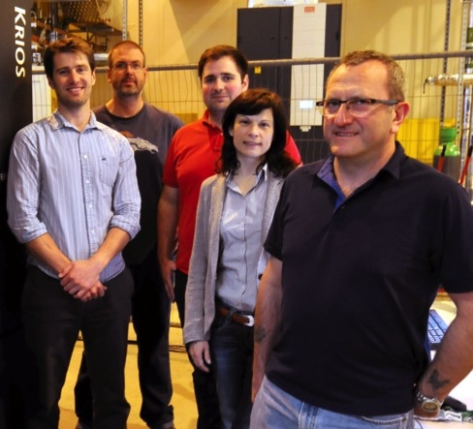
eBIC People
eBIC EM Scientists:
  Alistair Siebert, Dan Clare and Corey Hecksel.
  FEI installation and application support team:
    Alan Boswell, Alex Buzduga, Sonja Welsch, Felix de Haas, Sacha de Carlo
  Diamond light source staff:
  Jean Lane, Alun Ashton, Nick Rees, Michelle Bennett, Alison Roblin and many others…
Gatan Installation:
  Liam Spillane.
eBIC management:
  Dave Stuart, Kay Grünewald, Helen Saibil & Martin Walsh.
Alistair Siebert, Dan Clare, Alex Buzduga, Sonja Welsch, Alan Boswell

Slide 35
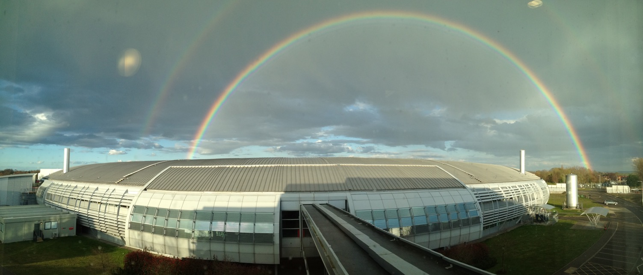
Thanks for your attention!

