Slide 1


Slide 2
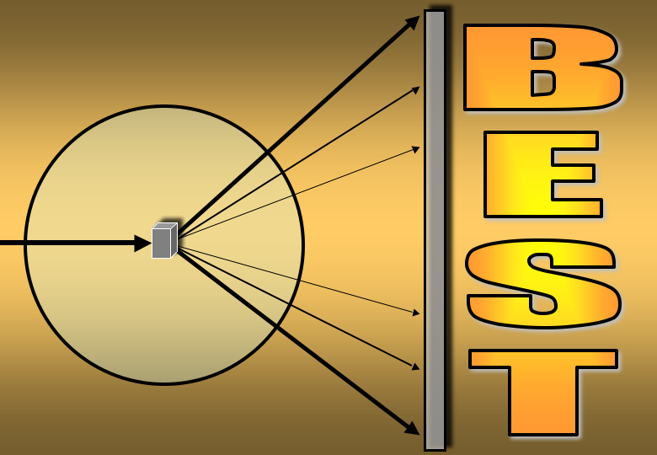
BEST a program for optimal planning of X-ray data collection from protein crystals
Alexander Popov
ESRF, MX group

Slide 3
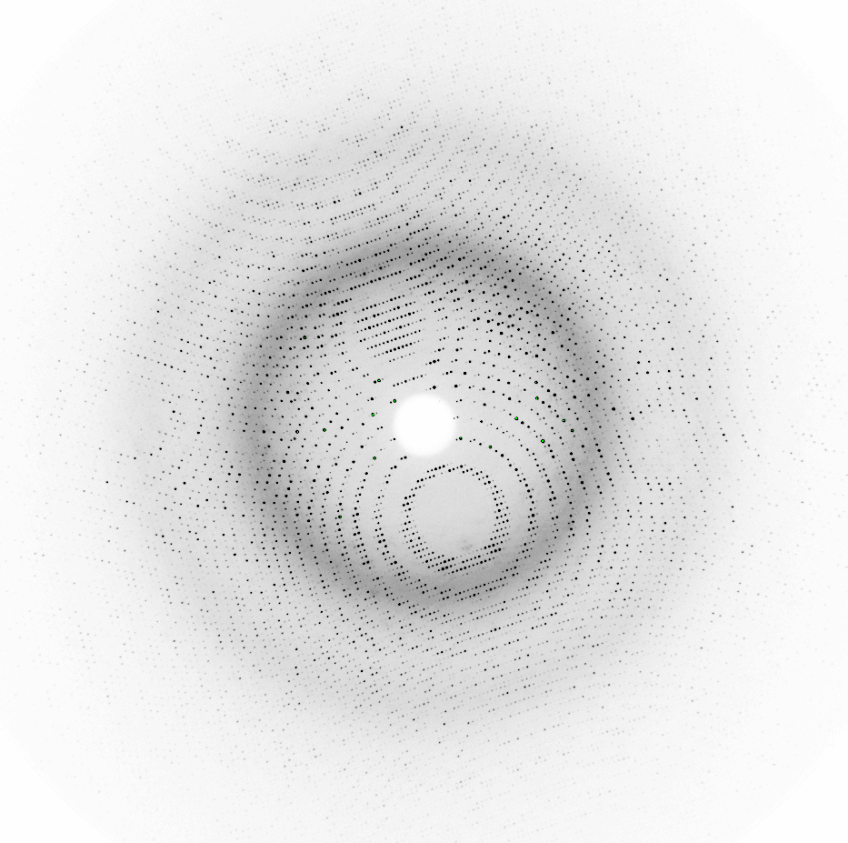
Ω = 90°
Initial Images
MOSFLM XDS
Space group, Cell parameters, Orientation, Mosaicity
I(h,k,l), I_{background}
BEST
Geometry
Optimal starting spindle angle and scan range
Maximum rotation angle without spot overlap
Optimal Multiplicity
Statistics calculation
Reconstruction of average intensity vs. resolution
Statistics modeling based on Wilson distribution
Radiation damage modeling
Optimal plan(s) of data collection

Slide 4
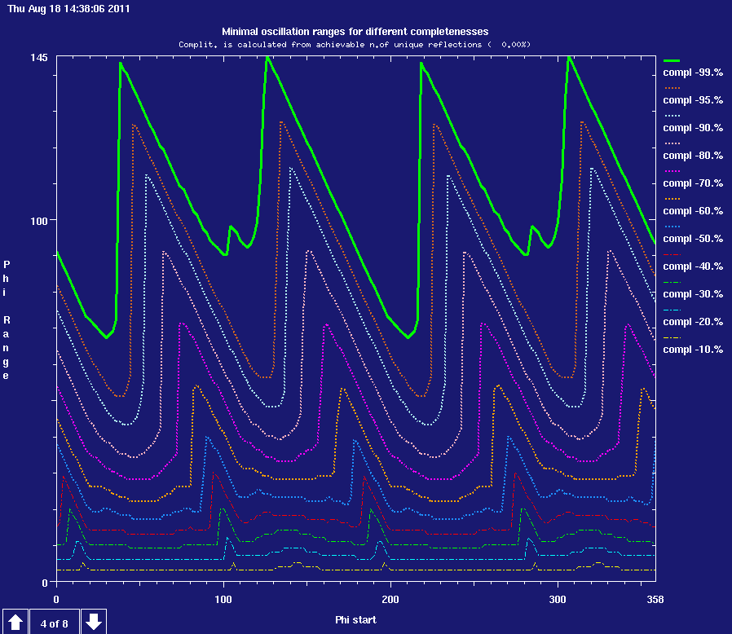
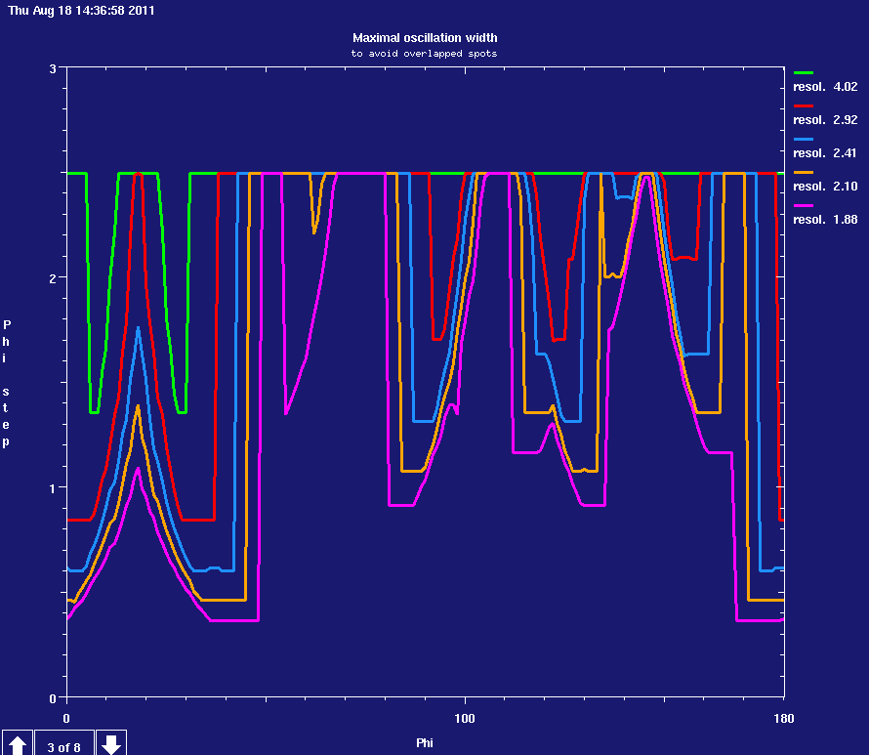

GEOMETRY
Space group, Cell parameters, Orientation, Mosaicity, Spot Size
Optimal starting spindle angle and scan range
Maximum rotation angle without spot overlap

Slide 5
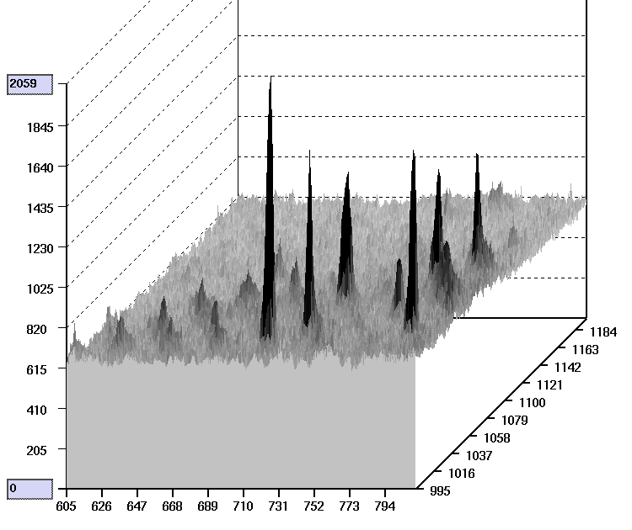
DATA STATISTICS
Main uncertainties of the observed intensities are determined
by counting statistics
I_{p}
I_{b}
I_{p}
I_{b}

Slide 6
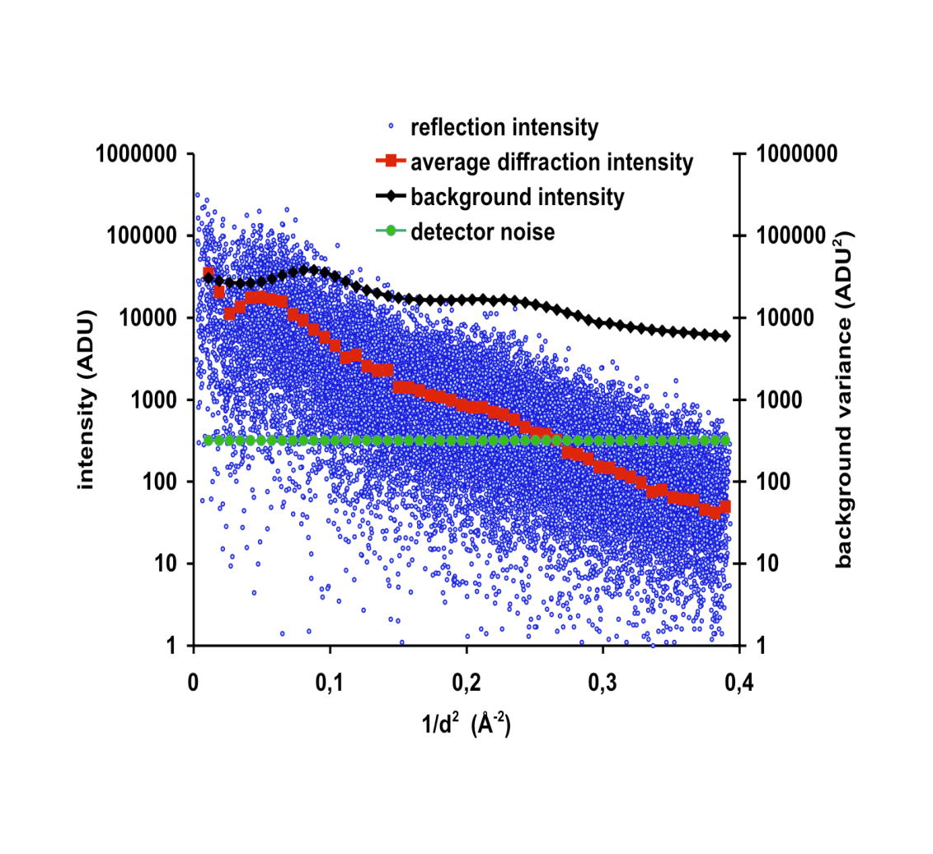
Statistics

Slide 7
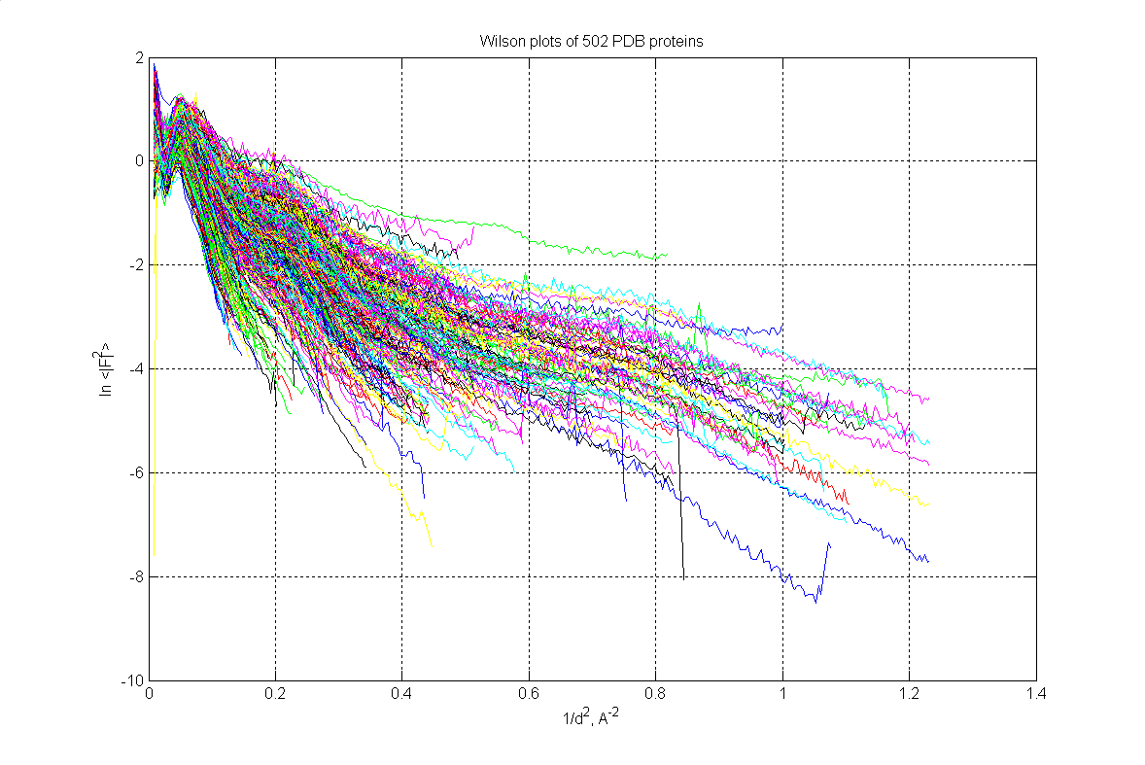
Wilson plot

Slide 8
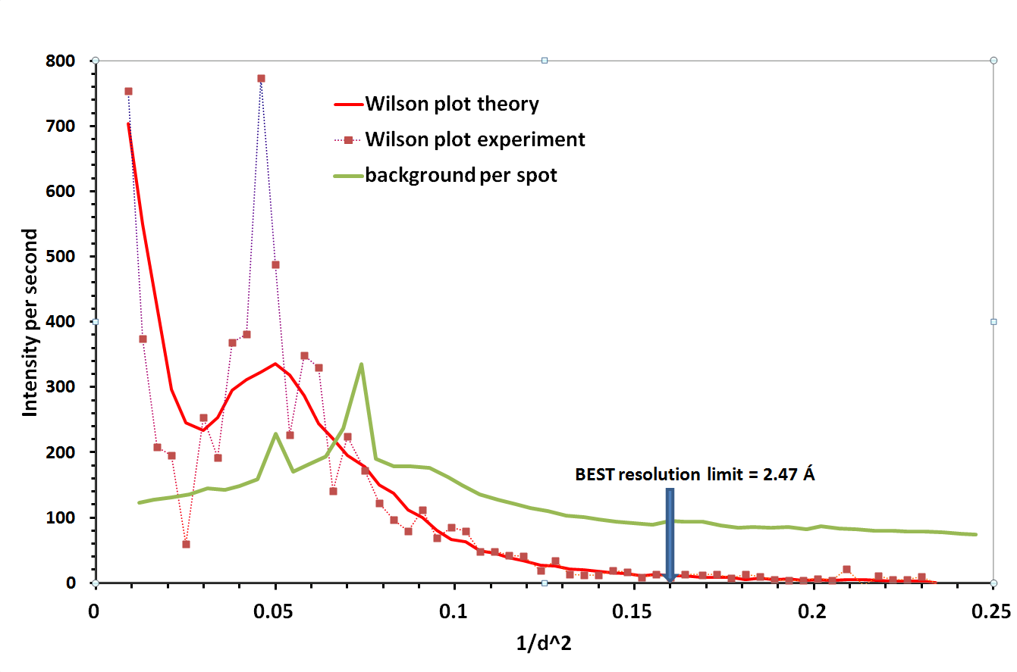

Slide 9
Intensity decay:

Slide 10
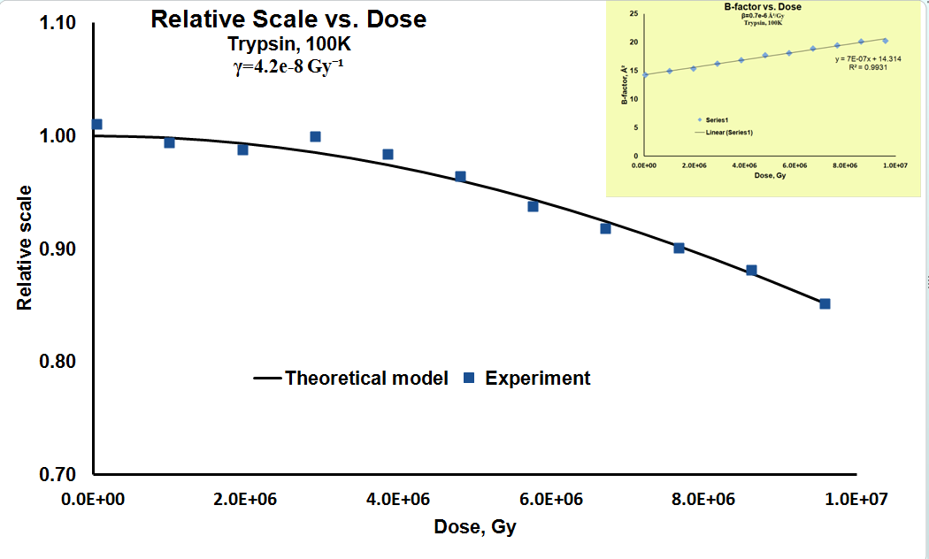
Global radiation damage

Slide 12
Basic ideas of BEST
Semi-empirical model for diffraction intensity vs reciprocal space coordinate
Semi-empirical model of variance vs integrated intensity
σ²_{І}(J)=k_{o}+k₁J+k₂J²
Integration over the scanned reciprocal space using Wilson distribution
Radiation-damage model
Resolution-dependent intensity decay:
Notes:
Some years ago we together with Sasha have written a program, that felt into category of so-called “data collection strategy” programs,
Of which there are many, but it has an important – from our point of view – charateristic that it does not consider only the completeness
Of indices , but fairly all the parameters you can consider in the idealized experiment from the point of view of the signal-to-noise ration.
Starting from relatively simple-minded assumption that one can approxinmate the variance in integrate intrensity by a quadratic function
Of the intennsity itself – whether on speaks about integrating the Bragg peak or background
The software basically in that form with some minor modifications over time became quite usefull and fairly widely
Accepted – for instance it is a data collection planning or “strategy” module in both automated data collection systems
Now – DNA in europe and Blueice in US. But

Slide 13
Expected Intensity Variation
<σ/I>
<I_{D}>/ <I_{o}>
R_{1I}
Dose [Gy] , d=2.5 Å
SAD
Notes:
Here we fix the decay parameters at expected values and resolution at 2.5 angstroem, and look how different contributions to data statistics will change with the dose. This is a falloff in intensity we expect. This what happens to the contribition of counting statistics to the data accuracy – if plan our data collection for I over sigma of 2 in the last shell, and continue measuring using constant exposure time, then far bellow the Henderson limit of 2x10to7 there will alrady be no data in the last shell at all. At the same time, the errors due to non-isomorphism will remain at a comparatively negligible level up to much higher doses. By properly planing the data collection we can modify the behaivior of this curve – ideally to make it constant. This contribution becomes important if we want to collect very accurate data, and we can not affect it in any other way except lowering the dose. For instance, the chart tells us that the whole dose resrve for MAD or SAD experiment is an order of magnitude lower if we whant to keep non-isomorphism bellow resonable 5-10%, and this corresponds to only about 10-15% intensity change – in a reasonable agreement with what experienced crystallographer would quote as a tolerable decay in such experiment. Thought here the situation is more complicated and correlation between these contribution to the bijvoet pairs must be taken into account.

Slide 14
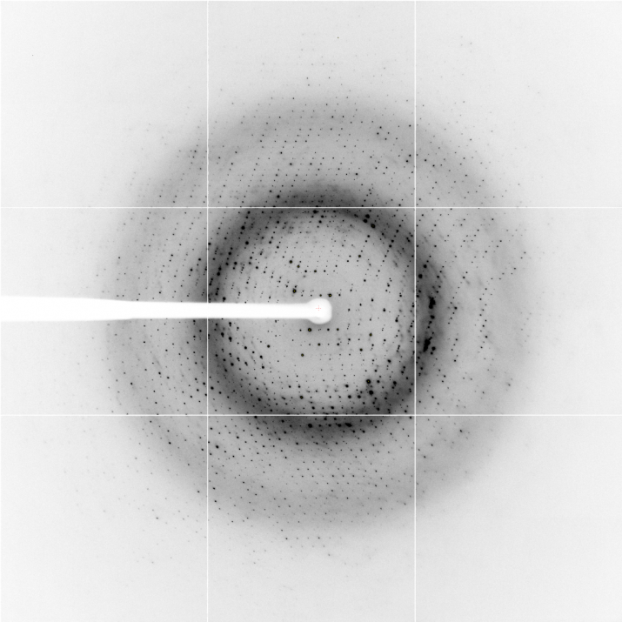
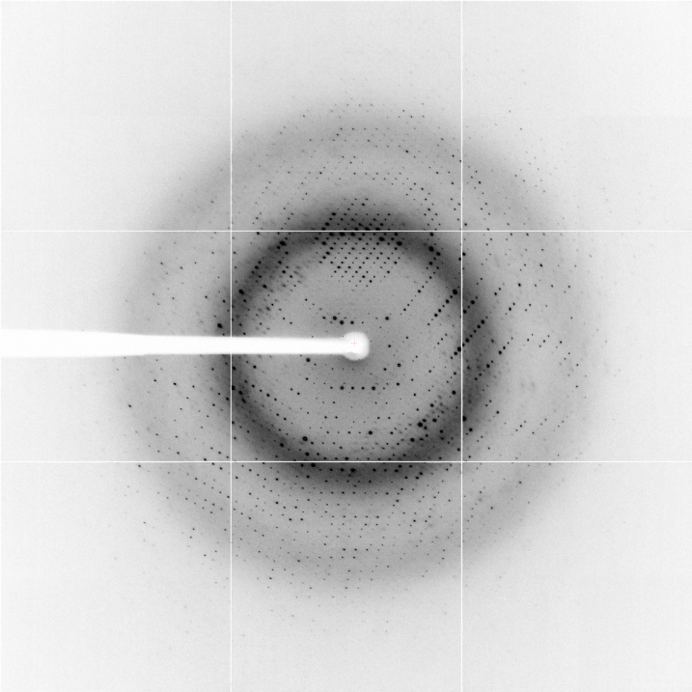
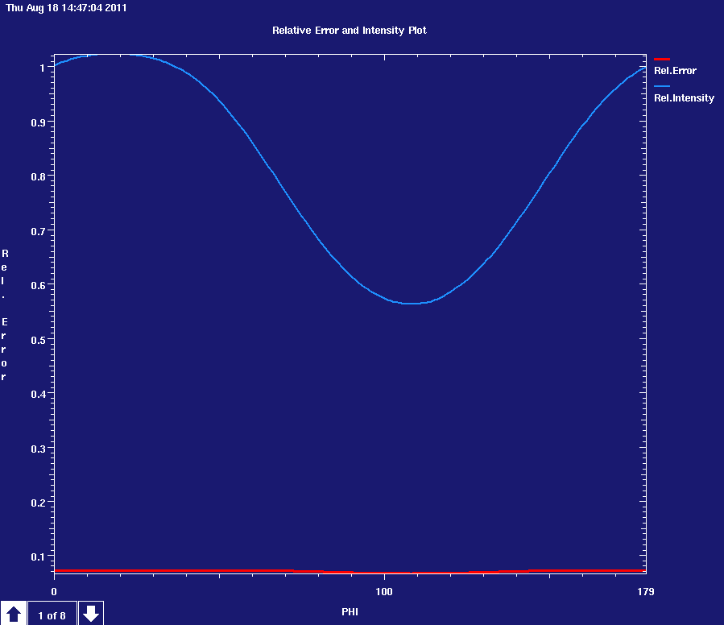
Intensity Anisotropy
φ=0º
φ=90º
Intensity vs. crystal position

Slide 15
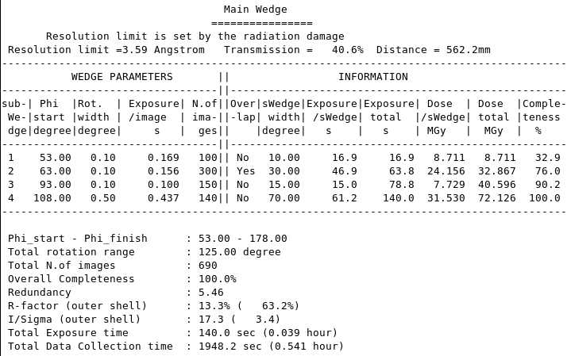

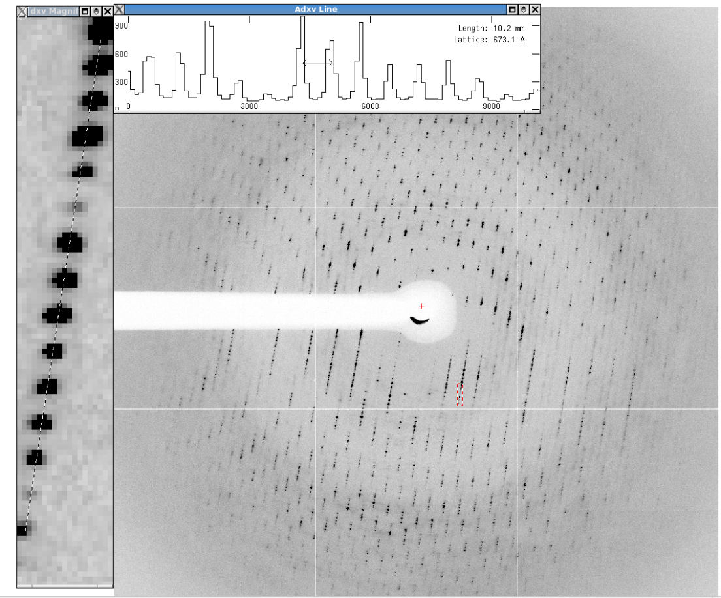
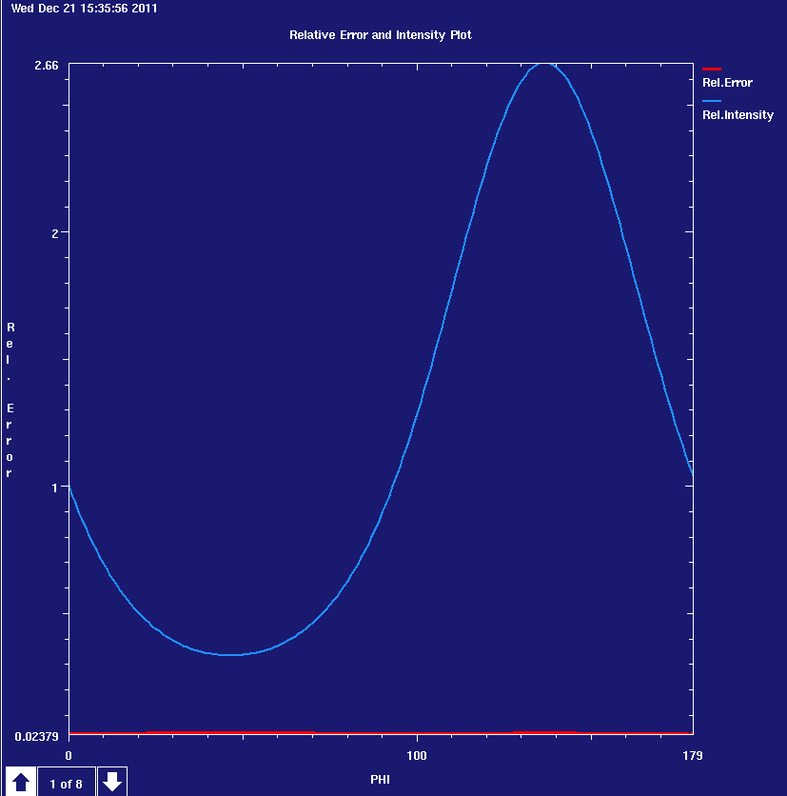


Slide 16
Optimal Oscillation Range

Slide 17
Data collection strategy accounting radiation damage
Crystal shape and size
Beam profile and size
User choices
Beamline Flux
Crystal contents
Initial Images
Optimize data collection
Optimize SAD data collection
Find optimal crystal orientation
Low-resolution optimal
Rad. Damage sensitivity
Multi-positional data collection
Helical data collection
Estimate data statistics
MOSFLM XDS
RADDOSE
Absorbed dose rate
Dose (Time) limit
Geometry limits
Aimed statistics
Aimed completeness
Aimed redundancy
Aimed resolution
Detector parameters
Beamline parameters and limitations
BEST 4.1
Optimal plan(s) of data collection
Statistics
B-factor

Slide 18
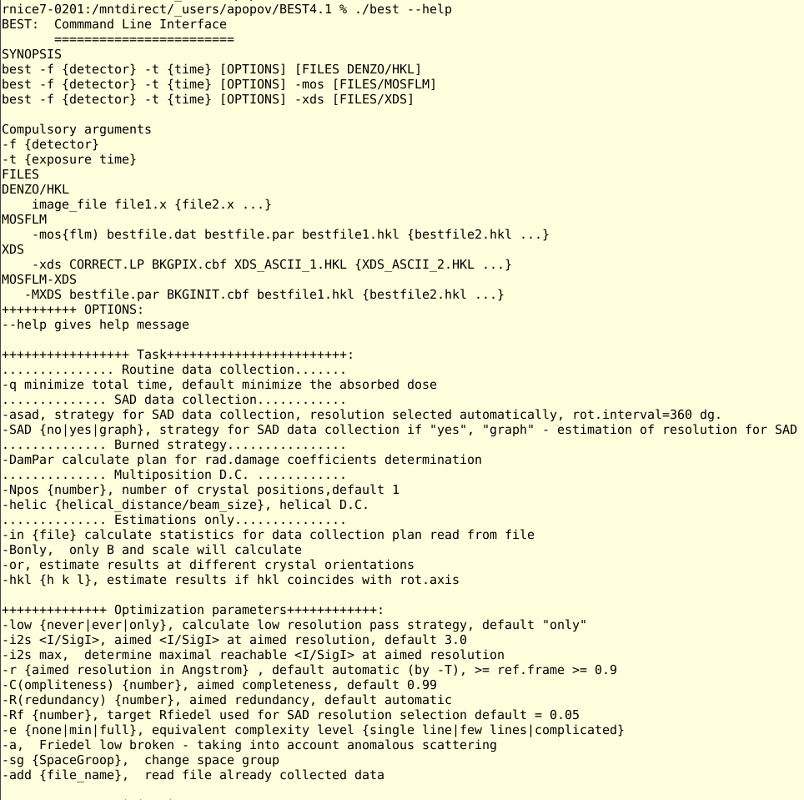

Slide 19
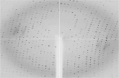
EDNA characterisation v1.3
A workflow written in Python
+ Xtal info
+ beam flux
+ diffraction plan
LABELIT
DISTL
MOSLFM
indexing
Indexing
Evaluation
Ok
Failure
MOSFLM
Predictions
MOSFLM
integration
XDS backg.
estimation
LABELIT
indexing
Ok
[RADDOSE]
Indexing
Evaluation
BEST
Failure
Data collection plan

Slide 20
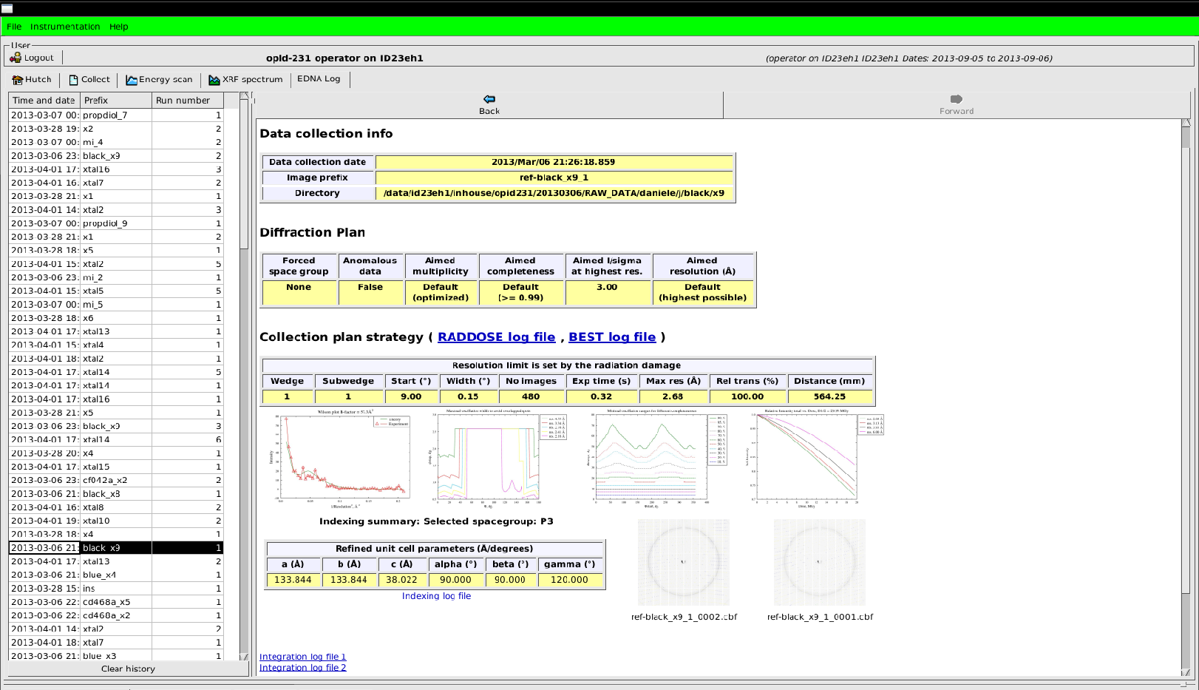
EDNA
20
Notes:
20

Slide 21
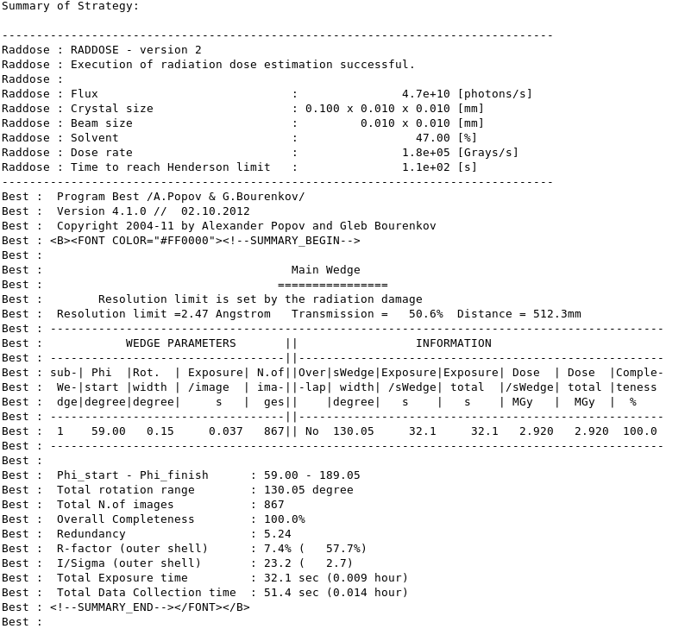
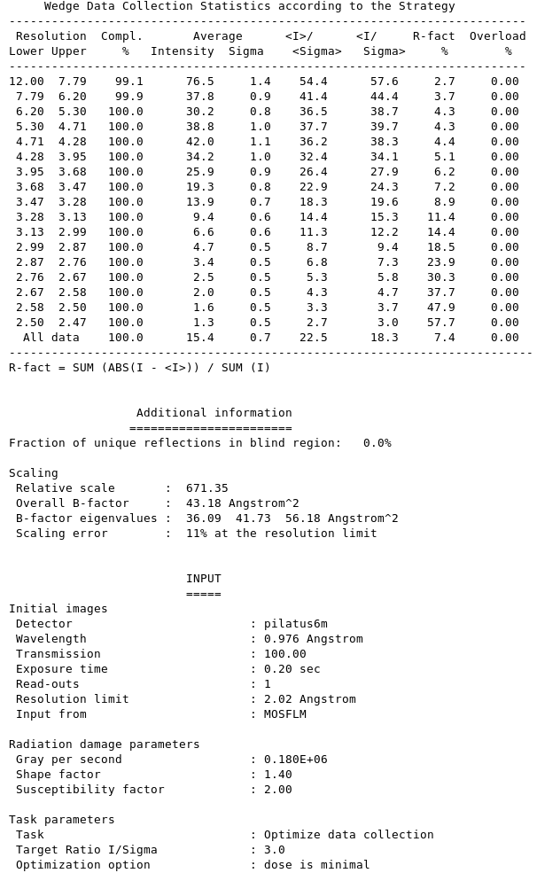

Slide 22
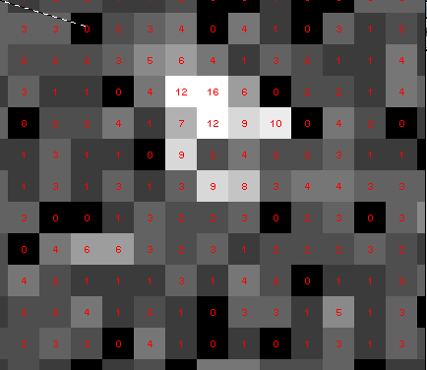
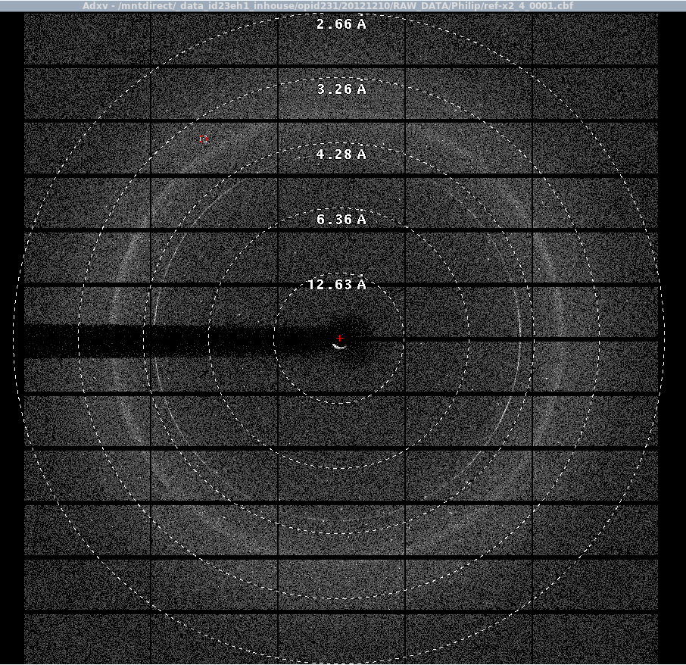
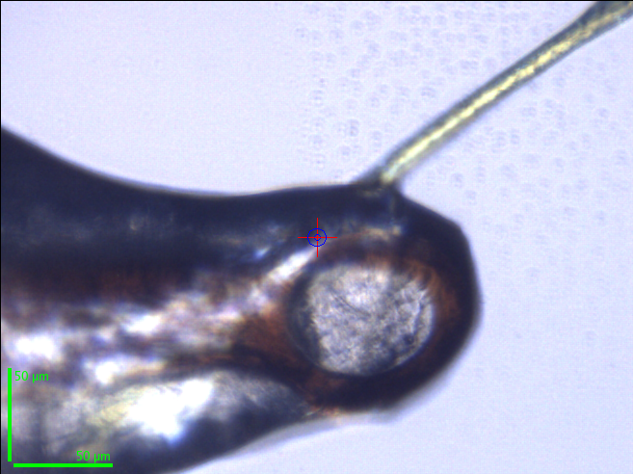
............... Routine data collection.......
-q minimize total time, default minimize the absorbed dose
cyan fluorescent protein

Slide 23
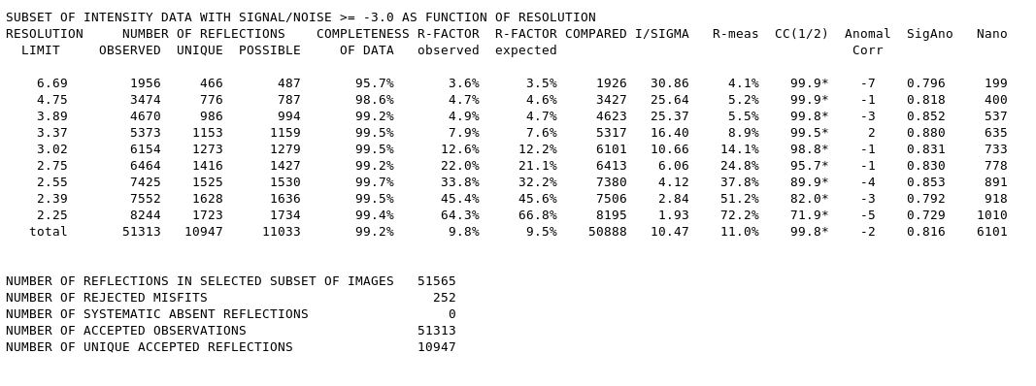
BEST prediction
XDS

Slide 24
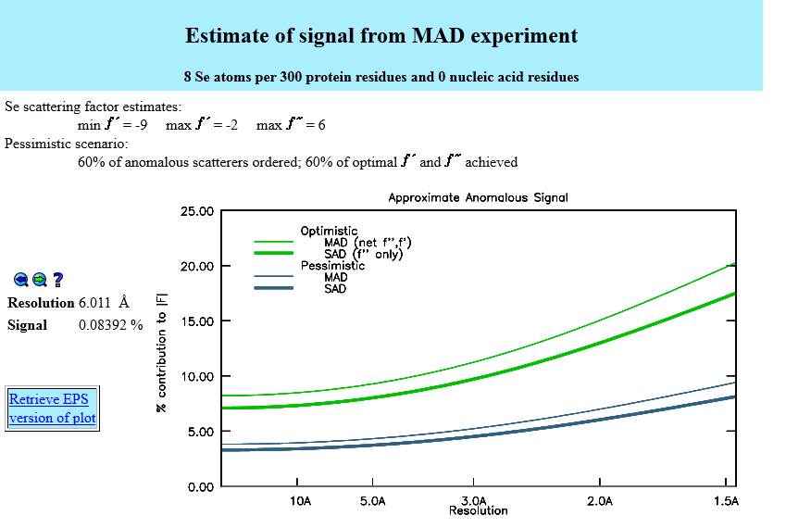
SAD optimization
.............. SAD data collection............
-asad, strategy for SAD data collection, resolution selected automatically,rot.interval=360 dg.
-SAD {no|yes|graph}, strategy for SAD data collection if "yes", "graph" - estimation of resolution for SAD
Minimum of RFriedel = <|<E2+/w>-<E2-/w>|> is a target
noise only, no anomalous scattering itself:
decay, non-isomorphism
exact pair-vice dose differences for Bijvoet mates
http://skuld.bmsc.washington.edu/cgi-bin/MAD_power.pl
---------------------------------------------
Resolution RFriedel(%) I/Sigma Redundancy
---------------------------------------------
10.12 0.8 74.1 23.7
6.90 0.8 43.6 23.7
5.34 1.1 48.4 23.0
4.51 1.2 47.5 23.5
3.98 1.6 34.5 20.6
3.60 2.5 22.4 13.9
3.31 4.0 14.0 11.9
3.08 6.6 8.3 7.0
2.89 10.5 5.2 6.1
2.73 15.6 3.7 2.5
2.60 23.0 2.4 3.8
----------------------------------------------------------------------

Slide 25
SAD optimization
Minimum of R_{Friedel} = <|<E²⁺> - <E²⁻>|> is a target
Dose>30 MGy
Garman limit
Dose>2 MGy
site-specific damage processes the radiation damage may start affecting anomalous signal

Slide 26
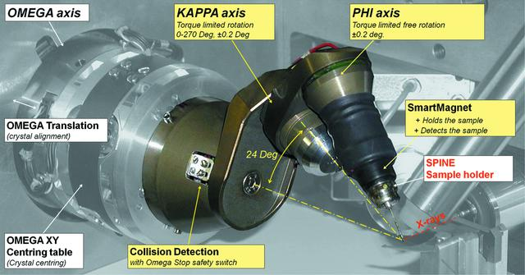
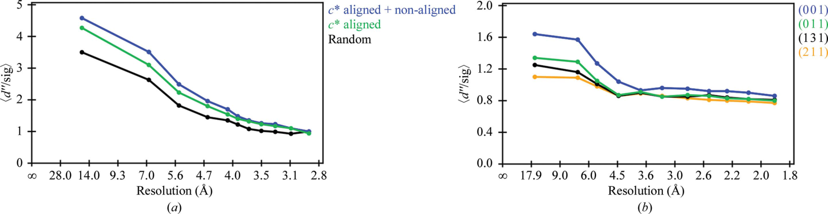
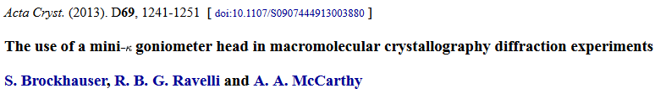
Kappa goniostat re-orientation

Slide 27
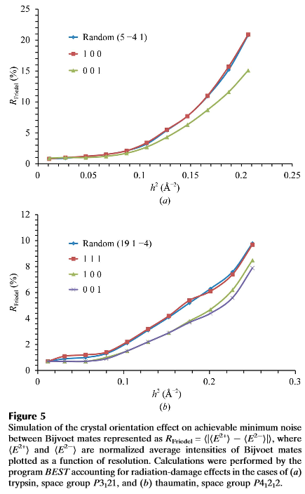
Kappa goniostat re-orientation

Slide 28
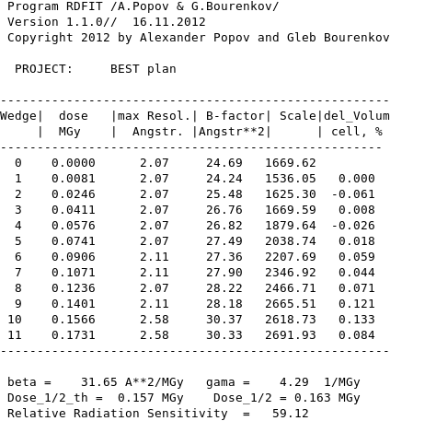
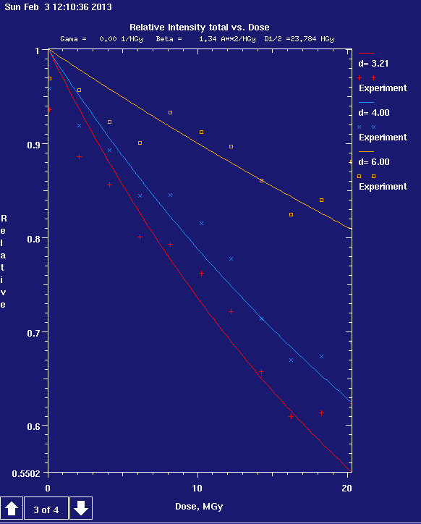
Induced Burn Strategy
Beamline Flux
Crystal contents
Crystal sizes
Initial Images
User
RADDOSE
MOSFLM XDS
Rad. Damage sensitivity
Absorbed dose rate
BEST
Plan of data collection
Minimal RD inside the testing cycles
Must induce significant changes in Intensity
The intensity measurements remain statistically significant up to the last cycle of data collection
11 cycles for testing
10 cycles for burning
Measurements
XDS auto
RDFIT

Slide 29
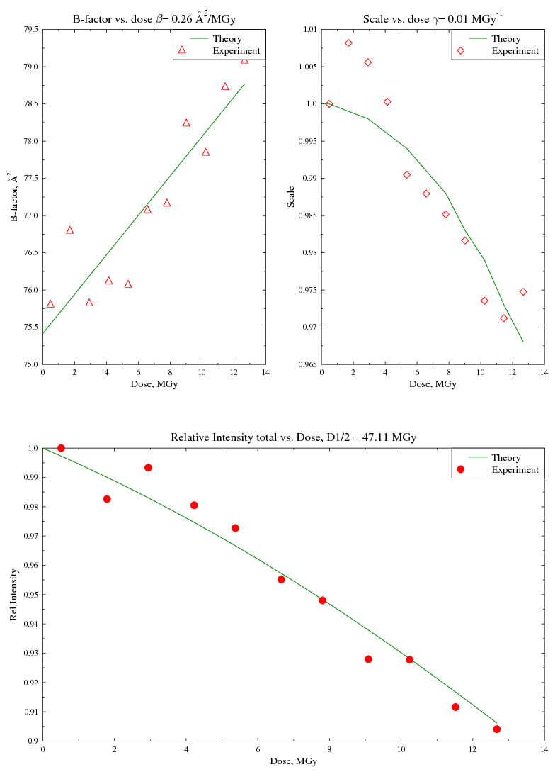
Example results from ”burning strategy”

Slide 30
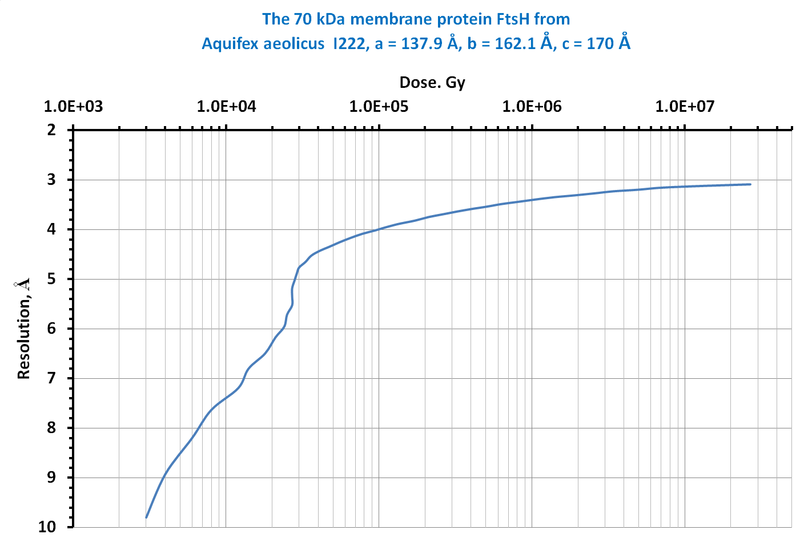
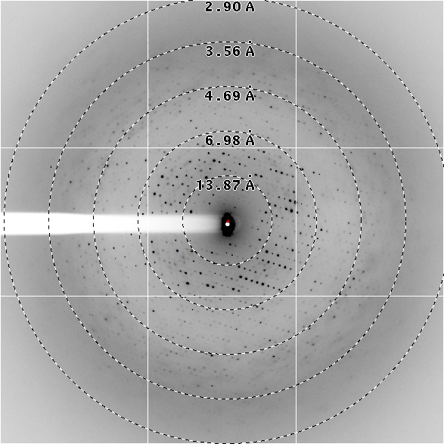

Slide 31
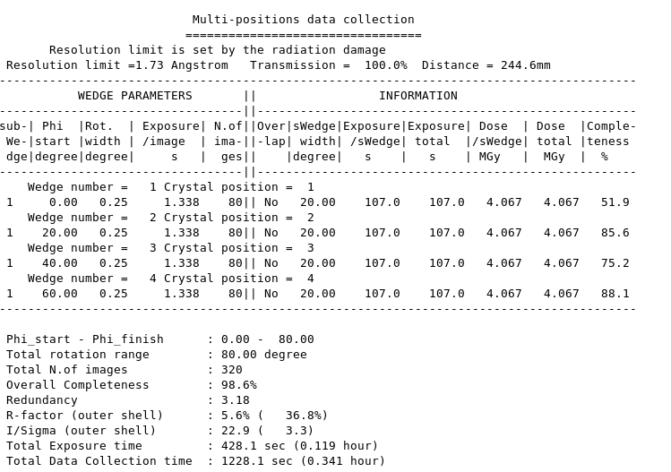
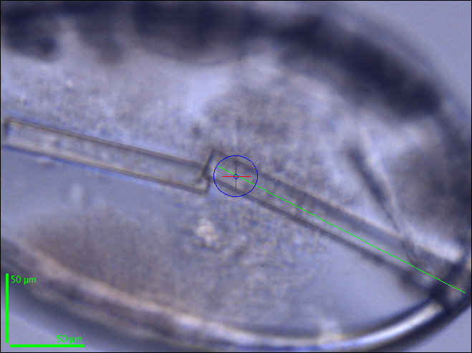
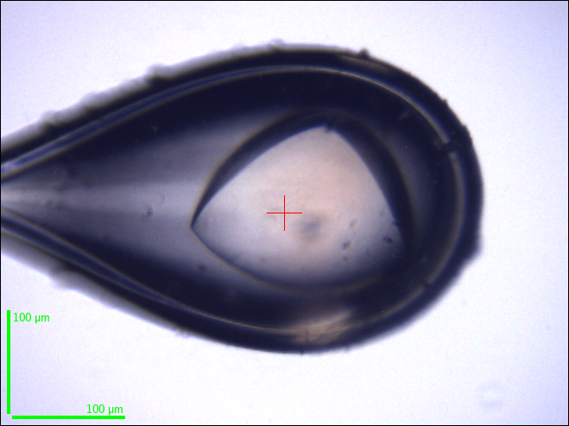
Multi-positional or helical data collection
FAE crystals
ID23-1
E=12.75Kev, I=35 mA, Aperture=0.03 mm
Flux=1.5x10¹¹ Photon/sec
FAE2 – 5 positions
The 70 kDa membrane protein FtsH from
Aquifex aeolicus I222, a = 137.9, b = 162.1, c = 170

Slide 32
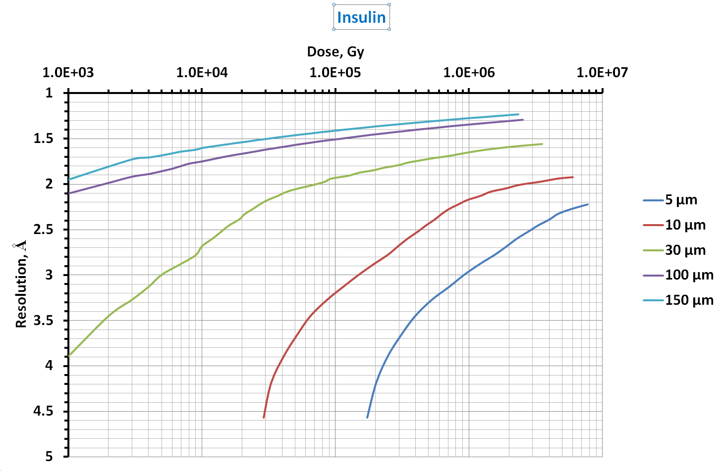
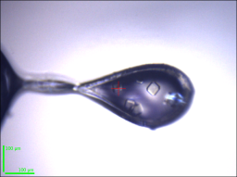
Diffraction resolution vs. absorbed dose for different crystal size
150 µm
100 µm
30 µm
10 µm
5 µm
B-factor=16 Á²
completeness =100%
Rot.range=26°

Slide 33
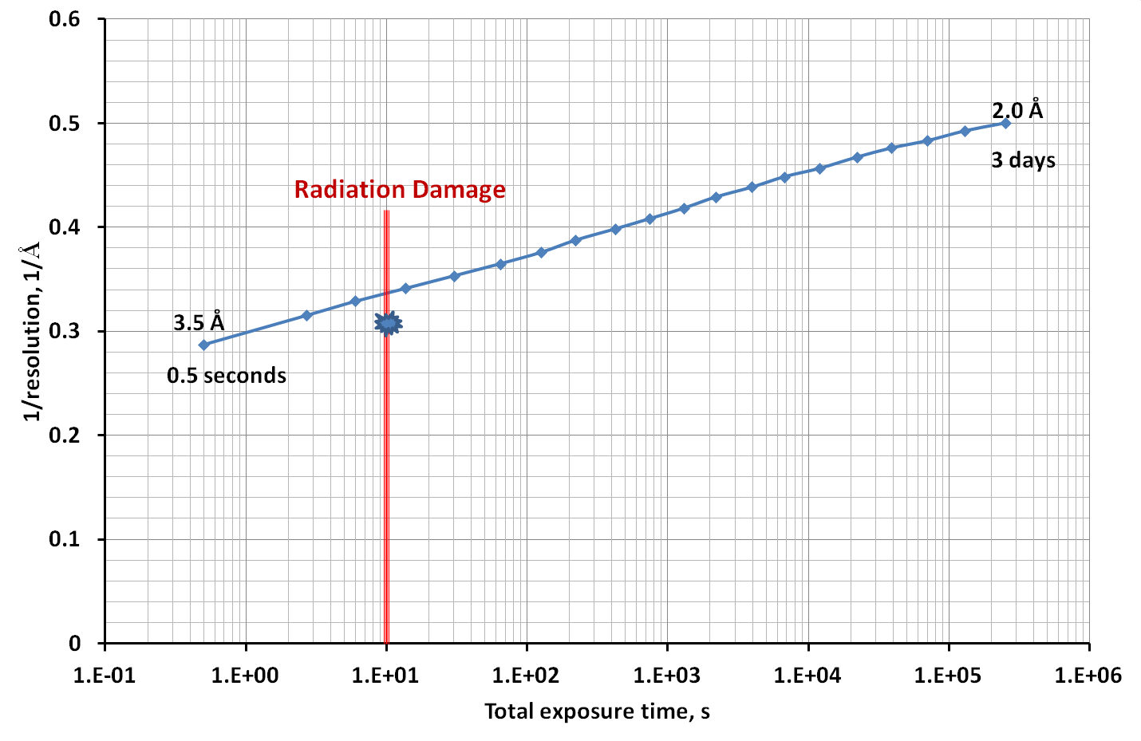
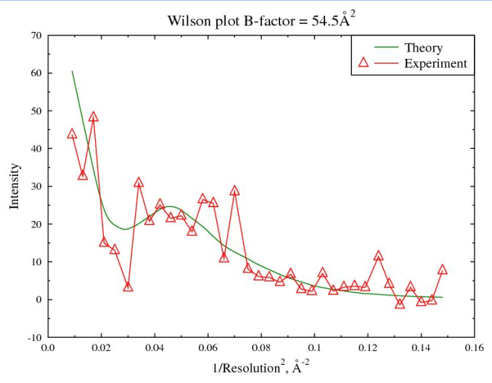
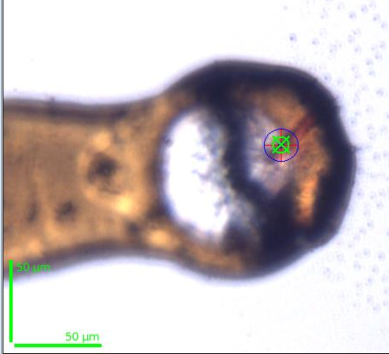
Resolution vs. Total exposure
BEST estimations, No radiation damage
Or 25000 crystals
Macrhodopsin
ID23-1,
Aperture 20
Flux =4.7e+11 [photons/s]
Dose rate =0.5 Mgy/s

Slide 35
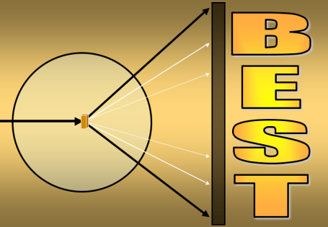
Two-dimension DC
Test image(s)
X-ray
Already collected data
MOSFLM XDS
Space group, Cell parameters, Orientation
Number of crystals
Data Collection Strategy
Data Collection
Auto Processing

Slide 36
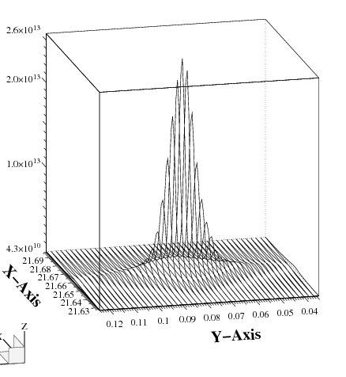

Beam profile effects
time (s)
fast decay in the
beam center
Log(I(t))
slow decay at the tails
ID23-2, 7e10 ph/s, trypsin, thin resolution shell [1.2 Å]

Slide 37
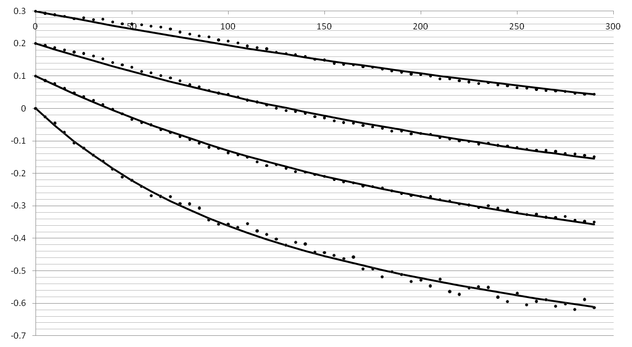


1st order model convolved with the beam profile
t (sec)
d= 3.6 Å
d= 2.4 Å
measured with a 5 µm pinhole
1 fit parameter per data set, in all resolution shells : β = 0.88 Å²/MGy
1st order rate equation, no intermediates
Log(I(h,t))
d= 1.8 Å
d= 1.2 Å
ID23-2, 7e10 ph/s, trypsin

Slide 38
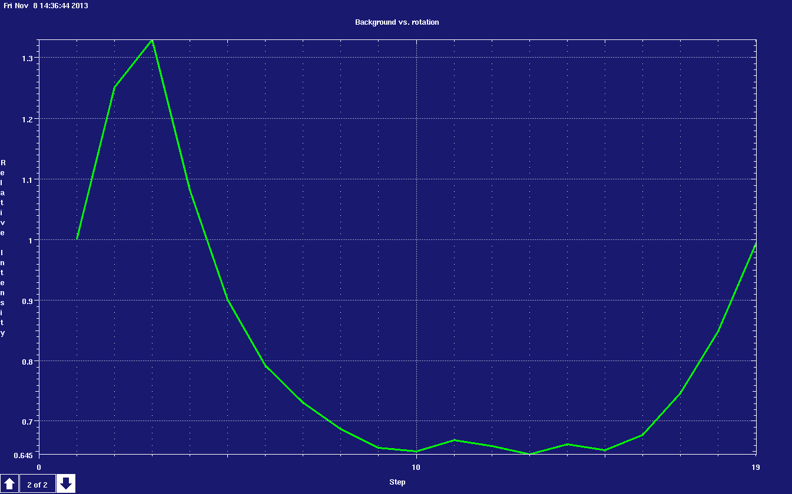
Background vs. Crystal position

Slide 40
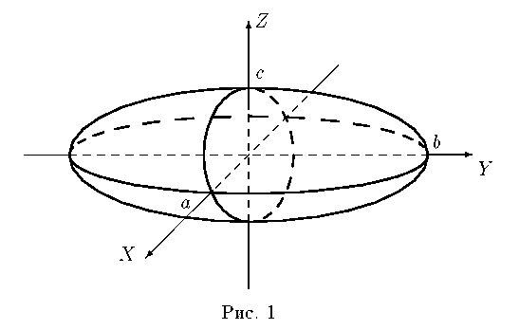
Diffraction sample Modeling
Voxel
Volumetric Picture Element

Slide 41
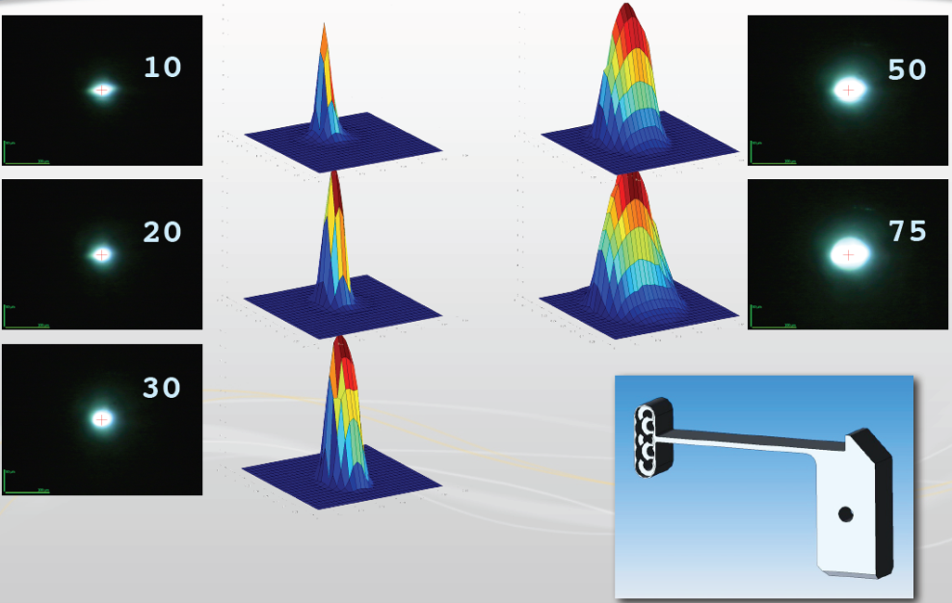
Ω
Flux
σx σy
aperture

Slide 42
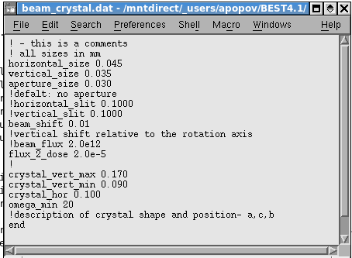
Ωmax
Ωmin
Vertical max
Vertical min
Crystal horizontal

Slide 43
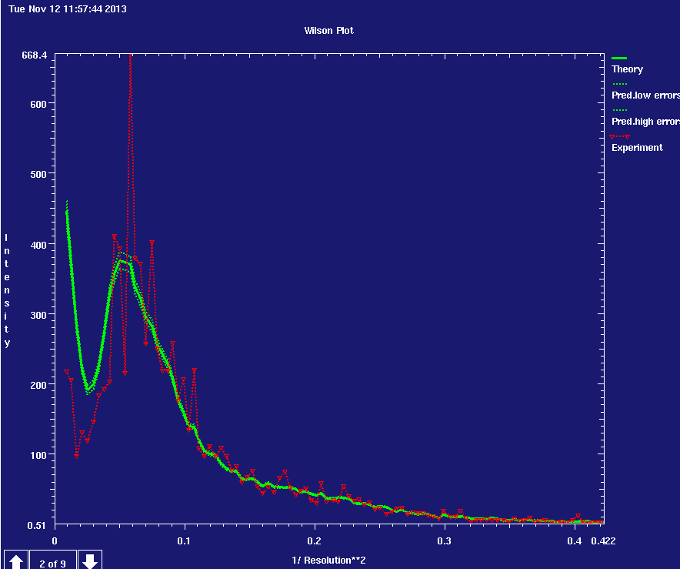

First step - scaling

Slide 44

First step - scaling

Slide 45




Slide 46
Acknowledgements
Gleb Bourenkov
ESRF MX Group
Olof Svensson & EDNA developers team
46
Notes:
46

