Slide 1
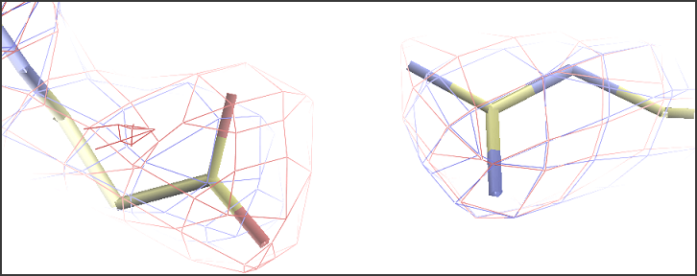
Validation & optimisation
From a solved structure to the final model
PDB_REDO
Robbie P. Joosten
Netherlands Cancer Institute
CCP4-Diamond school 2015

Slide 2
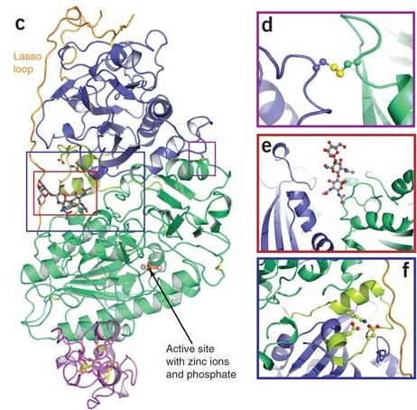
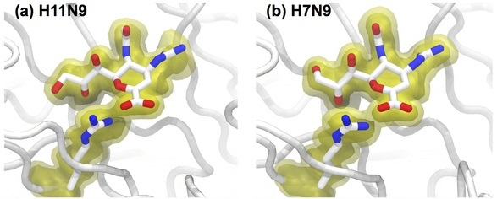
We want to know...
Introduction
What are a protein’s function and mechanism?
How can we manipulate them?
We need the best possible model to answer these questions

Slide 3
The best possible model
Introduction
Use validation when making the model
  Check model vs. data and vs. prior knowledge
  Focus on outliers (fix or explain them)
  Know the things that can go wrong
Optimise the model
  Focus on what can be improved
  Choose best refinement parameters
  Rebuild parts of the model
  PDB_REDO automates this

Slide 4
Validation

Slide 5
Need to know
Validation
Check the validity and value of a model
  Accuracy and precision
Many different software tools
  General: WHAT_CHECK, MolProbity, PDB-server
  Special purpose: PDB-care, CheckMyMetal etc.
  Tools may check the same things differently
Not a substitute for common sense
  False positives do occur
  Conflicting results
  Not all problems are detected (explicitly)

Slide 6
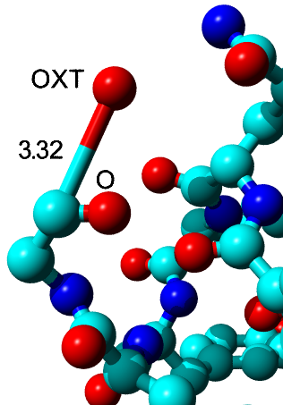
Bonds and angles
Validation
Individual outliers
  Usually fitting errors
  Express deviation in terms of SD (Z-scores)
  Example: Z = 105
Large overall deviations from ideal values
  Express as rmsZ, not rmsd
    Should be < 1.000
  Use tighter restraints

Slide 7
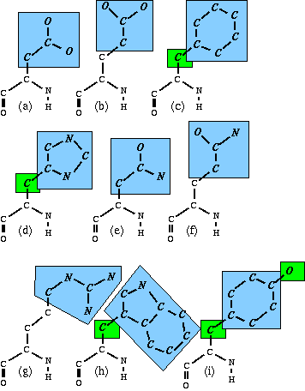
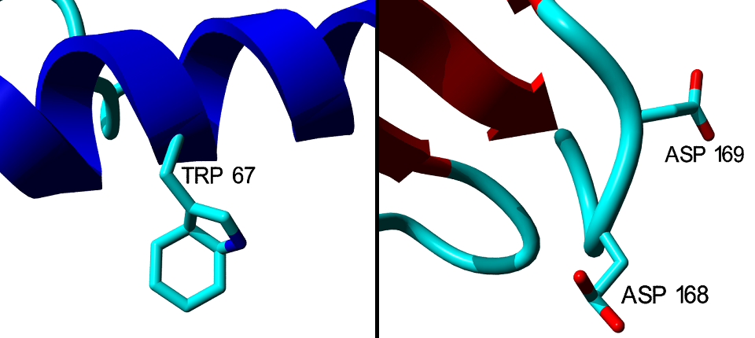
Planar groups
Validation
9 side chains have planar groups
Outliers indicate fitting errors or too loose restraints
37σ deviation
64σ deviation

Slide 8
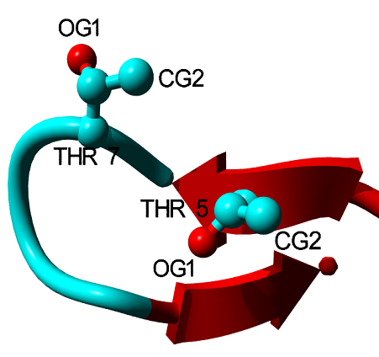
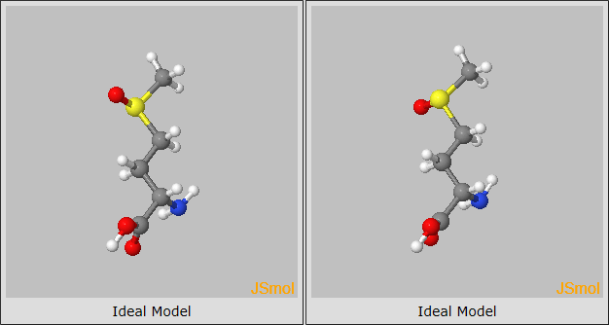
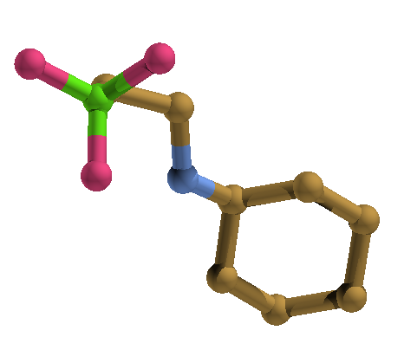

Chirality
Validation
Real chemical chirality
  Different compounds (know what to expect)
Administrative (computational) chirality
  Non-chiral atoms can be chiral in software
  Errors lead to refinement problems
O1
O2

Slide 9
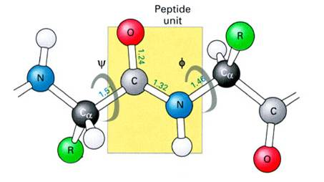
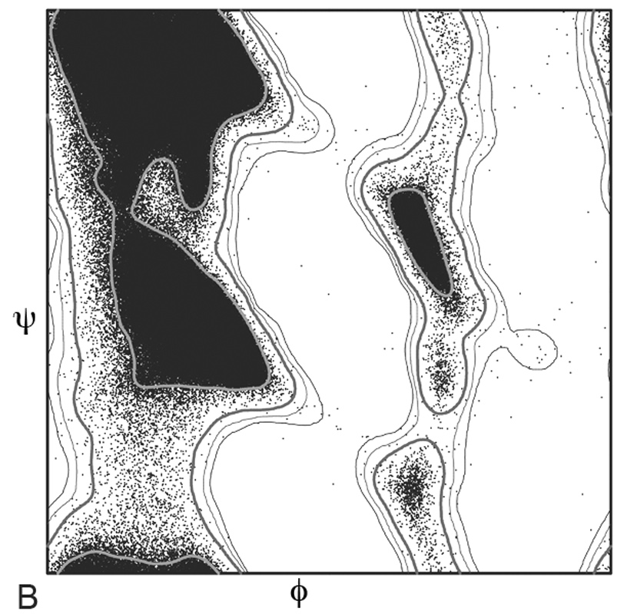
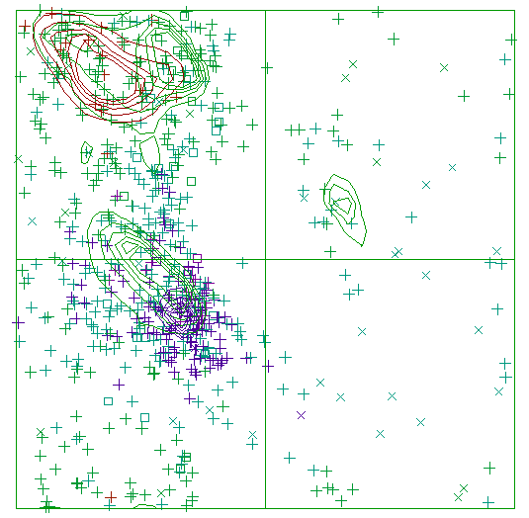
Backbone torsion angles
Validation
Ramachandran plot
  φ and ψ angles
  Compare to the PDB
    Or a subset
Different implementations
  MolProbity and Coot: preferred, okay, outlier
    Good for finding specific problems
  WHAT_CHECK: overall Z-score
    Good for checking building and refinement progress

Slide 10
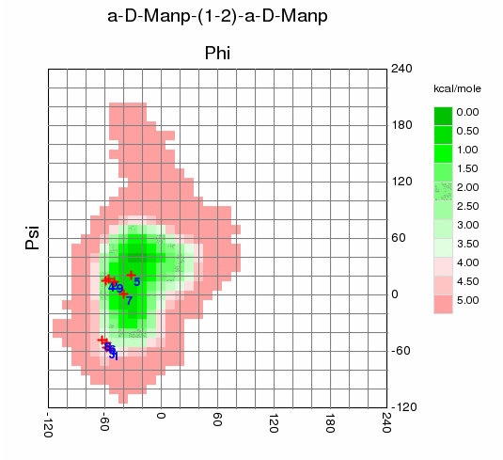
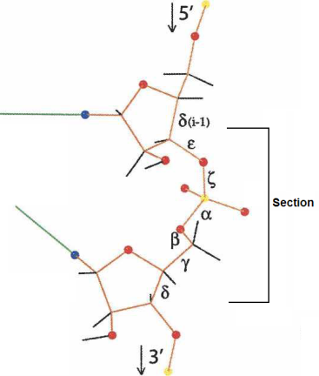
Backbone torsion angles
Validation
Peptides are flat
  ω angle is ~180° or ~0° (with exceptions!)
  Fitting errors (and poor restraints) cause outliers
Ramachandran-like validation for non-proteins
  RNA in MolProbity
    46+7 backbone conformers
  Sugars in CARP
    sugar-sugar bond specific

Slide 11
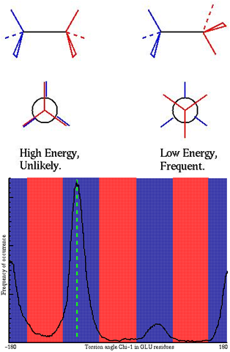
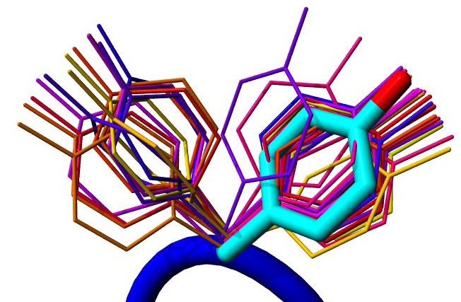
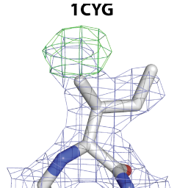
Side chain torsion angles
Validation
Steric hindrance causes discrete rotamers
Check against (backbone specific) distributions from the PDB
Outliers are fitting errors...
...or false positives

Slide 12
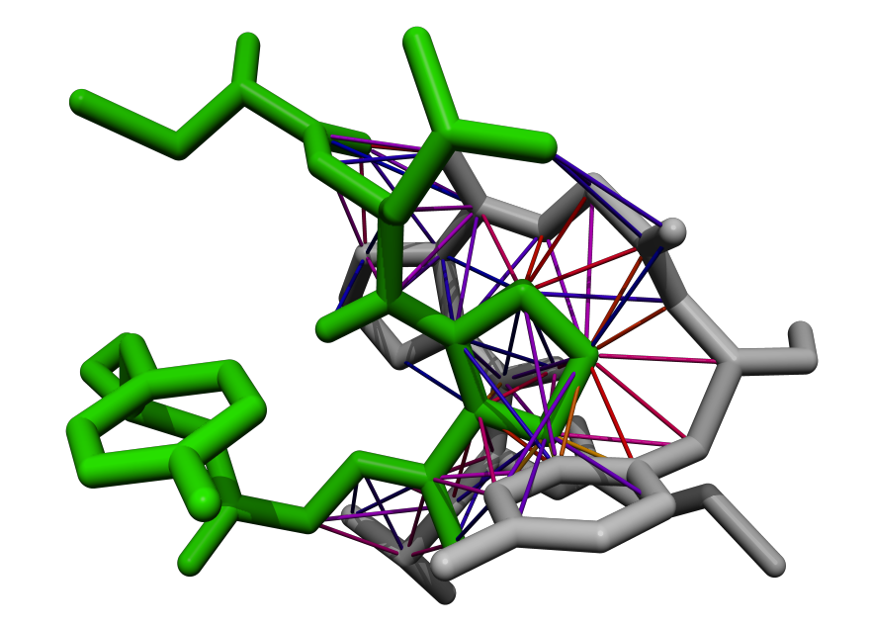
Bumps
Validation
Two atoms cannot occupy the same space
Average PDB file > 100 bumps
Bumps vary in severity
  Mild bumps can be fixed by refinement
  Severe bumps typically require rebuilding
Don’t forget about symmetry
  MolProbity does!
Normal contact Mild bump Severe bump

Slide 13
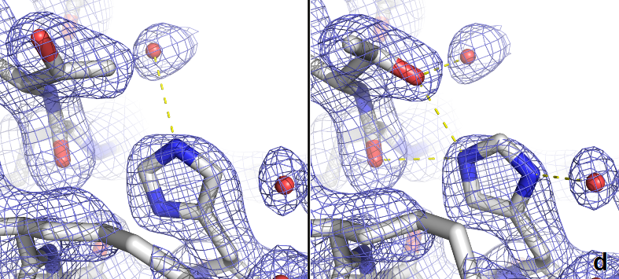
Hydrogen bonds
Validation
Asn, Gln, and His flips
  Detected by WHAT_CHECK and MolProbity
  Also use common sense
Buried unsatisfied H-bond donors and acceptors indicate (subtle) errors
Waters should also make hydrogen bonds
  3b3q has > 250 waters without H-bonds

Slide 14
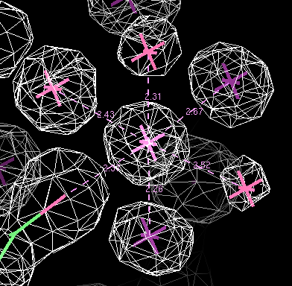
Metal ions
Validation
Metal ions are easily overlooked
Detect with WASP, COOT, CheckMyMetal, WHAT_CHECK and Phenix
  All use the BV method
  Very different results
  Crystallisation conditions guide ion selection
  Anomalous signal may help as well

Slide 15
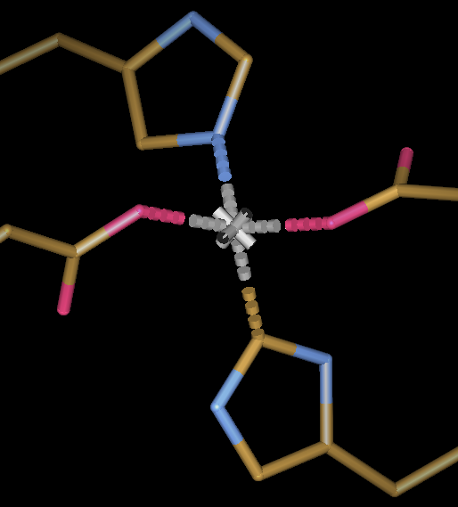
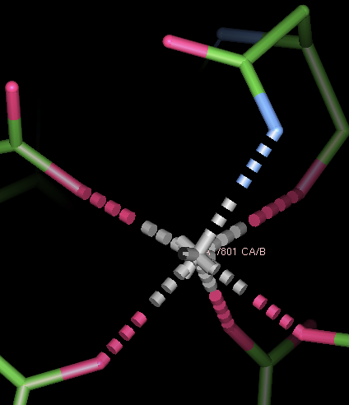
Metal ions
Validation
Na, Mg, K, Ca prefer coordination by oxygen
  Flip Asn or Gln side chains if needed
Carbons usually do not coordinate metals
  Cyanide and carbon-monoxide are exceptions
Notes:
pdb1hfe.ent:LINK CE1 HIS S 82 ZN ZN S 500

Slide 16
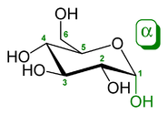
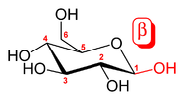
Sugars are complicated
Validation
Small differences matter for biology/biochemistry
Maps are frequently difficult to interpret
Coordinates and residue name must match sugar identity
  Or your refinement will go wrong
Bonds between sugars are common
  ‘Always’ from C1 to an oxygen (O1 is lost)
  Original position of the O1 describes bond type (α or β)

Slide 17
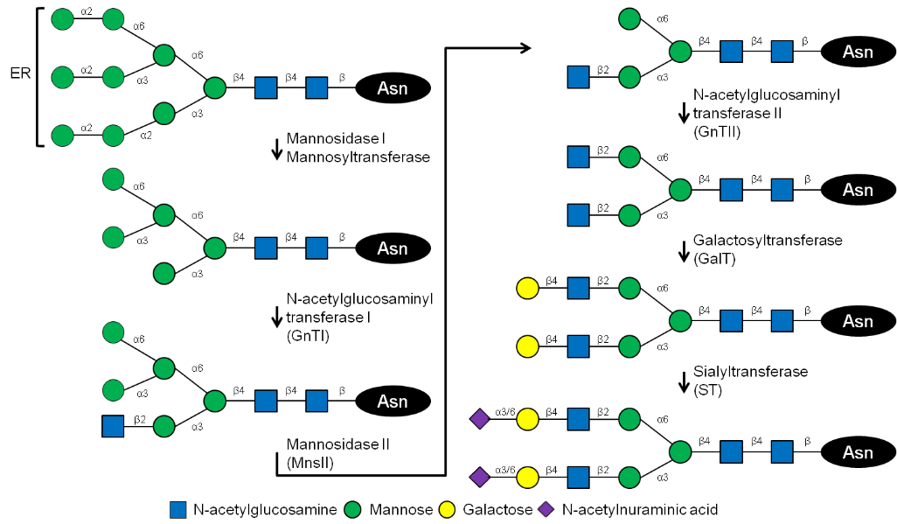
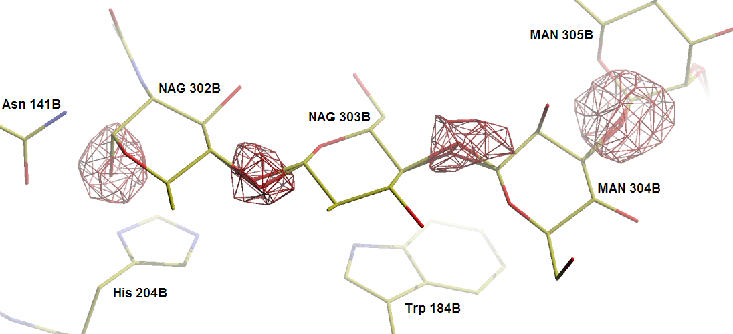
Sugar validation
Validation
PDB-care validates nomenclature, connectivity based on atom coordinates and biological pathway

Slide 18
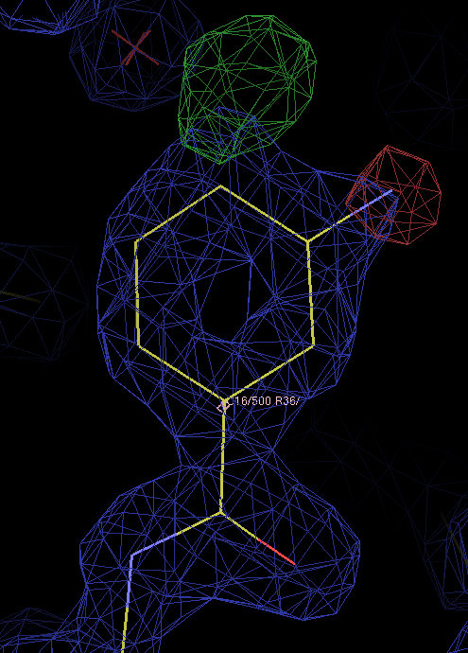
Ligands
Validation
Validation steps:
Is something there?
  Check the (difference) density
Is it my ligand?
  Check contacts
  Keep crystallisation conditions in mind
  Check the density in detail
Is the geometry sensible?
  Check against restraints
  Check against small molecules
  Check the restraints themselves

Slide 19
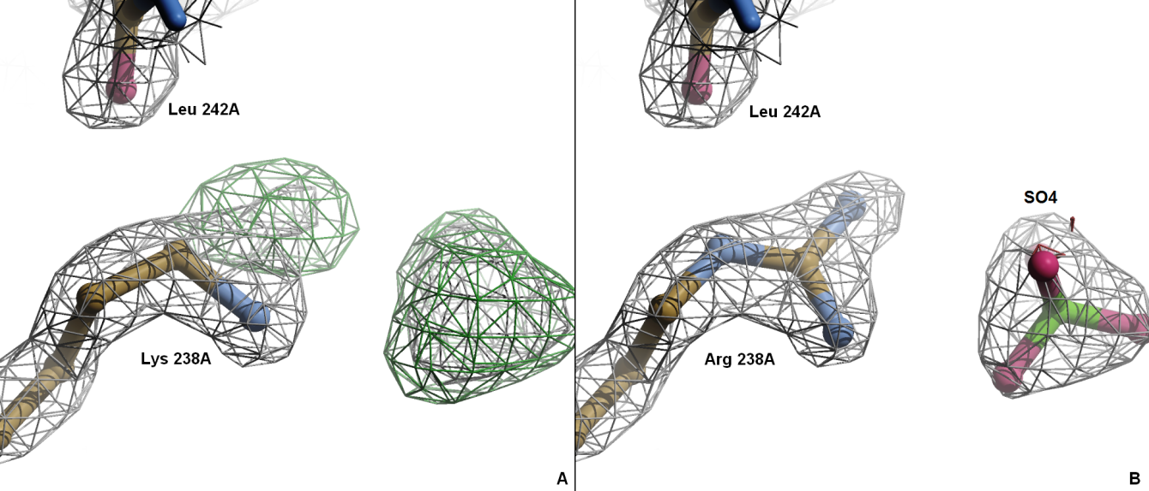
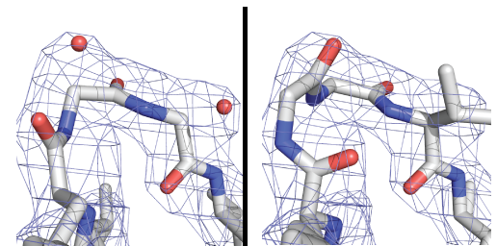
Things that are not validated
Validation
Sequence errors
Register errors
Hints: poor side chain interactions, poor packing

Slide 20
Validation is a lot of work, but it helps you make better models

Slide 21
Model optimisation
Refinement settings
  Restraint weights (geometry, B-factors)
  Solvent model
  High resolution cut-off
  Special cases (NCS, twinning, occupancies)
Model parameters
  B-factor model
  TLS group selection
Structure model
  Main chain
  Side chains
  Hetero compounds
Automation speeds up optimisation

Slide 22
PDB_REDO
PDB
Model optimisation pipeline
Originally designed for PDB entries and their X-ray data
  Databank with 83k entries
Combines existing tools with decision-making algorithms
  Refmac for refinement
Modular pipeline
  Add new methods to fill methodological gaps
  E.g. for model rebuilding
Available as webserver and standalone software
Data cleanup
Parameterisation
Refmac
Rebuilding
Validation
PDB_REDO

Slide 23
The PDB_REDO pipeline
Methods
Phase 1: Preparation
  Parse the input data
  Check fit with data and structure quality
Phase 2: (Re-)refinement
  Optimise refinement parameters
  Be conservative
Phase 3: Rebuilding
  Change the model in real-space
  Be progressive
Phase 4: Final refinement and validation

Slide 24
Phase 1: Preparation
Methods
Parse experimental data
  Create new R-free set when needed
    5% to 10% of reflections; try to get 1000 reflections
    Adapt refinement protocol (more cycles)
Validate model and data
  WHAT_CHECK, SFCHECK and PDB-care
Parse PDB file
  Extract TLS selections
  Delete side-chains with 0.00 occupancy, hydrogen and crazy LINKs
  Sugar-specific: fix residue names, assign LINK types, delete superfluous oxygens

Slide 25
Phase 1: Preparation
Methods
Recalculate R(-free) in Refmac
  Establish a baseline
Detect twinning
Create restraints for ligands and LINKs
  Taken from CCP4 dictionary
  Created by Refmac/Libcheck
  User supplied
Fix chirality problems by atoms swapping or residue renaming

Slide 26
Phase 2: Refinement
Methods
Use local NCS restraints or strict NCS
Always use riding hydrogens
Add additional restraints when needed
  Jelly-body restraints (automatic)
  Zinc sites (automatic)
  Harmonic position restraints (automatic)
  DNA/RNA restraints from LibG (optional)
  Hydrogen bond restraints (optional)

Slide 27
Phase 2: Refinement
Methods
Optimise refinement settings for Refmac
  Optimise solvent mask parameters
    Try different values for probe sizes and shrinkage
    Select on R-free
  Use detwinning if both SFCHECK and Refmac detect twinning
  Find high resolution cut-off through paired refinement
    Karplus & Diederichs, Science 336, 2012
  Select B-factor model (with Hamilton test)

Slide 28
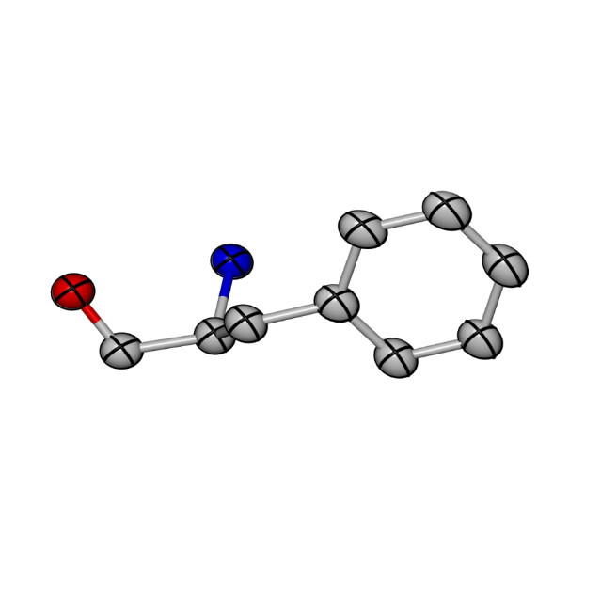
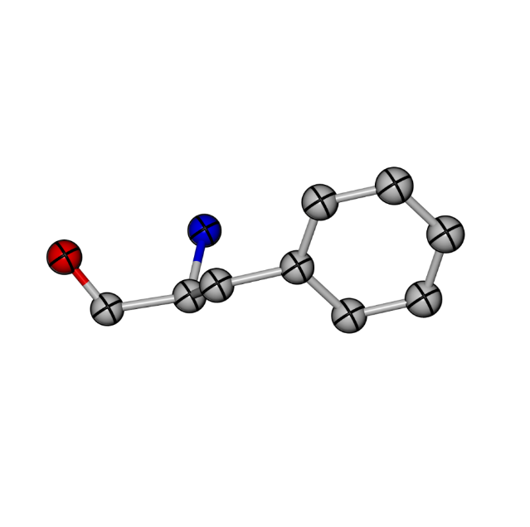
B-factor model selection
Intermezzo
A lot -
30 -
13 -
4 -
0 -
Use ANISOtropic Bs (6 parameters)
Reflections/atom
Test: isotropic or anisotropic Bs
Reset B to Wilson B, refine with default weights
Use ISOtropic Bs (1 parameter)
Test: individual or one overall B
Reset B to Wilson B, refine with tight B-restraints

Slide 29
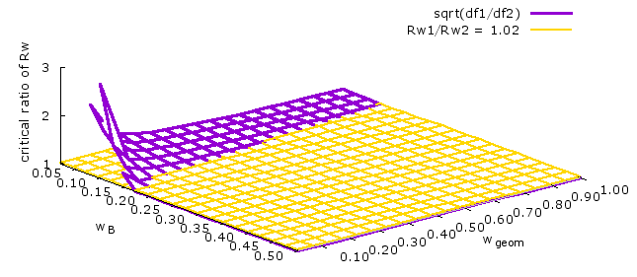

B-factor model selection
Intermezzo
Do the Hamilton test
  Try all values of w and w_{x}
  See which percentage is acceptable
    If percentage > 90%, choose complex model
    If percentage < 15%, choose simple model
    Else check for signs of over-fitting
      Take the simple model if R-free – R > cut-off
      Make sure that dR < 2*dR_{free}
$$\frac{R_{w,simple}}{R_{w,complex}}>\sqrt{\frac{N_{data}+{wN}_{restr}−N_{par}}{N_{data}+{wN}_{restr}−N_{par}+w_{x}N_{restr,x}−N_{par,x}}}$$

Slide 30

Phase 2: Refinement
Methods
Optimise TLS model
  Reset B to Wilson B, do pure TLS refinement
    Try 1 group per chain
    Try TLS groups from PDB header
    Try additional user-supplied TLS group selections
  Reject overfitted models with reduced Hamilton R ratio test
  Select best model based on LLfree
    Biased towards simple TLS model
$$\frac{R_{w,simplest}}{R_{w,other}}>\sqrt{\frac{N_{data}−{20∗N}_{TLS,simplest}}{N_{data}−20∗N_{TLS,other}}}$$

Slide 31
Phase 2: Refinement
Methods
Optimise B-factor weight
  Try up to 7 weights in short refinement
  Select best weight based on LLfree
    Bond and angle rmsZ < 1.000
    Avoid high R-free/R ratio
Actual refinement
  Try up to 7 geometric restraint weights
  Select best model based on LLfree
    R-free should go down
    Bond and angle rmsZ < 1.000
    Avoid high R-free/R ratio
  Keep original model if no model is acceptable

Slide 32
Phase 3: Rebuilding
Methods
Use new maps to further optimise the model
Centrifuge deletes waters with poor density
  ~58 waters per PDB entry
  Example: 1lf2
Waters | R | R-free | Difference
338 | 24.0% | 27.8% | 3.8%
240 | 24.3% | 27.5% | 3.2%

Slide 33
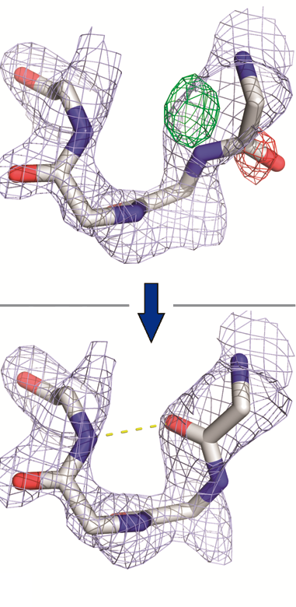
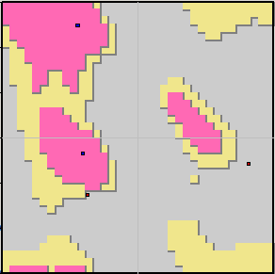
Phase 3: Rebuilding
Methods
Pepflip inverts peptide planes
Candidate selection
  Use DSSP secondary structure
  Check peptides
    Not in the middle of SS elements
  Improved ED fit after flip
  Difference density near O
Do RSR before and after flip
  Coot mini-RSR
Validation
  Ramachandran plot should improve

Slide 34
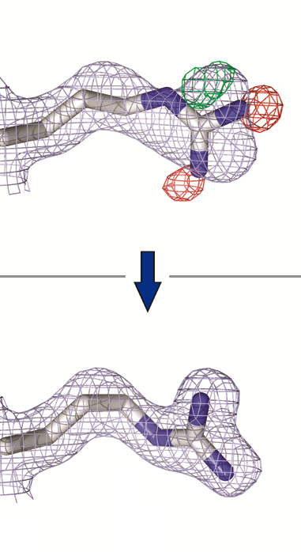
Phase 3: Rebuilding
Methods
SideAide side chain rebuilding
Find best rotamer or build missing side chain
  For every residue, not only poor rotamers
  By residue type, smallest first
  Leave difficult cases for last
Conservative torsion RSR
See if map correlation improves
  Else keep original side chain
HQN flips for hydrogen bonding
  Uses WHAT_CHECK

Slide 35
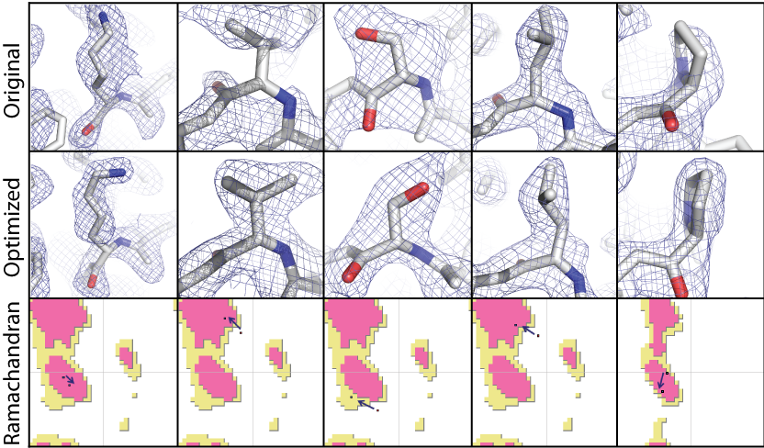
Phase 3: Rebuilding
Methods

Slide 36
Phase 4: Validation
Methods
Short refinement
  Final model optimisation
  Try 3 different geometric restraint weights
Geometry validation with WHAT_CHECK
Protein stability validation with FoldX
  Estimate ΔG_{fold}
Analysis of model changes with YASARA
  Changed rotamers
  Hydrogen bond flips

Slide 37

Phase 4: Validation
Methods
Weighted bump severity
$WBS=\frac{100∙\sum{{d_{bump}}_{}^{2}}}{\#atoms}$
Example: 2o9u
  Arg X 1082 most problematic residue
  Rotamer changed
d_{bump}
 | #bumps | Clash score | Worst (Å) | WBS
PDB | 48 | 33.63 | 1.26 | 0.875
PDB_REDO | 19 | 15.24 | 0.57 | 0.089

Slide 38



Phase 4: Validation
Methods
Real-space density validation
  Calculate per-residue RSCC in EDSTATS before and after PDB_REDO
  Convert RSCC to Z-score (Fisher transformation)
  Calculate Z-score of model change
$$RSCC=\frac{\text{cov}(ρ_{obs},ρ_{calc})}{\sqrt{\text{var}\left(ρ_{obs}\right)\text{var}(ρ_{calc})}}$$
$$z= \frac{1}{2}\ln{\frac{1+RSCC}{1−RSCC}}$$
$$Z=\frac{z_{redo}−z_{old}}{\sqrt{1/{\left(N_{old}−3\right)+1/\left(N_{redo}−3\right)}}}$$

Slide 39
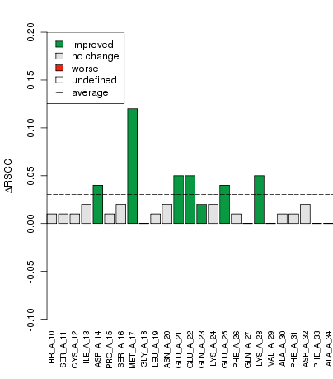
Phase 4: Validation
Methods
Real-space density validation
  Significant change if |Z|>2.6
  Plot change and significance for each residue
  RSCC sensitive to B-factor (change)

Slide 40
Phase 4: Validation
Methods
Comparative ligand validation
  Fit with X-ray data
    RSR and RSCC from EDSTATS
  Heat of formation
    Energy required to form ligand in current geometry
  Interactions with binding site
    Bumps
    H-bonds
    Hydrophobic contacts
    π-π interactions
    Cation-π interactions
Notes:
Knowledge-based potentials

Slide 41
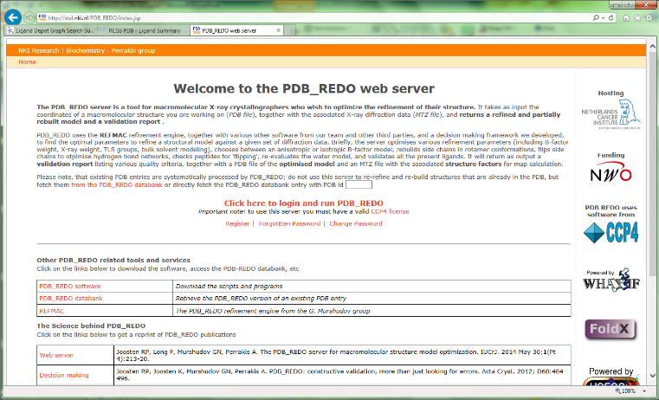
Running PDB_REDO
Use the server
  Register/log in
  Submit PDB & MTZ
    Add restraint file
  Wait (about 1 hour)
Run a local job
  Test many TLS group selections
  Modify PDB_REDO behaviour
    Try non-standard options (e.g. DNA/RNA restraints)
    Switch off functionality

Slide 42
PDB_REDO output
Output
New model + new map coefficients
Tools to continue working on the structure model in the lab
  Optimised settings for refinement in REFMAC
  Already refined TLS model
Description of model changes
  At the local and the global level
  Visually oriented: colour coding, plots, visualisation script for COOT

Slide 43
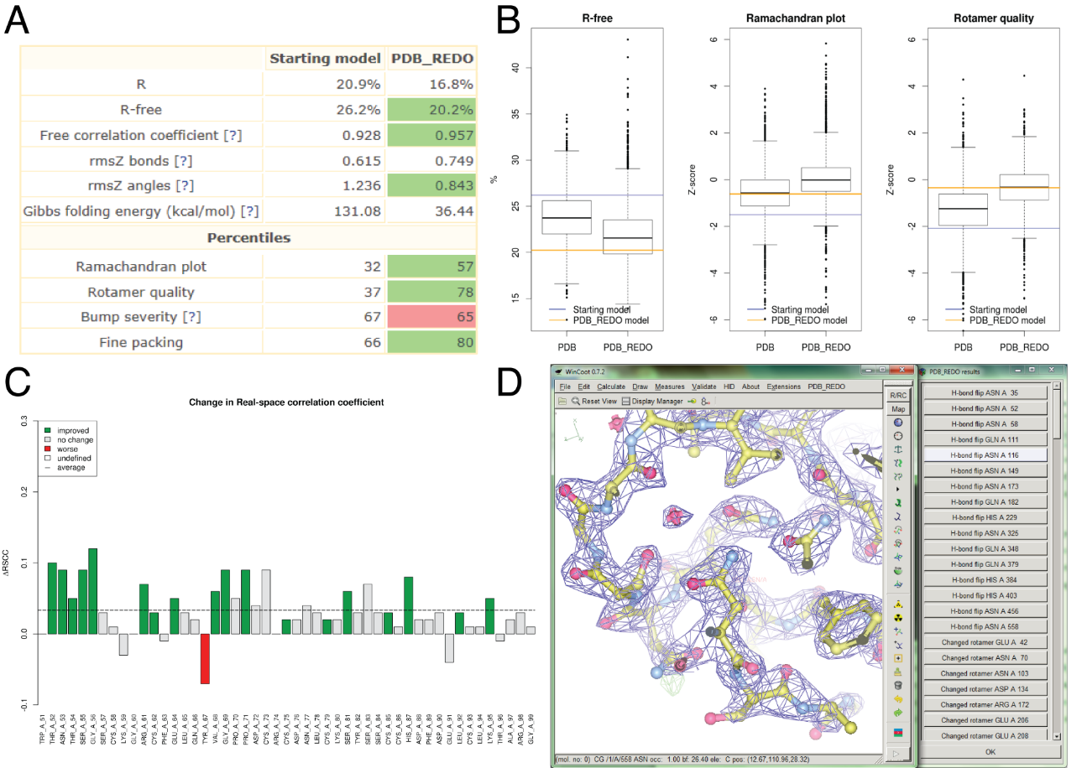
PDB_REDO output
Output

Slide 44
Overall results
Results
Improved fit with experimental data
  73911 structures (with original test set)
  Majority of models improves significantly
  Average ΔR-free 1.5%
  3.3 x σR-free
Improved geometry
  Ramchandran plot
  84167 structures

Slide 45
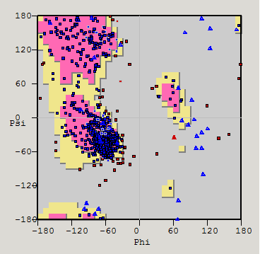
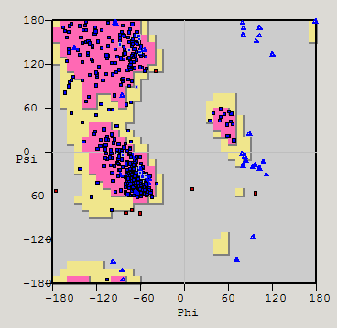
Ramachandran plot (1ni1)
Results
PDB
PDB_REDO
Z-score : -5.75 -0.95
Preferred: 81.7% 94.4%
Allowed : 11.0% 4.5%
Outliers : 7.3% 1.1%

Slide 46
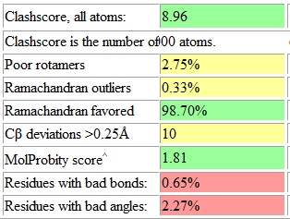
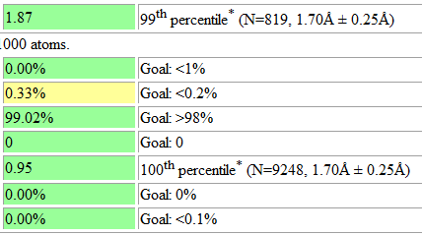
MolProbity (1sbp)
Results
PDB
PDB_REDO

Slide 47
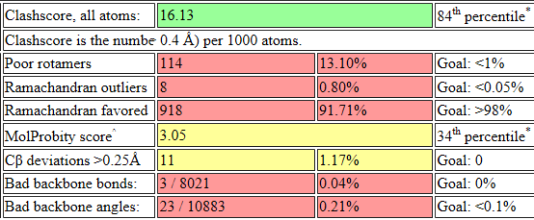
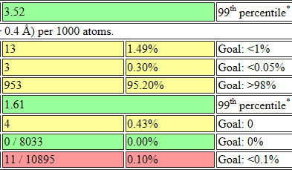
MolProbity (1n8z)
Results
PDB
PDB_REDO

Slide 48
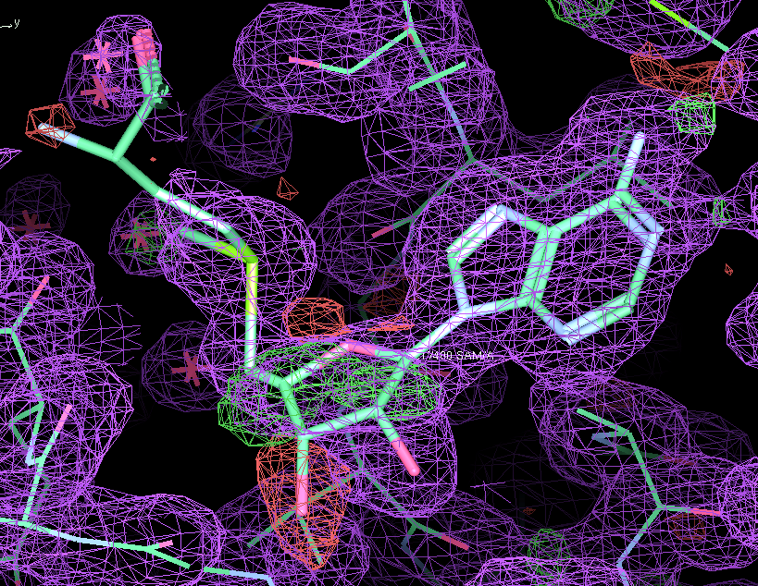
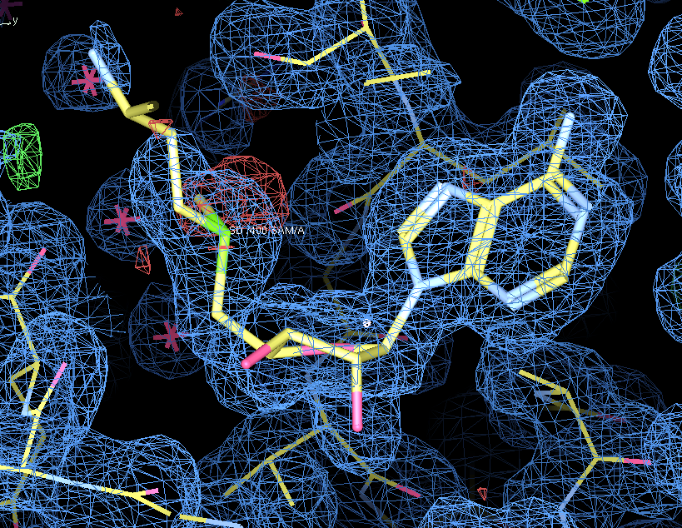
Ligands (1v2x)
Results
PDB
PDB_REDO
Real-space R : 0.15
Real-space CC : 0.91
Number of bumps : 22
Heat(formation) : 11817
Hydrogen bonds : -70
0.09
0.96 5 322 -95

Slide 49
Zinc sites
Results
PDB
PDB_REDO

Slide 50
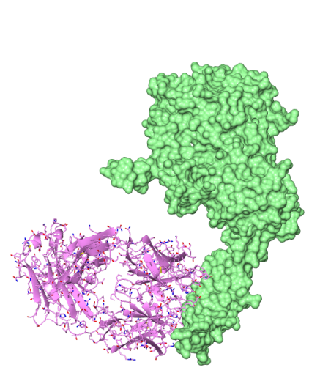
Herceptin – HER2 interface
After PDB_REDO:
R-free from 31.6% to 26.7%
  7σ improvement
Moved from 34th to the 99th quality percentile in MolProbity
Notes:
7 sigma improvement
Changes a30 A31 (herceptin) C602 C596 (HER2)
34th %-ile to
1n8z

Slide 51
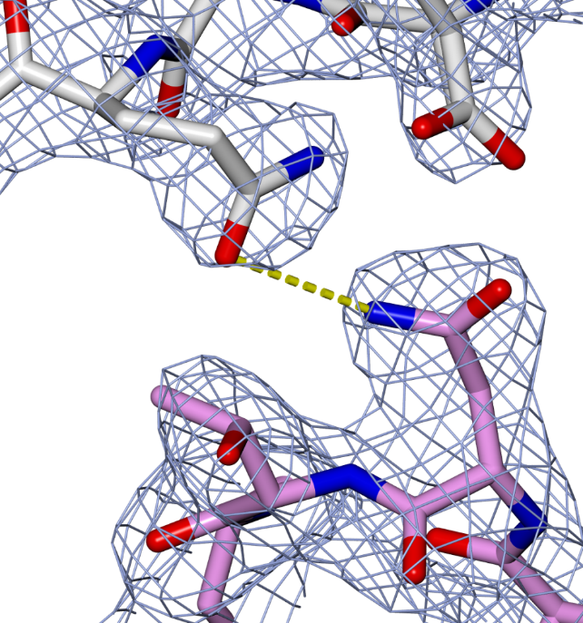
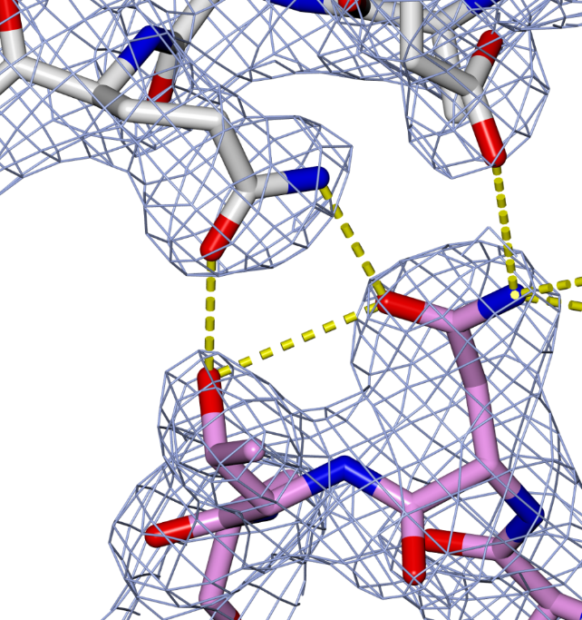
Herceptin – HER2 interface
PDB
PDB_REDO
Notes:
7 sigma improvement
Changes a30 A31 (herceptin) C602 C596 (HER2)

Slide 52
Using PDB_REDO is little work, but it helps you make better models

Slide 53




PDB_REDOers
Nijmegen:
W Touw
G Vriend
Amsterdam:
R Joosten
B van Beusekom
K Joosten
A Perrakis
Key contributors:
Eleanor Dodson, Ian Tickle, Paul Emsley, Ethan Merritt, Elmar Krieger, Thomas Lütteke, Rachel Kramer Green, Sanchayita Sen, Andrey Lebedev, Bernhard Lohkamp
Cambridge:
G Murshudov
F Long

